Slide 1

Online Course Production @ The University of Edinburgh
Stuart Nicol
(Head of Educational Design & Engagement)
stuart.nicol@ed.ac.uk
#nicolvision

Slide 2



What is the OCP service?
Who: A central service producing high quality online courses
Instructional designers, media producers, project managers, online marketing specialists, service manager. Underpinned by our OER service.
What: Mainly MOOCs (https://www.onlinecourses.ed.ac.uk/) on partner platforms. Also CPD, student transition courses, microcredentials, etc.
Why: A commitment to openness, sustainability, inclusivity, etc.
How: Governance & QA:
Strategy group, academic policies, board of studies (QA). Local and partner QA. Strict compliance with accessibility legislation.
Notes:
Values in the design process (things to be aware of): Decolonialising the curriculum; equality and inclusivity; etc.. Alignment to UN Sustainable Development Goals.
MOOC processes embedded in mainstream academic policy: Programme and Course Approval and Management Policy.
Academic QA through BoS.
We do QA on the courses here at Edinburgh, and our partners also do QA.
All of our course materials comply with accessibility legislation.
And where we can, out outputs are open by default (all media outputs have a CC licence where possible).

Slide 3
OERs & MOOCs
OERs
Learning, teaching and research materials in any format and medium that reside in the public domain or are under copyright that have been released under an open license, that permit no-cost access, re-use, re-purpose, adaptation and redistribution by others.
UNESCO Recommendation on Open Educational Resources (2019)
MOOCs
Integrate the connectivity of social networking.
Active engagement of many learners.
The facilitation of an acknowledged expert in a field of study.
A collection of freely accessible online resources.
McAuley et al (2010) https://davecormier.com/edblog/wp-content/uploads/MOOC_Final.pdf
Notes:
MOOCs give access to some level of active teaching (although this is increasingly changing).
Teaching costs – the thorny issue of who pays for teaching.
This is a big political question when it comes to further and higher education.
Lowering the barriers.
MOOCs are made up of OERs.
MOOCs generate OERs.
The MOOC Model For Digital Practice
Alexander McAuley, Bonnie Stewart, George Siemens and Dave Cormier.

Slide 4
Lowering the barriers to university teaching & credit?
OERs (mainly audio & video)
MOOCs / short online courses
Microcredentials
(MicroMasters)
Access to further university study.
Mostly free, paid upgrade features
Bundled MOOCs. University credit costs less & different entry req.
Free and openly licenced
`
`
`
`
`
`
`
`
`
`
`
`

Slide 5
How we make sure the online resources we produce are as open as possible
Openness was ‘assumed’ to begin with.
MOOCs are closed (you need to sign up / freemium[ish] model).
We began by sharing videos on YouTube (https://www.youtube.com/user/OpenEdinburghUni).
(Individual videos with up to 19k views).
We now share video playlists on Media Hopper (https://media.ed.ac.uk/channel/Open+Media+Bank/76589901).
Easy to share in our courses, open to the world, downloadable/editable files.

Slide 6
Lessons we’ve learned …
Not every ‘free’ short online course can be openly licenced:
The Warhol MOOC.
Don’t ‘close’ your course over a couple of image:
The Bonnie Prince Charlie and the Jacobites MOOC.
You can do great things by reusing OERs:
The Chronic Respiratory Diseases MOOC trailer.
Launched on 1st Feb 2021 during lockdown.
No access to location filming
Uses free-to-use and openly licenced media (images, video, and music).

Slide 7
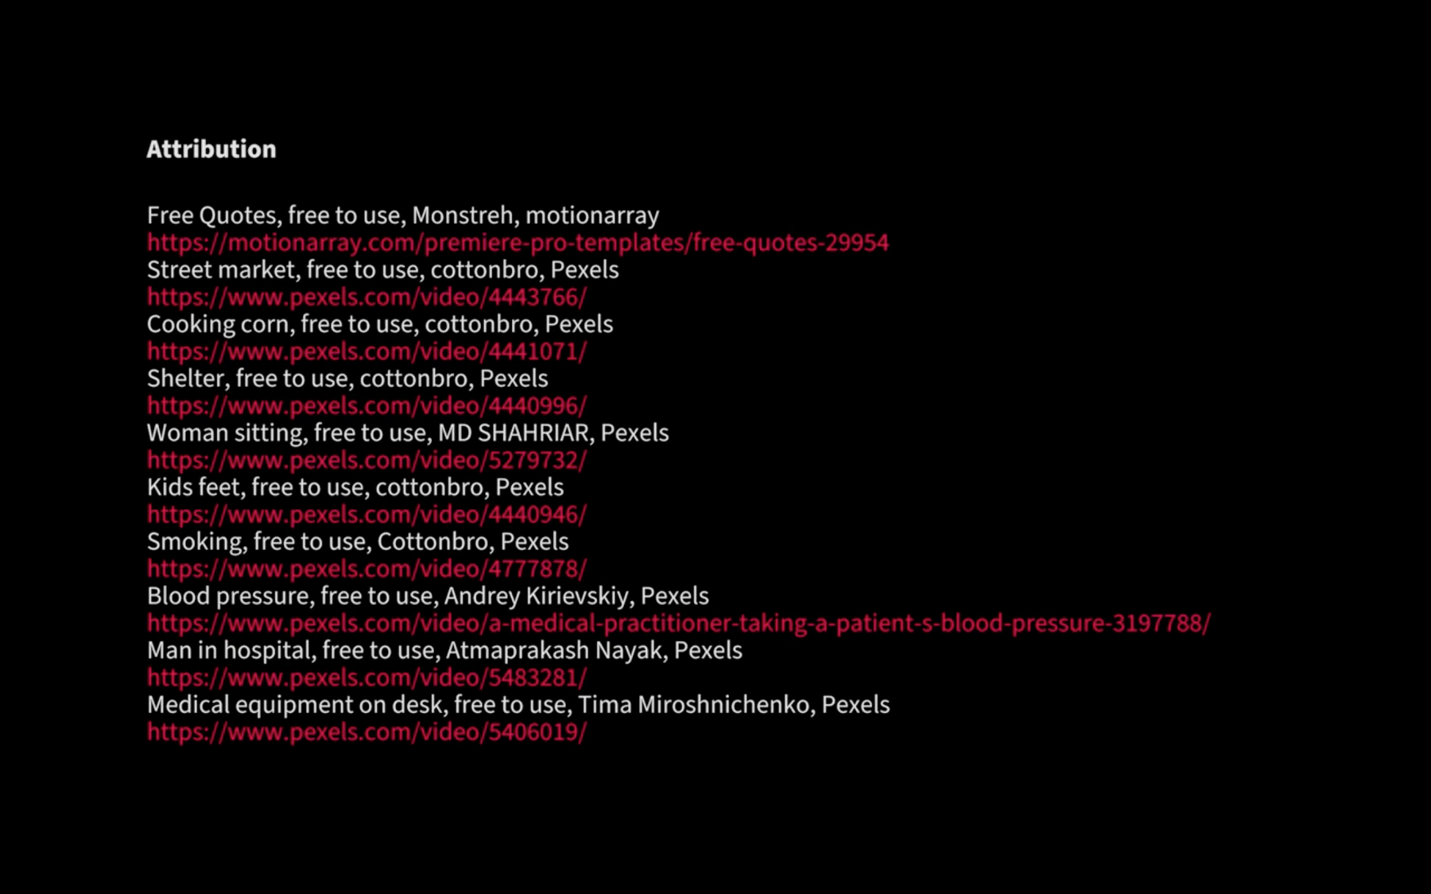

Slide 8
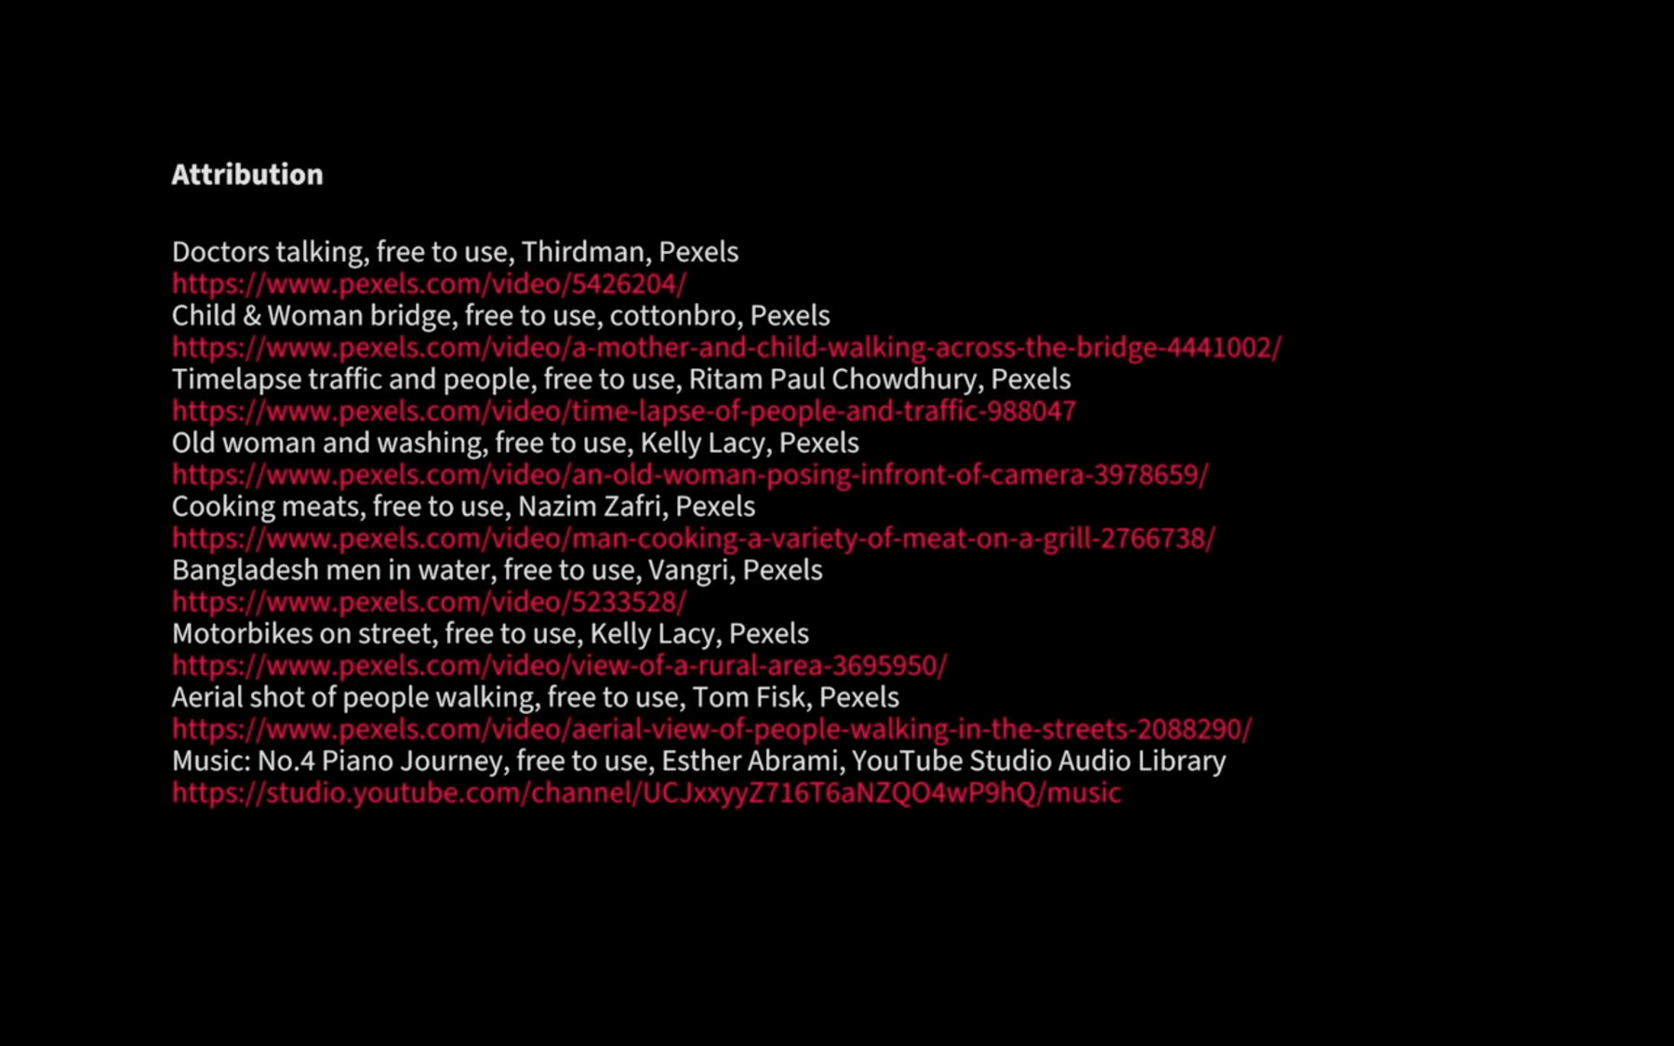

Slide 9
Links and references
https://www.onlinecourses.ed.ac.uk/
https://www.youtube.com/user/OpenEdinburghUni
https://media.ed.ac.uk/channel/Open+Media+Bank/76589901
https://open.ed.ac.uk/about/
https://media.ed.ac.uk/playlist/dedicated/76589901/1_vum2cj6a/1_so7djtpu
UNESCO Recommendation on Open Educational Resources (2019)
https://en.unesco.org/themes/building-knowledge-societies/oer
The MOOC Model For Digital Practice (McAuley et al 2010)
https://davecormier.com/edblog/wp-content/uploads/MOOC_Final.pdf

