Slide 1

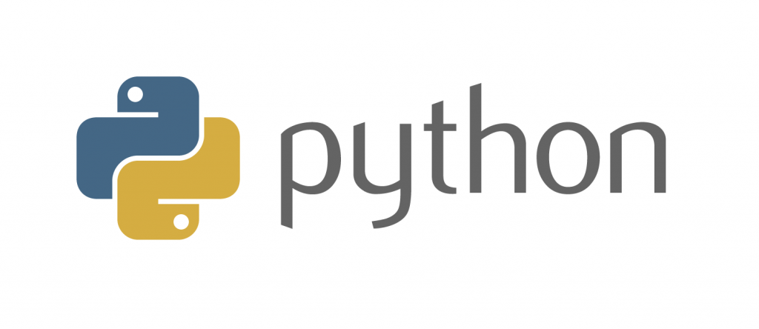
For Data Science
Notes:
- Welcome and thank you for coming
- Introduction
- aims:
-- introduce fundamentals
-- build up confidence for self-study!!! Not as scary as the real-world version
- assumptions:
-- basic high-school maths
-- no prior experience in coding
CC-BY Digital Skills Team at the University of Edinburgh www.ed.ac.uk/is/skills

Slide 2
Structure
Part 1 - Introduction, recap & warm-up exercises
Part 2 - NumPy (Numerical Python)
Part 3 - Basic plotting
Part 4 - pandas (Python Data Analysis Library)

Slide 3

Ask!
The art and science of asking questions is the source of all knowledge.
- Thomas Berger
Do not hesitate to ask!
During exercises (you can also ask others).
Image by mohamed Hassan from Pixabay
Notes:
All of us learn through asking and being curious
more of a conversation - don't hesitate to stop me and ask

Slide 4
Now let me ask something..
Why do you want to learn Python/programming?
What would you use Python for?
Notes:
make notes

Slide 5
Failure
Coding is all about trial and error.
Don't be afraid of it.
Error messages aren't scary, they are useful.
Notes:
You might fail 5 times while doing something but in the end you will understand how it works and be able to replicate it

Slide 6

Python natalensis by A. Smith on Wikimedia Commons

Slide 7

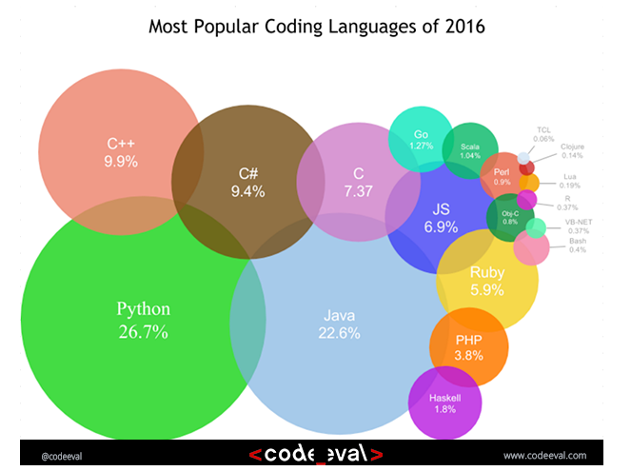
History
Started by Guido Van Rossum as a hobby
Now widely spread
Open Source! Free!
Versatile
Guido Van Rossum by Doc Searls on Flickr CC-BY-SA
Notes:
- Started by Guido Van Rossum as a hobby over the Christmas vacation.
- named after Monty Python's Flying Circus
- First released in 1991, loved by Unix scripters
- Now transformed into the most popular interpreted language. You can build anything with it!
- Facts! Python was the most used language in 2016 and still most likely is!

Slide 8
Python today
Developed a large and active scientific computing and data analysis community
Now one of the most important languages for
Data science
Machine learning
General software development
Packages: NumPy, pandas, matplotlib, SciPy, scikit-learn, statsmodels
Notes:
Why choose it instead of MATLAB, R, SAS, Stata and others?
- It is free and open source
- Intuitive and easy to learn
- Extremely versatile – examples – websites, planes, robots, data
- Large and friendly community
- packages
Very important in industry and academia

Slide 9
2 Modes
IPython
Python can be run interactively
Used extensively in research
2. Python scripts
What if we want to run more than a few lines of code?
Then we must write text files in .py
Notes:
Python has 2 modes of running
- IPython stands for Interactive Python
Python can be interpreted – good for a calculator
Live demo!

Slide 10
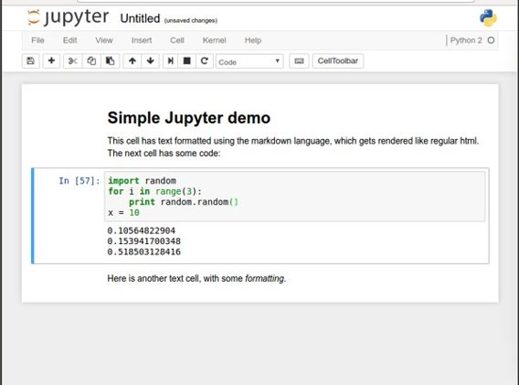
Noteable (Jupyter notebooks)
Easy to use environment
Web-based
Combines both text and code into one
Come with a great number of useful packages
Notes:
We will be using Noteable, just another service Jupyter Notebooks. It is free and open source
Web environment focused at Python
Easy to use – nice gui and no setup required
Block based. Has blocks which execute the code within it. Single type only
Allows to combine text and code into same page. Helps with readability

Slide 11
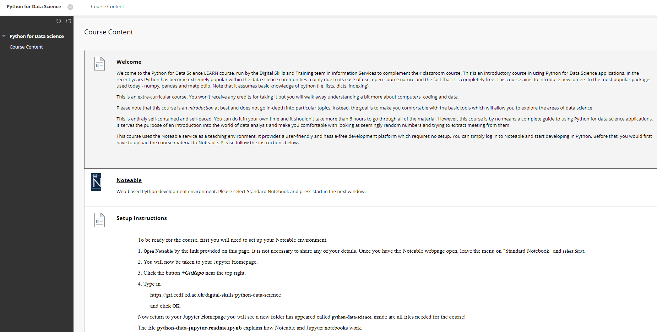
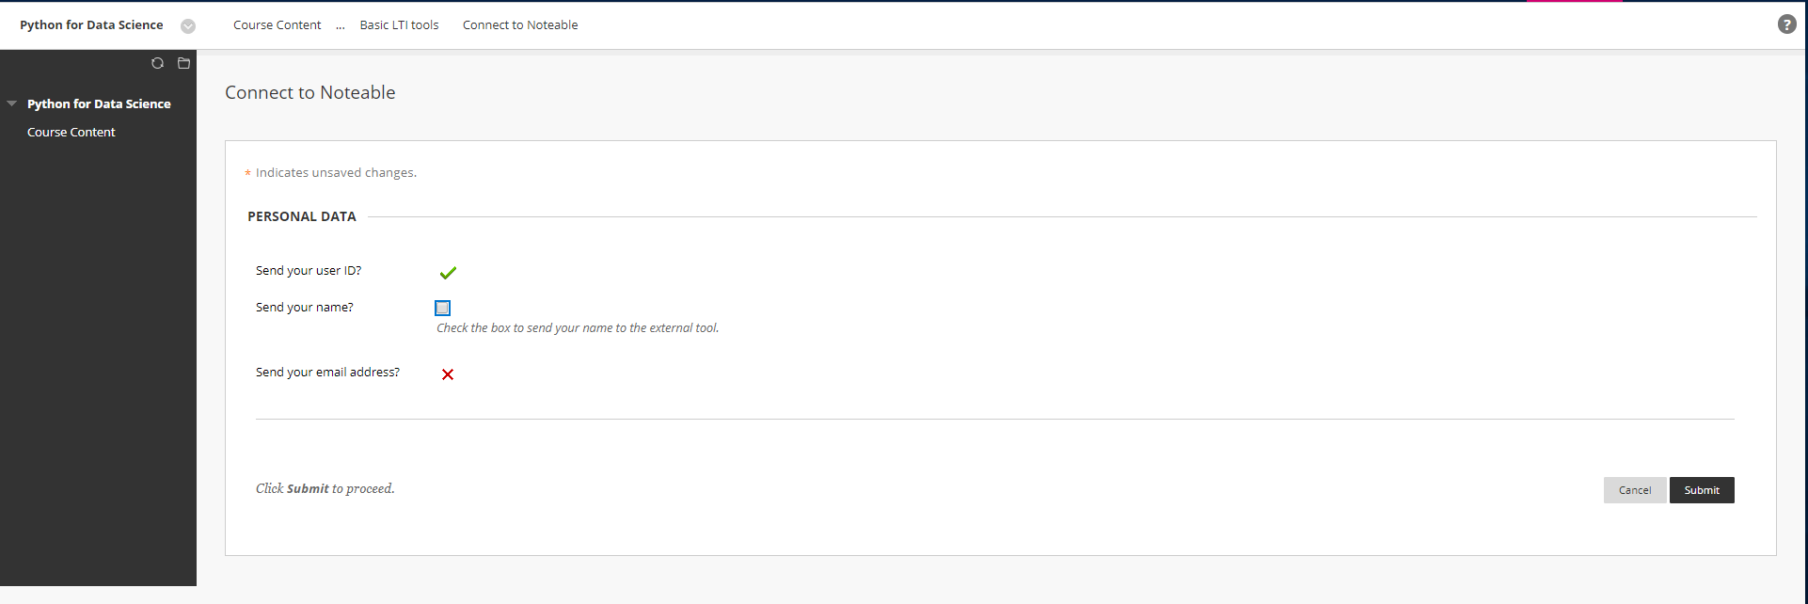
1. Start Noteable
Notes:
start noteable from learn - Link at the top of homepage
Agree on personal data usage
You don't have to share anything

Slide 12
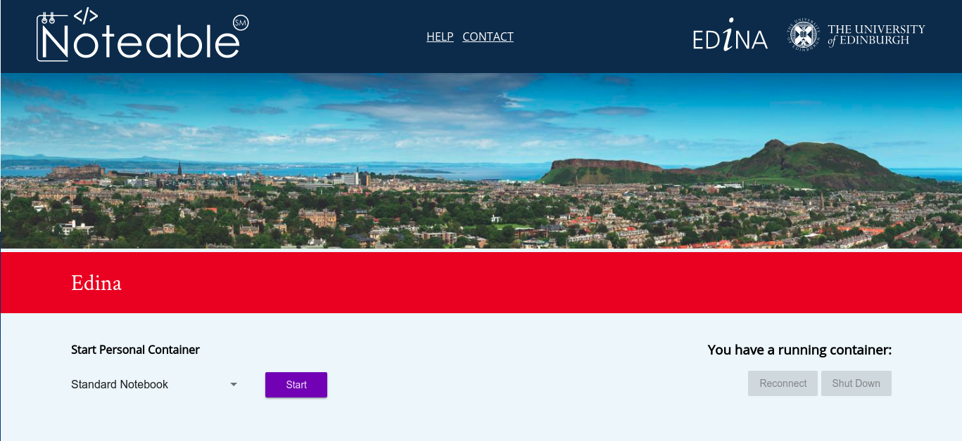
Notes:
Probably enter myed login details
Then press start on noteable homepage

Slide 13
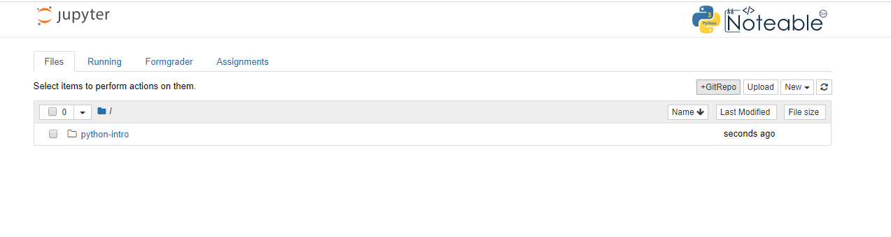
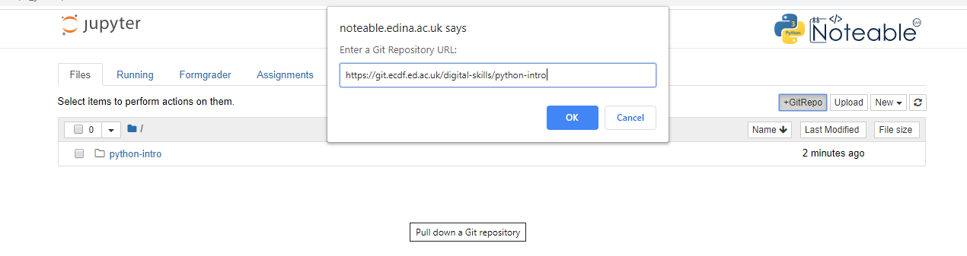
2. Clone GitRepo(recommended)

Slide 14
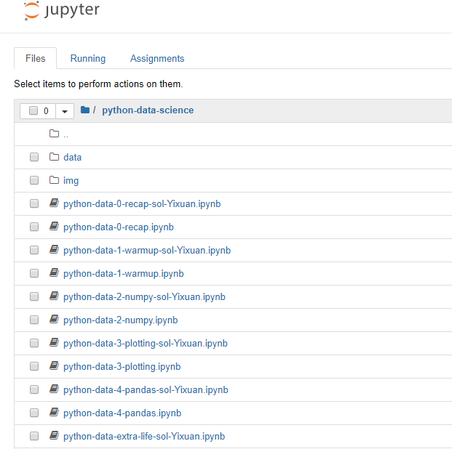
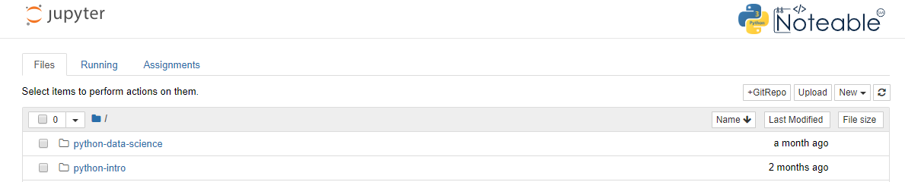
3. Starting a notebook
Notes:
Start a notebook by clicking on it.
Notebook 0 is an environment introduction.
Skip that, open notebook 1
Make sure that everybody is ready

Slide 15

4. Toolbar
Stop execution
Save
Cut, copy
paste
Block type
New block
Move block
Reset block
And clear output
Notes:
Autosave

Slide 16
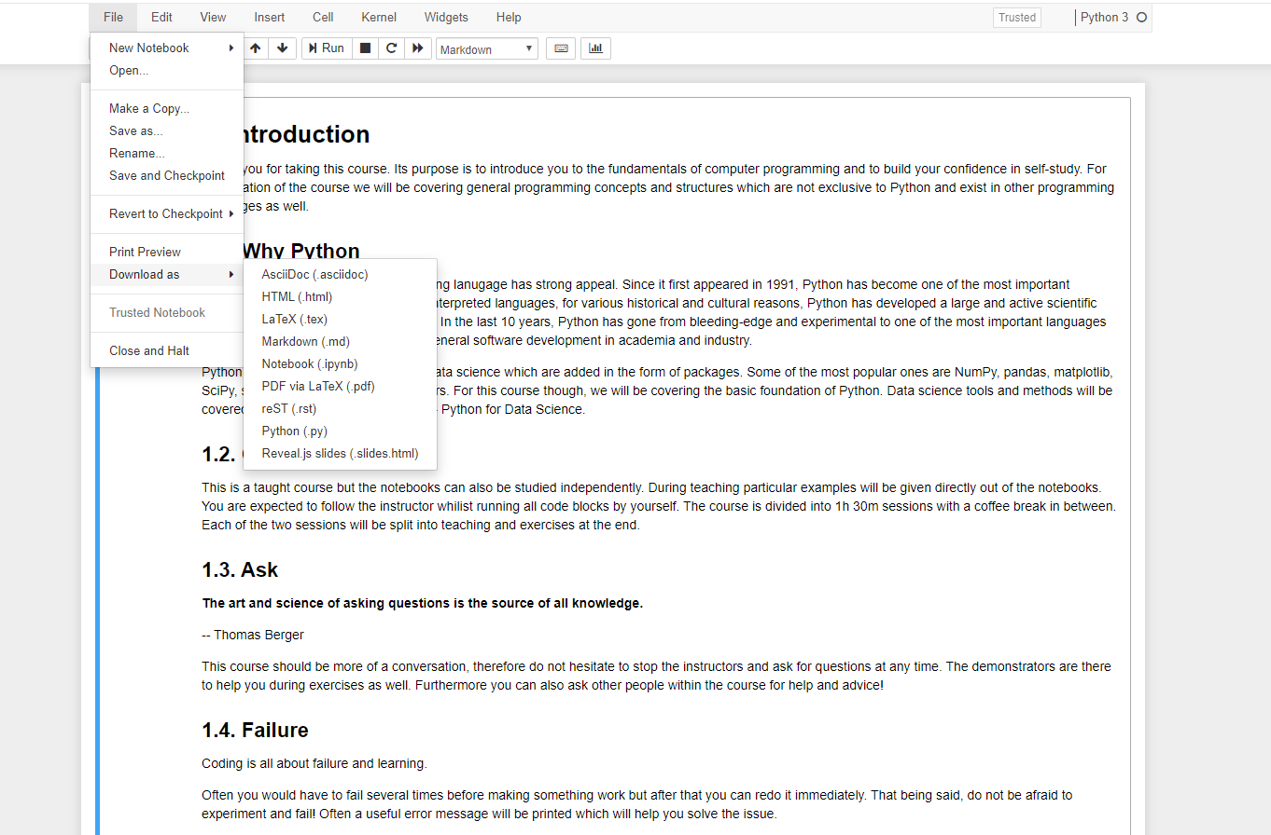
5. Download files

Slide 17
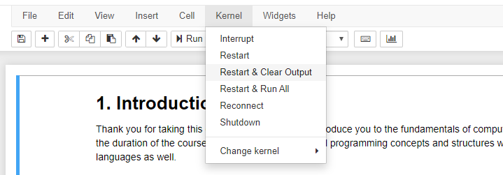
6. Kernel/Restart & Clear output

Slide 18
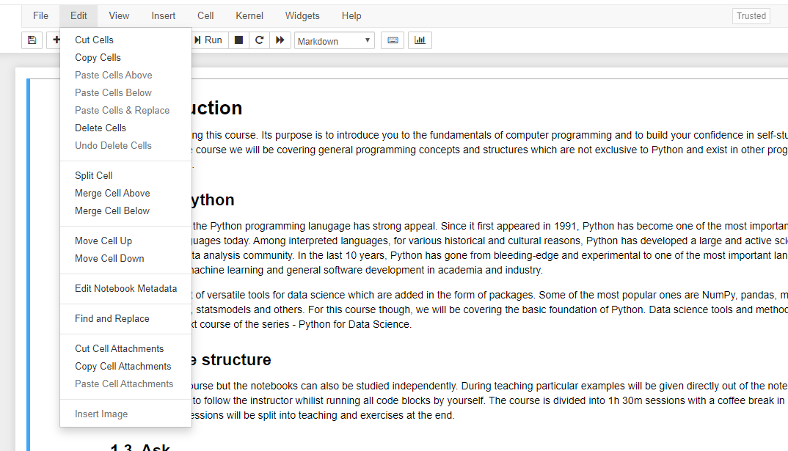
7. Edit/Delete Cell

Slide 19
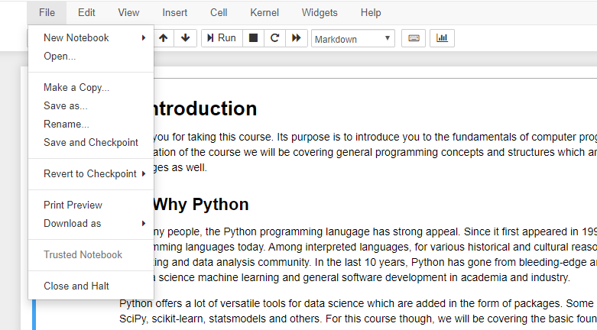
8. File/ Close & Halt

Slide 20
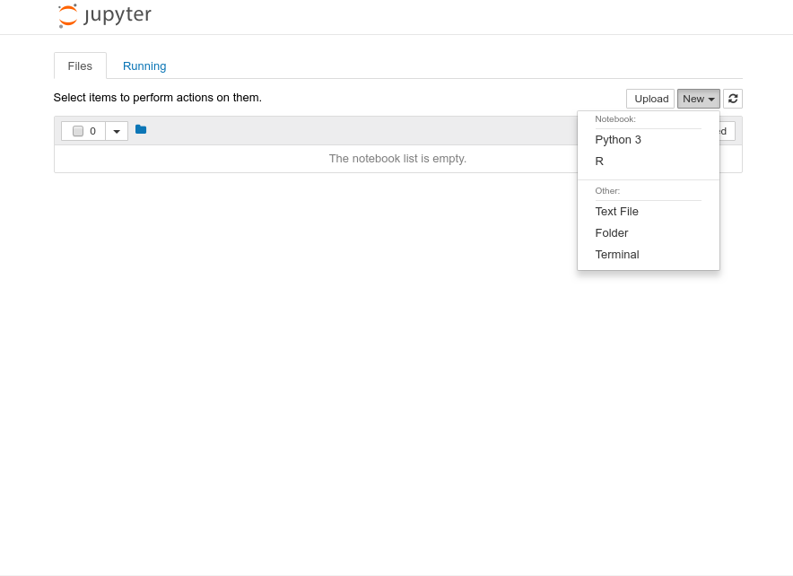
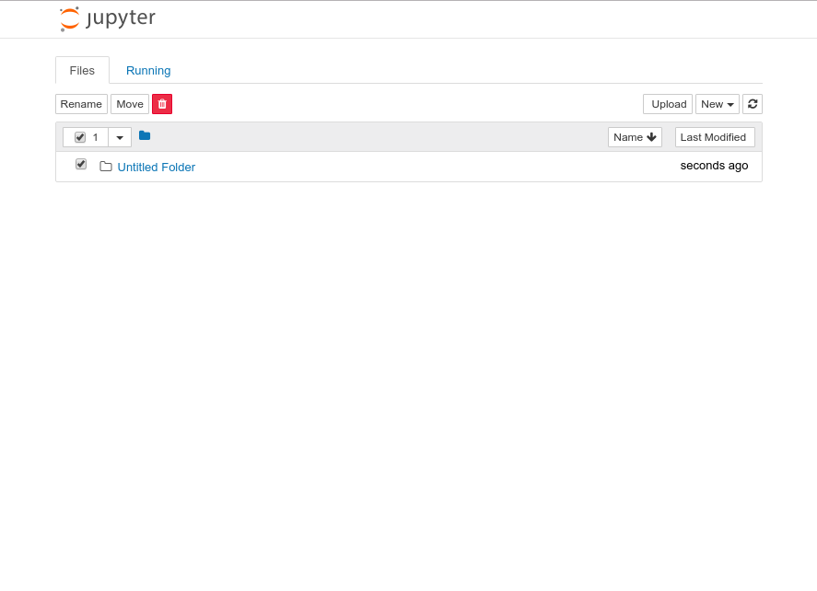
9. Create a folder 10.Rename
Notes:
We need to make a course folder
Then rename it to Introduction to Python or whatever
Then go into that folder

Slide 21
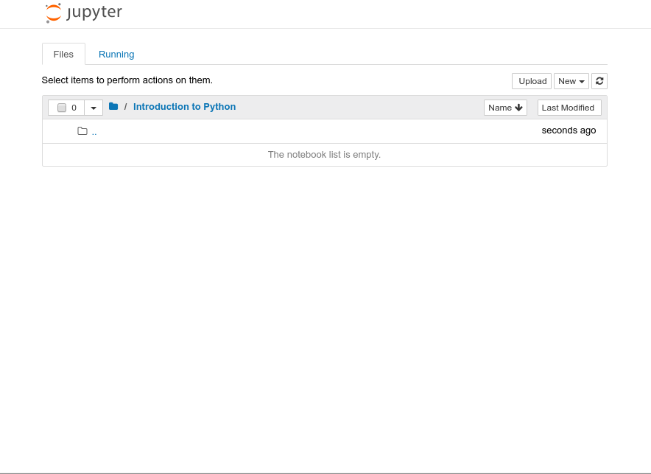
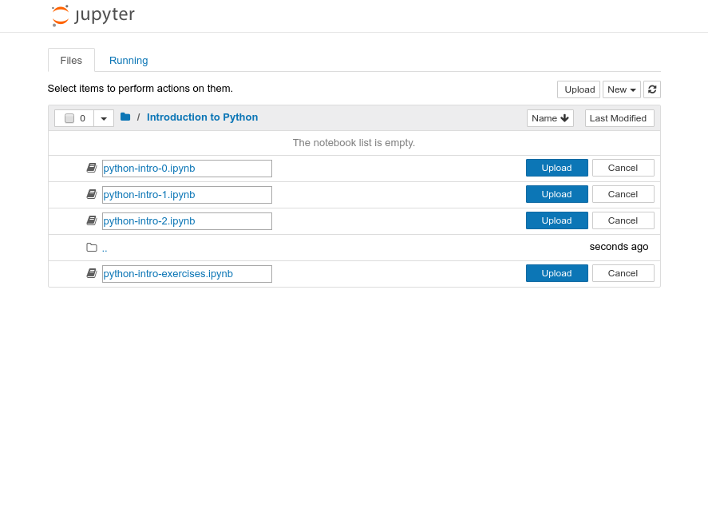
11. Upload files
Notes:
Make sure that you are inside that folder

Slide 22
Running blocks
By pressing the Run button
Shift + Enter – runs block
Alt + Enter – creates a new block
Notes:
Run button but its best with shortcut Shift + Return/Enter
Alt + Return/Enter which creates a new block after the on you are currently on.

Slide 23
Other operations
File/Save and Checkpoint
File/Revert to Checkpoint
Tab completion
Introspection
Notes:
Checkpoints are useful!
You can download it as multiple different things:
Notebook
Python script
pdf

Slide 24
Let us start
To follow along, you need to open your own notebook. But please try to keep up with my presentation, as you still have time for exercises during the teaching.

Slide 25
Thank you for attending!
You can continue to access the ‘Python for Data Science’ Learn course and notebooks after the course.
There are solution notebooks for all the topics we have covered today, plus notebooks covering additional topics (text analysis, signal processing, regular expressions, network analysis, machine learning & Conway’s game of life).
Visit the Digital Skills Framework to find more Python learning resources: https://www.digitalskills.ed.ac.uk/

