Slide 1
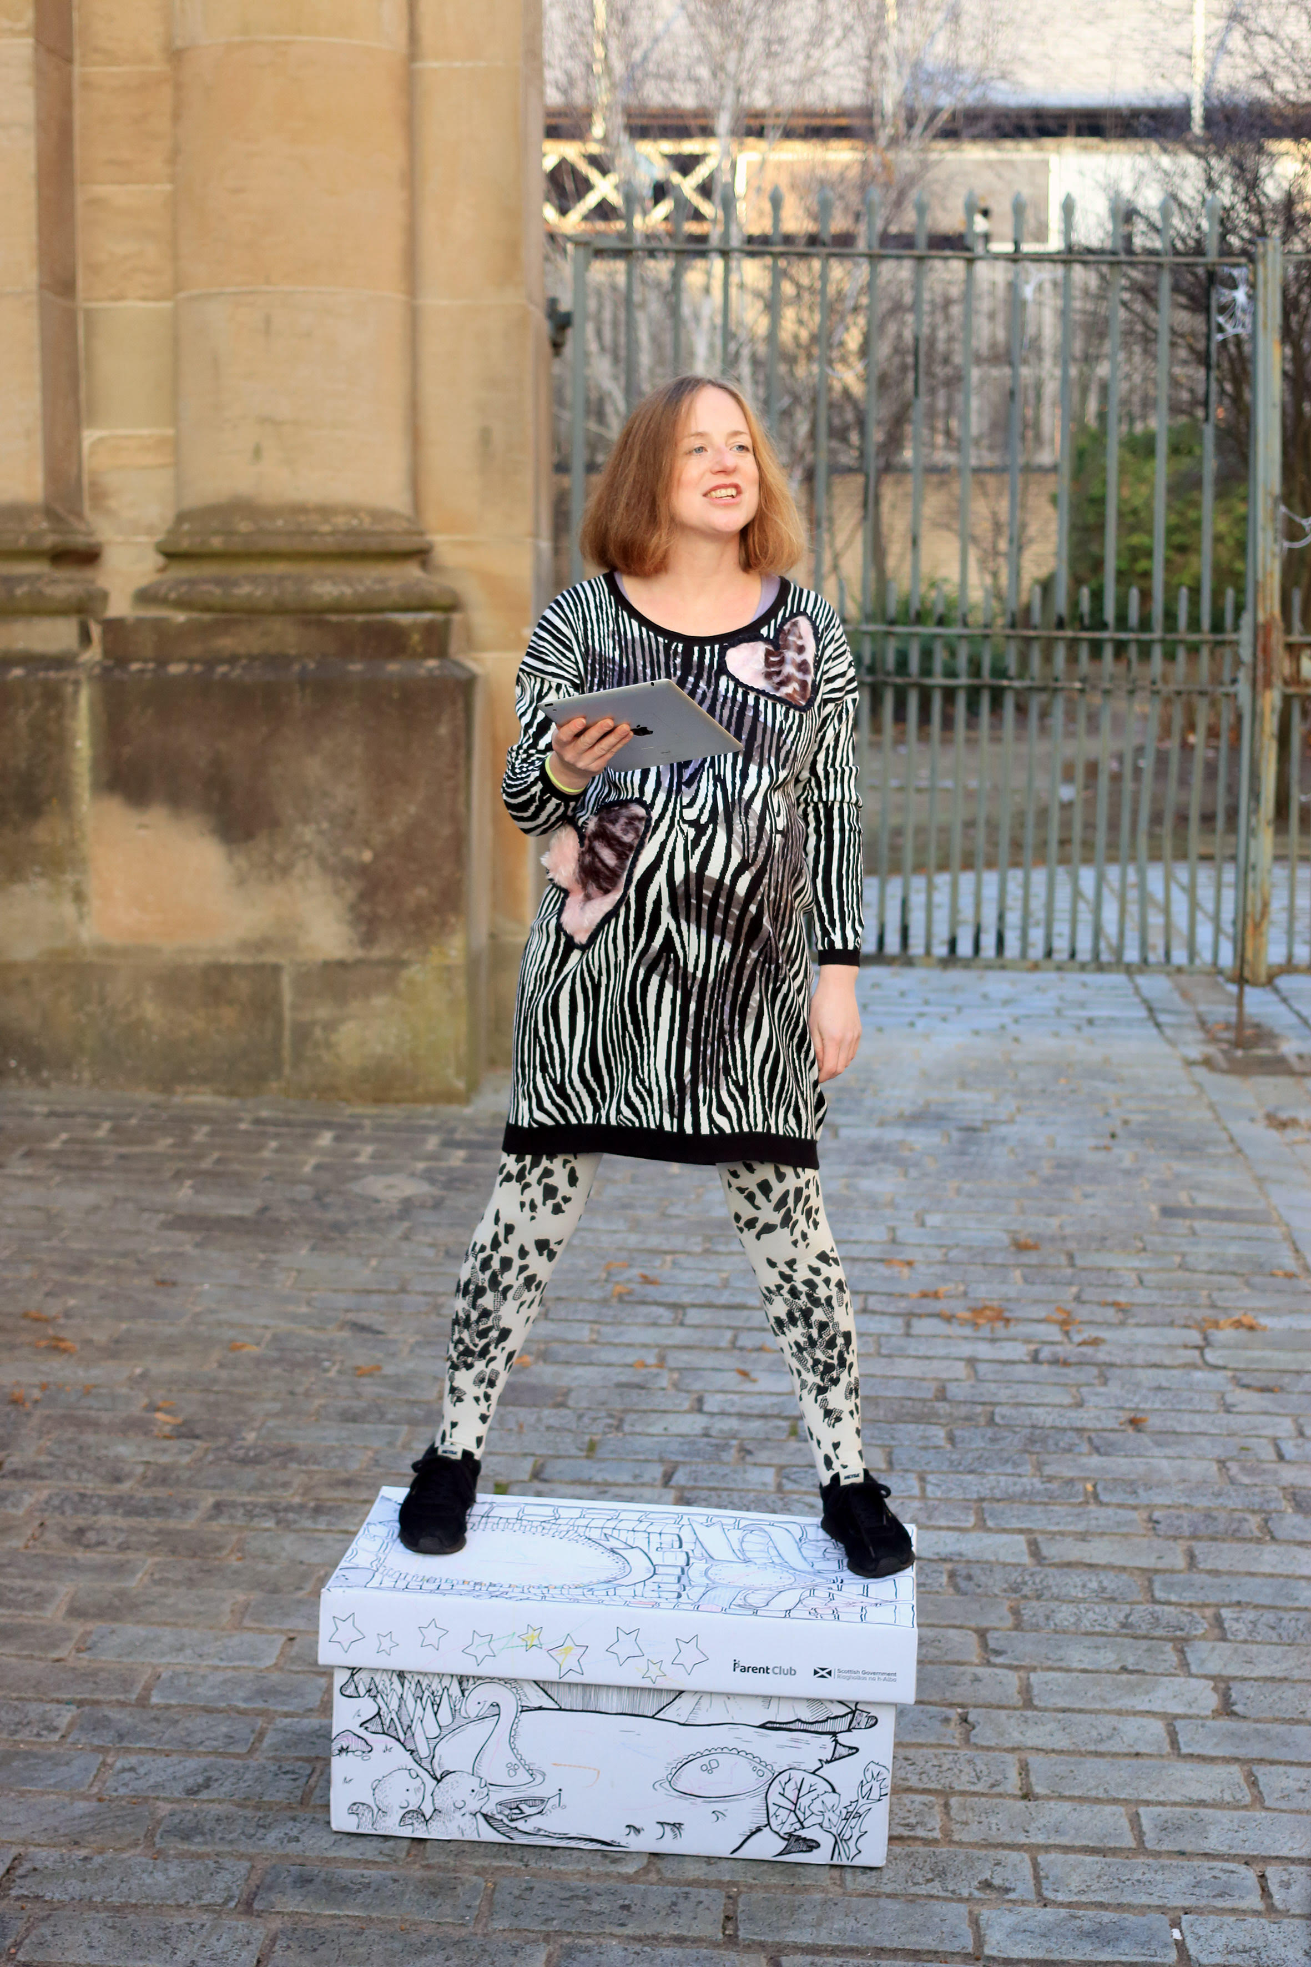

Shona Macnaughton Progressive (2017) www.shonamacnaughton.com The University of Edinburgh Contemporary Art Research Collection Accession number EU5663 Kirsten Lloyd School of History of Art, The University of Edinburgh (Kirsten.Lloyd@ed.ac.uk) This resource is licensed CC BY NC ND, Kirsten Lloyd, University of Edinburgh, 2021.

Slide 2
All images, unless otherwise stated:
Shona Macnaughton, Progressive (2017) performance documentation. Photography Matthew Williams. University of Edinburgh Art Collection. CC BY NC ND.

Slide 3
Contents
Resources
Introduction Part 1 (video link)
Introduction Part 2 (video link)
Additional References
Questions

Slide 4
Resources Art and the City Rosalyn Deutsche and Cara Gendel Ryan, ‘The Fine Art of Gentrification’, October 31 (1984): 91–111. Josephine Berry Slater and Anthony Iles, ‘No Room to Move: Radical Art and the Regenerate City’, Mute, 2009, https://www.metamute.org/editorial/articles/no-room-to-move-radical-art-and-regenerate-city. Richard Florida, ‘The Rise of the Creative Class’, Washington Monthly, May 2002, https://washingtonmonthly.com/magazine/may-2002/the-rise-of-the-creative-class/. Gender and Gentrification Kirsteen Paton, Gentrification: A Working-Class Perspective (Farnham: Ashgate, 2014). Winifred Curran, Gender and Gentrification (Abingdon, Oxon; New York: Routledge, 2017).

Slide 5
Resources Progressive Contemporary Art Research Collection, online catalogue entry: https://collections.ed.ac.uk/art/record/111643?highlight=* Shona Macnaughton: Script read by the artist (available to all those with an EASE password) https://media.ed.ac.uk/media/Progressive_Full/1_y9wqczb0

Slide 6
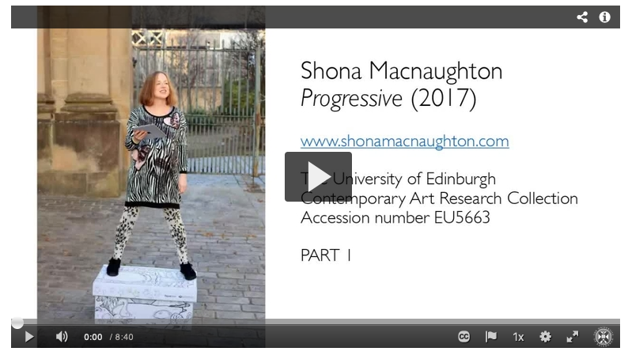
Introduction to Shona Macnaughton’s Progressive (2017) Part 1, 8 minutes 40 seconds https://media.ed.ac.uk/media/OER+Macnaughton+Progressive+Part+1/1_k3gfbke8
Introduction Part 1

Slide 7
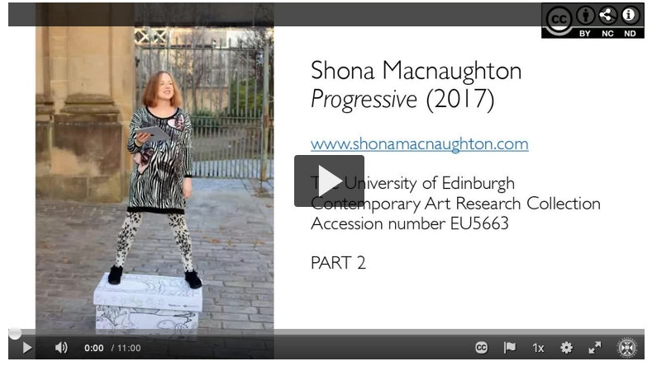
Introduction to Shona Macnaughton’s Progressive (2017) Part 2, 11 minutes https://media.ed.ac.uk/media/OER+Macnaughton+Progressive+Part+2/1_yhi6plt4
Introduction Part 2

Slide 8
Additional References Liz Bondi, ‘Gender Divisions and Gentrification: A Critique’, Transactions of the Institute of British Geographers 16, no. 2 (1991): 190–98. Catriona Burness, ‘Remember Mary Barbour’, Scottish Labour History 50 (2015): 81–96. Neil Gray, ed., Rent and Its Discontents (London; New York: Rowman & Littlefield International, 2018). Neil Gray and Gerry Mooney, ‘Glasgow’s New Urban Frontier: “Civilising” the Population of “Glasgow East”’, City 15, no. 1 (2011): 4–24. Hamish Kallin, ‘Opening the Reputational Gap’, in Negative Neighbourhood Reputation and Place Attachment: The Production and Contestation of Territorial Stigma, ed. Paul Kirkness and Andreas Tije-Dra (Abingdon: Routledge, 2017), 103–18. Leslie Kern, ‘From Toxic Wreck to Crunchy Chic: Environmental Gentrification through the Body’, Environment and Planning D: Society and Space 33, no. 1 (2015): 67–83 Gregory Sholette, Dark Matter: Art and Politics in the Age of Enterprise Culture (London ; New York: Pluto Press, 2011).

Slide 9
Questions
1. What links does the artist draw between her own body and the environment, and to what ends?
2. Is neoliberal urbanism a concern for feminist struggle?

