Slide 1
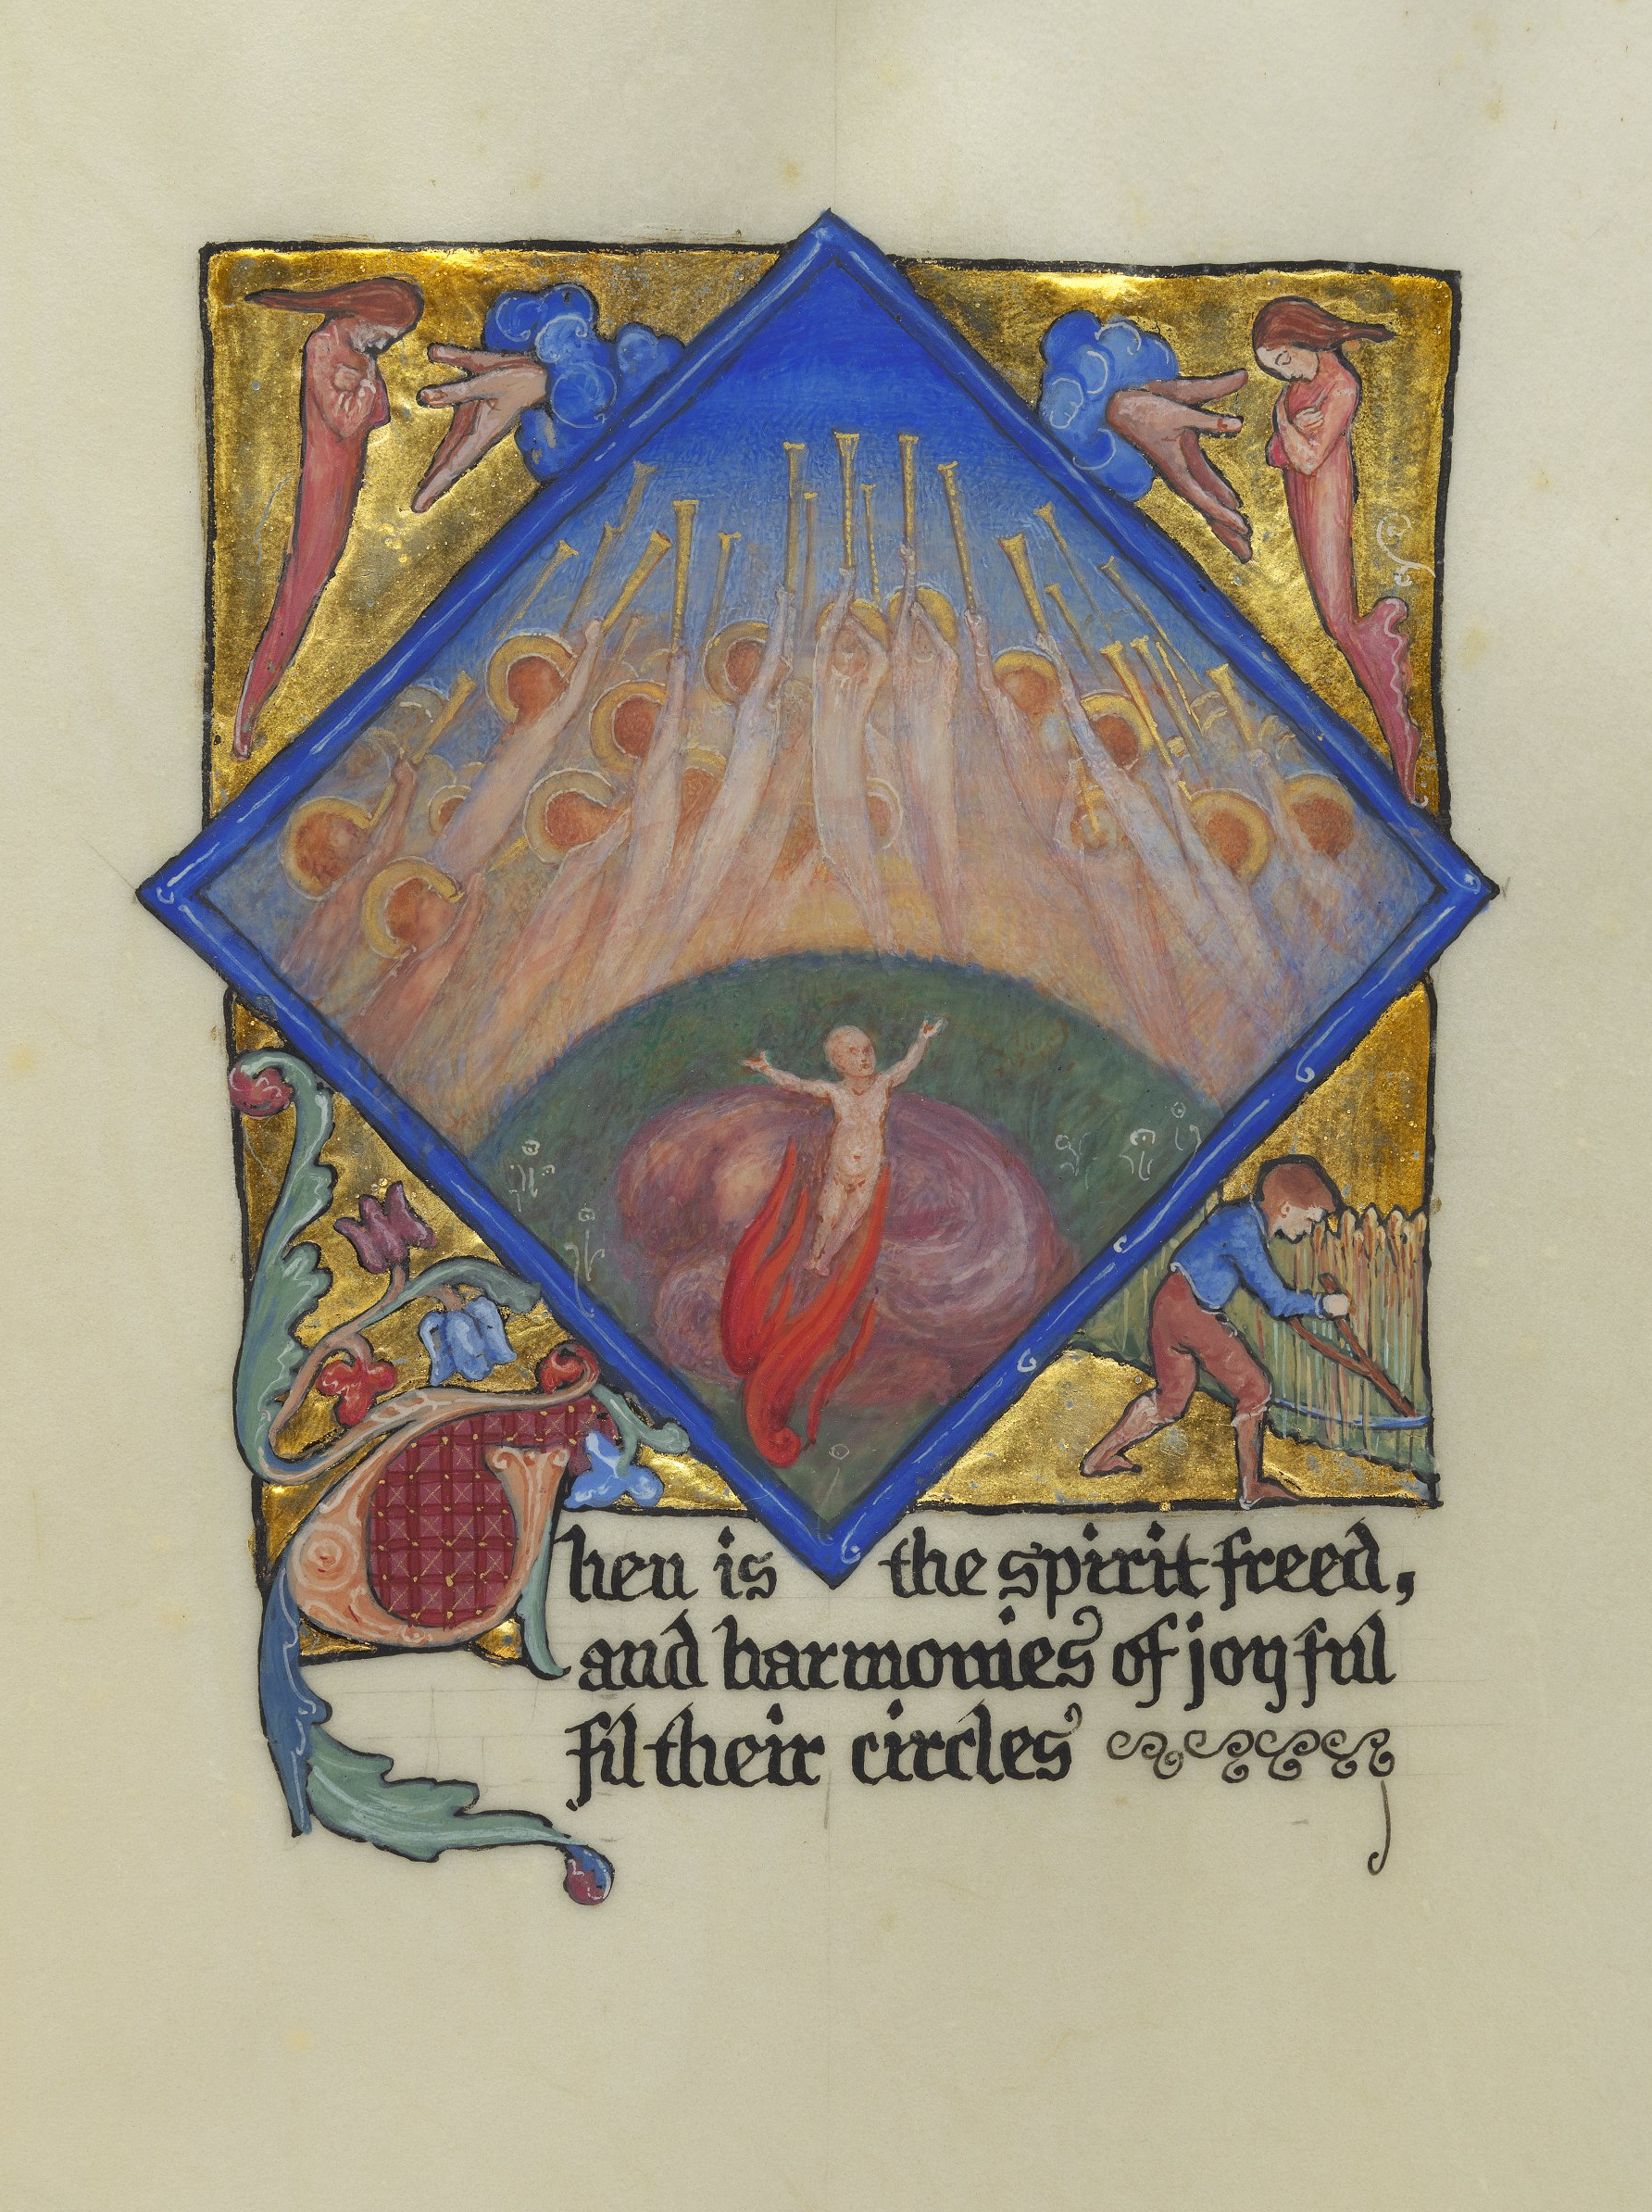
OER Service, Policy,
Open Media Bank,
& Open Textbooks
Stephanie (Charlie) Farley
Information Services, University of Edinburgh
Song School St. Mary, 1897, Phoebe Anna Traquair, CC BY, University of Edinburgh, https://images.is.ed.ac.uk/luna/servlet/s/perpr8

Slide 2
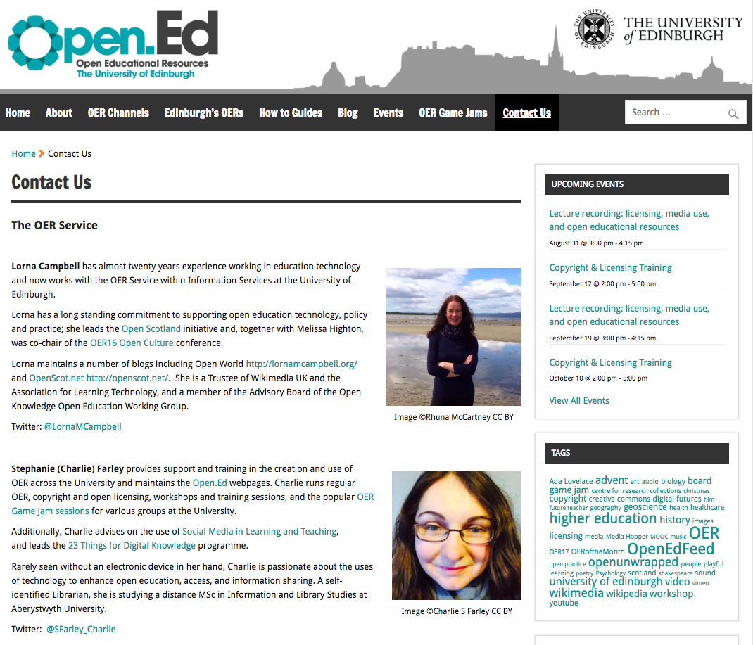

Lorna M. Campbell
@LornaMCampbell
Stephanie (Charlie) Farley
@SFarley_Charlie
Open.Ed OER Service
Learning, Teaching & Web
Information Services
http://open.ed.ac.uk/
@OpenEdEdinburgh
Notes:
Our central OER Service, comprising of myself and Lorna, is based in our Learning Technology and Web Services division, instead of Library services where OER often sits in many institutions. This is because our focus is specifically on learning and teaching materials and the education, training, and support of our staff and students to make the use, creation, and sharing of those materials open both within and without of our university.

Slide 3
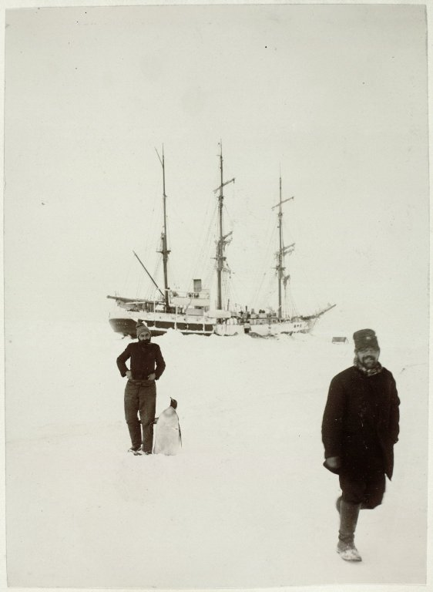
OER Service Activities
Digital skills workshops & events around OER and open education.
Provide support to Schools and Colleges.
Provide advice, guidance and training on copyright and open licensing.
Support ISG Playful Engagement Strategy.
Papers of William Speirs Bruce, No.686,
©University of Edinburgh,
CC BY-NC-SA 2.0, https://flic.kr/p/fcwCzM
Notes:
The OER Services runs a wide range of digital skills workshops and events focused on OER and open education. We offer support directly to Schools and Colleges, and we provide advice, guidance and training on copyright and open licensing. The Service also supports the ISG Playful Engagement Strategy and works closely with our Wikimedian in Residence.

Slide 4
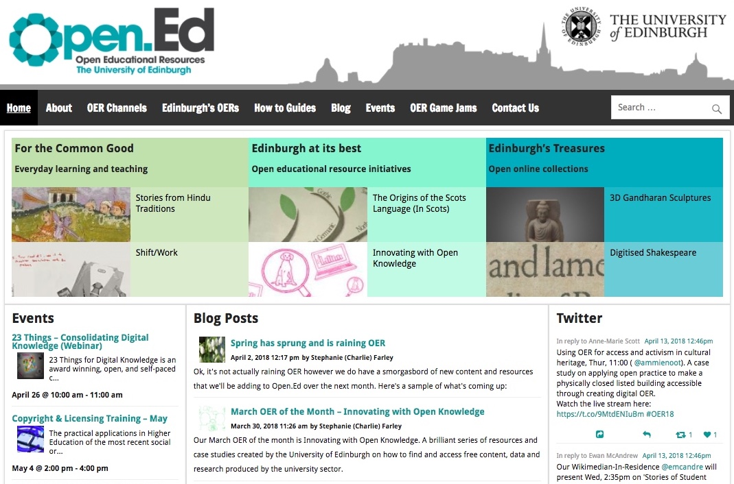
Open.Ed, https://open.ed.ac.uk/
Notes:
We have our own dedicated website for the service on which we provide guidance materials, information about training and events, blog posts from ourselves and staff and students across the university. We also use this space to provide a showcase of the excellent OER created by our staff and students that have come to our attention. Including showcases of the open licensed and high value materials produced by our MOOCs and short online learning courses.

Slide 5

University of Edinburgh OER Policy
http://open.ed.ac.uk/about/
Approved by Learning and Teaching Committee in January 2016, revised & updated in 2021.
Informative and permissive.
Encourages staff and students to use, create and publish OERs to enhance the quality of the student experience.
Helps colleagues make informed decisions about creating and using OER.
CC BY-NC-SA 2.0, Centre for Research Collections, https://flic.kr/p/fcwNdT
Notes:
Underpinning all of this activity is our University’s OER Policy.
Approved by our Learning and Teaching Committee in 2016 and revised and updated just last year. The policy sets out our mission and vision as mentioned earlier by Melissa. It outlines why and how we encourage staff and students to use, create and publish OERs, and the OER service exists to provide the support and structure to make this happen.

Slide 6

Copyright Debt
“From the moment a colleague tells you that they don’t have time, or don’t care about the copyright licensing and metadata on their teaching materials and load them up into a VLE, online course environment, departmental website, online course-pack, lecture power-point slides, whatever, you start to accrue ‘copyright debt’.
Someone will have to go back to those materials at some point to check them, figure out who made them and when and check for 3rd party content. The longer time passes (or staff change) between the original materials being uploaded in to the VLE the harder it will be to find the original source.”
~ Melissa Highton
Technical debt for OER https://thinking.is.ed.ac.uk/melissa/2015/04/24/technical-debt/
Notes:
It’s very common to think of OER as primarily being of benefit to those outwith the institution, however open licenses also help to ensure that we can continue to use and reuse the resources that we ourselves have created.
Unless teaching and learning resources carry a clear and unambiguous licence statement, it is difficult to know whether and in what context they can be reused. This is a phenomenon that Melissa Highton has referred to as copyright debt.
If you don’t get the licensing right first time round it will cost you to fix it further down the line, and the cost and reputational risk to the university could be significant if copyright is breached. And this is one of the best strategic reasons for investing in open educational resources at the institutional level. We need to ensure that we have the right to use, adapt, and reuse, the educational resources we have invested in.

Slide 7
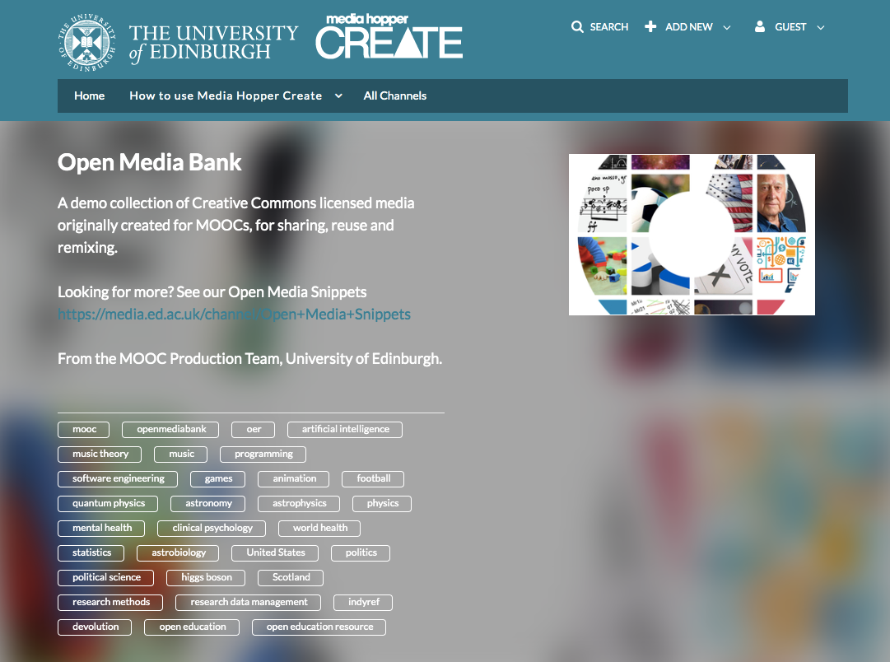
Open Media Bank, https://media.ed.ac.uk/channel/Open%2BMedia%2BBank/
Notes:
So one of the ways that we’re addressing this is to ensure that all the content we produce for our open online courses is also freely available to download under open licence from the Open Media Bank channel on Media Hopper Create service. We now have over 650 open licensed MOOC videos which are available to re-use under Creative Commons licence, covering topics as diverse as music theory, mental health, clinical psychology, programming, the discovery of the Higgs Boson particle, astrobiology and the Scottish independence referendum. And some of these resources are now being re-used for campus based teaching.

Slide 8

Fundamentals of Music Theory
Open Textbook
Coursera MOOC: Fundamentals of Music Theory
MOOC content adapted alongside new materials for a blended learning course.
Student Experience Grant funded collaborative project between OER service & staff and student interns from the Reid School of Music.
Content adapted into a open textbook for use within and beyond the University.
https://blogs.ed.ac.uk/opentextbooks/
Fundamentals of Music Theory open textbook, https://books.ed.ac.uk/edinburgh-diamond/catalog/book/ed-9781912669226
Notes:
A perfect example of this is our Fundamentals of Music Theory open textbook. The content for this book came from our popular Coursera MOOC Fundamentals of Music Theory, which was reused in addition to new materials developed for an on campus blended learning course.
Led by Dr Nikki Moran and Lorna M. Campbell, a Student Experience Grant was used to fund a collaborative project between the University’s OER Service, and staff and student interns from the Reid School of Music to further re-use and adapt this content to create an open textbook suitable for use by staff and students both within and beyond the University.
This is just one of many projects in which we work with and co-create OER with our students.

Slide 9
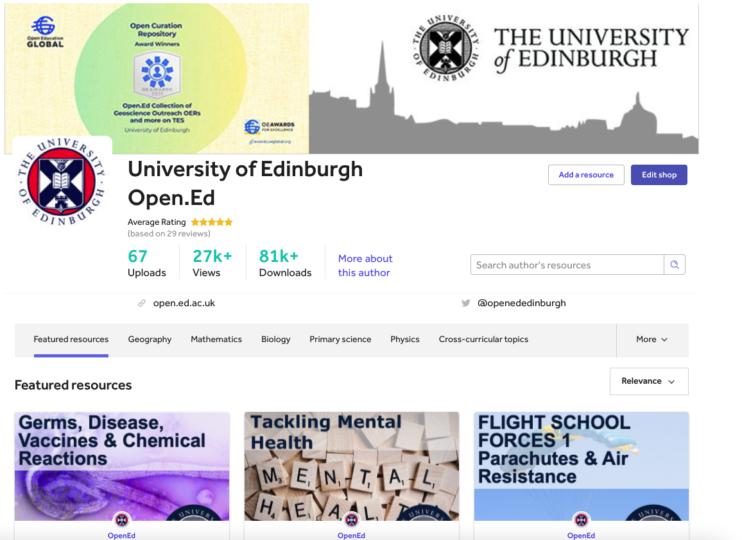
University of Edinburgh on TES Resources, https://www.tes.com/teaching-resources/shop/OpenEd
2021 OE Global Open Curation Award, https://awards.oeglobal.org/awards/2021/open-curation/open-ed-collection-of-geoscience-outreach-oers-and-more-on-tes/
Notes:
Each summer the OER Service employs Open Content Creation student interns, who take the materials created by Geoscience Outreach students, make sure everything in those resources can be released under open license and then share them on TES along with Curriculum for Excellence learning objectives and outcomes, so they could be found and reused by other teachers and learners.
However, I’ll pass the baton on now to Ari to speak about how we promote our online courses.

