Slide 1


Introduction to Chinese Philosophy: Confucianism I
Background and the Analects
Lee Wilson, 2020

Slide 2

About the Course
儒
Overview of the major Confucian and Daoist schools of Classical Chinese philosophy
Warring States Period (475–221 BCE)
Audience of ruling class and literati
Philosophical, thematic approach
Ethics, politics, metaphysics, epistemology, philosophy of language, etc.
Focus on human nature
Text-heavy
In English translation
道

Slide 3
Philosophers & Texts
儒
儒
Confucianism
Confucius
The Analects
http://www.acmuller.net/con-dao/analects.html
https://ctext.org/analects
Mencius
The Mencius
http://www.acmuller.net/con-dao/mencius.html
https://ctext.org/mengzi
Xunzi
The Xunzi
Daoism
Laozi
The Daodejing
http://www.acmuller.net/con-dao/daodejing.html
https://ctext.org/deo-de-jing
Zhuangzi
The Zhuangzi
https://terebess.hu/english.chuangtzu.html
https://ctext.org/zhuangzi
道
道

Slide 4

Summary
儒
General Background
Historical Background
The Analects
Confucius the Person
The Text
Concepts
道
Discussion on Selected Extracts
Analects

Slide 5
儒
儒
Timeline
Confucius 551 BCE
道
Mencius
372 BCE
Xunzi
c. 310 BCE
Qin unification 221 BCE
Confucians
道
Daoists
601 BCE (?)
Laozi
369 BCE
Zhuangzi
771–476 BCE Spring and Autumn Period
475–221 BCE Warring States Period
c. 624 BCE
Thales
c. 470 BCE
Socrates
428 BCE
Plato
384 BCE
Aristotle

Slide 6
儒
Ancient China
Xia Dynasty (c.2070–c.1600 BCE)
Shang Dynasty (c.1600–1045 BCE)
Zhou Dynasty (1045–221 BCE)
Qin Dynasty (221–206 BCE)
Han Dynasty (206 BCE–220 CE) . . .
Qing Dynasty (1636–1912)
Republic of China (1912–1949)
People’s Republic of China (1949–present)
道
Zhou Dynasty
Western Zhou (c.1045–771 BCE)
Eastern Zhou (770–221 BCE)
Spring and Autumn Period (771–481 BCE)
Warring States Period (481–221 BCE)

Slide 7
儒
道
image of Early Warring States Period [cropped] by SY¹

Slide 8
儒
The Warring States Period (475–221 BCE)
Hundred schools of thought
Confucianism (Ruism)
Mohism
Daoism
Legalism
School of Names
School of Yin Yang
Yangism
道
Jixia Academy (318–284 BCE)
State of Qi
State-sponsored
Mencius, Zhuangzi (?), Xunzi

Slide 9


儒
Logograms
山
Pictogram: ‘mountain’
Ideogram: ‘up’ / ‘down’
Radicals: ‘person’ + ‘two’ = ‘humaneness, benevolence’
上
下
道
人
二
仁

Slide 10

Scripts
儒
Oracle bone script
Shang Dynasty
Bronze script
Zhou Dynasty/Warring States Period
Bamboo and wood script
Warring States Period
Small seal script
Qin Dynasty
Clerical script/Tradition Chinese characters
Han Dynasty–1950s; contemporary Hong Kong, Taiwan, Macau
Simplified Chinese characters
People’s Republic of China
道
山
禮
山
礼

Slide 11
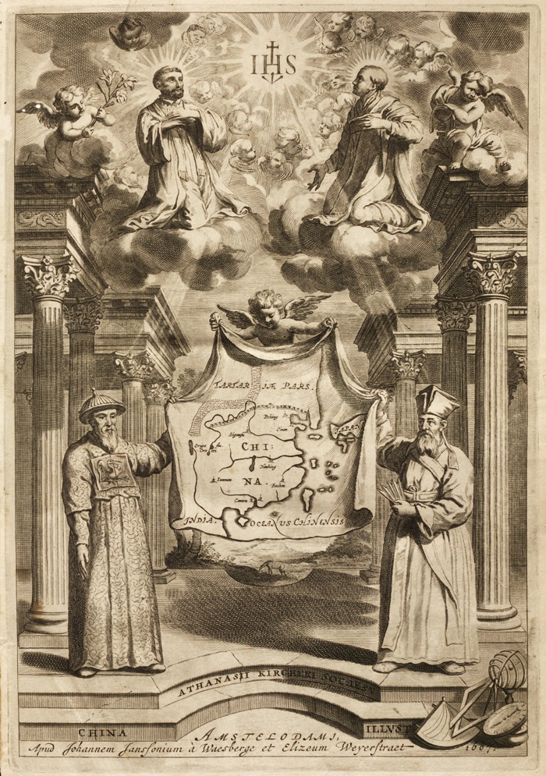
儒
Transliteration
Jesuit latinisation
‘Confucius’ for ‘Kongzi’
‘Mencius’ for ‘Mengzi’
Pinyin vs Wade-Giles romanisation
‘Kóngzǐ’ vs ‘Kung Tzu’
‘Dào’ vs ‘Tao’
Older vs newer scholarship
道
frontispiece by Athanasius Kircher²

Slide 12
儒
Three Sovereigns, Five Emperors
Three Sovereigns
Suiren
Fire
Fu Xi & Nüwa
Wedding ritual
Shennong
Herbal medicine
Five Emperors
Yellow Emperor/Shaohao
Cooking
Zhuanxu
Calendar
Emperor Ku
Music
Emperor Yao
The Palace
Emperor Shun
Pottery
道

Slide 13
儒
First and Last Dynastic Kings
道
Xia
Emperor Yu
Flood control
King (Tyrant) Jie
Cruel and lavish lifestyle
Reign fraught with natural disasters
Shang
King Tang
Overthrew King Jie
Lowered taxes and provided gold for families to buy back their children who were sold during droughts
King (Tyrant) Zhou [紂 zhòu]
Lavish and immoral lifestyle, neglecting state affairs
Zhou [周 zhōu]
King Wu
Overthrew King Zhou
Duke (Wen) of Zhou
Regent for young nephew King Cheng
Credited with the I Ching, Book of Poetry, Zhou Rituals, and Yayue music

Slide 14
儒
Sage Kings
Emperor Yao
Paragon of virtue and exemplar to subsequent kings
Relinquishes the throne to Shun
Emperor Shun
Responded to abusive, murderous step family with kindness
Impressed Yao with compassion and natural leadership
Relinquishes the throne to Yu
Emperor Yu
Devised system of irrigation canals to control floods
People install his son Qi as successor
道

Slide 15
Religion or Philosophy?
儒
Heaven [tian 天]
noun (or sometimes verb)
The sky
A higher power associated with the sky (and the natural order)
The cosmic-moral order
Shangdi [上帝 trans. High God] of the Shang Dynasty vs Tian of the Zhou Dynasty
Heaven’s mandate [tianming 天命] as political legimitation
The Zhou High King as the ‘Son of Heaven’
道

Slide 16
Myth or History?
儒
“The Zhou had given China … a vision: a vision of a world, ‘all under heaven,’ united in peace and harmony and cooperation, under ‘the son of Heaven.’ The vision, of course, was of China as it had existed under the first Zhou rulers, and it rapidly became exaggerated into a dream of a Utopia. Kings were never so great, their vassals were never such heroes, there was never such uniform justice, the people were never so prosperous and happy, as they were believed to have been under Wen and Wu and Cheng and Kang. But the dream grew. Eventually, when the philosophers took it over, they needed more scope than was afforded by an actual historical past; after all, there was some limiting knowledge of what had actually existed in early Zhou. So the philosophers projected this golden age back to the glorious days of remotely early legendary Emperors, where fancy was free to invent as it would. But this did not begin until late in Spring and Autumn times. The original golden age, and the prototype for later invention, was early Western Zhou. The Zhou had given the Chinese people a goal and a vision which they would never, perhaps, completely lose.”
H. G. Creel, The Origins of Statecraft in China
道

Slide 17
儒
Way or Truth?
道
“Their thinking is a response to the breakdown of the moral and political order which had claimed the authority of Heaven; and the crucial question for all of them is not the Western philosopher’s ‘What is truth?’ but ‘Where is the Way?,’ the way to order the state and conduct personal life.”
– A. C. Graham, Disputers of the Tao

Slide 18
儒
The Way [dao 道]
noun (or sometimes verb)
A physical road/path
A mode of conducting affairs, living one’s life, or organising of the state
The appropriate mode of conducting affairs, living one’s life, or organising the state
A linguistic account of b/c
The course of the natural or cosmic order
Way or Truth?
道

Slide 19
儒
Way or Truth?
“… far from finding the notion of truth inconceivable, ancient Chinese philosophers frequently asked themselves whether some statement was true or not, although they did not show the same degree of philosophical preoccupation with factual truth as Westerners might expect […] their key concept was that of the Way of conducting human affairs, not of objective factual or doctrinal truth.”
– Christoph Harbsmeier, Science and Civilisation in China Vol. 7: Language and Logic
道

Slide 20

儒
Confucius 551 BCE
Mencius
372 BCE
道
Confucians
Xunzi
c. 310 BCE
Qin unification 221 BCE
Daoists
601 BCE (?)
Laozi
369 BCE
Zhuangzi
771–476 BCE Spring and Autumn Period
475–221 BCE Warring States Period

Slide 21
What Is the Way to be Human?
儒

Slide 22
儒
Confucius the Person
Kong Qiu (孔丘), trad. 551–479 BCE
Referred to as ‘The Master’ by his disciples
Kongzi, Kong Fu Zi
Born to a minor noble family in the State of Song, but orphaned early
Family moved to the State of Lu
Held a minor position in the Lu government
Numerous disciples of historical note, positive or negative
“The Master said: At fifteen I set my heart on learning; at thirty I took my stand; at forty I came to be free from doubts; at fifty I understood the Decree of Heaven; at sixty my ear was attuned; at seventy I followed my heart’s desire without overstepping the line.” (Analects 2.4)
photograph of Confucius Statue in Chinese Garden, Singapore, by Anandajoti Bhikkhu³

Slide 23
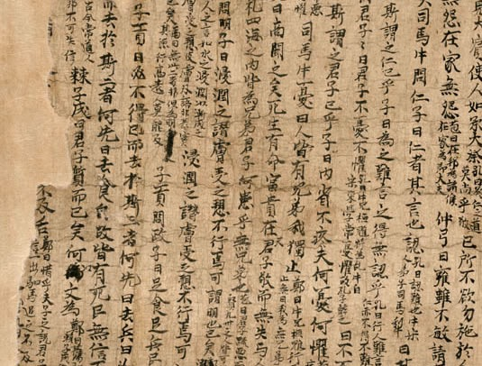
儒
The Analects [Lunyu 論語]
Written during early Warring States Period after Confucius’ death in 479 BCE (finalised mid-Han)
Comprised of 20 books
Largely written and compiled by his disciples
Disputed composition
Authorship of constituent books (e.g. Daoist corruption in Book 18)
Three key versions from archaeological excavations
Most important reference point for Chinese intellectual history
Dialogues, (apparently) dogmatic assertions, behavioural observations
Little argumentation
photograph of Analects of Confucius, from the Mogao Caves in Dunhuang, China⁴

Slide 24
儒
Human Nature in the Analects?
“Zigong said, ‘One can get to learn about the Master’s accomplishments in literature and the cultural tradition but not his views on human nature and the way of Heaven.’” (5.13)
“The Master said, ‘You can speak about higher matters to those who are above the middle in intelligence but not to those who are below the middle in intelligence.’” (6.21)
“The Master said, ‘I wish not to speak anymore.’ Zigong said, ‘If you do not speak, what will there be for your disciples to transmit?’ The Master said, ‘What does Heaven ever say? Yet the four seasons move in order, and the hundred things come to life. What does Heaven ever say?’” (17.19)

Slide 25
儒
Some Key Concepts in the Analects
Confucian Ritualism
Cultivating Virtue
The Gentleman

Slide 26
儒
(1) Confucian Ritualism
“The Master said, ‘People in ancient times did not speak carelessly, for they knew to feel ashamed if their action did not measure up to their words.’” (4.22)
“The Master said, ‘People of antiquity engaged in learning to cultivate themselves. People today engage in learning with an eye toward others.’” (14.24)
“The Master said, ‘Great was Yao as a ruler! Sublime was he! Heaven alone was great, and only Yao took it as his model. So vast and boundless was his virtue that the people could not give it a name. Yet sublime were his achievements, brilliant his cultural vestiges.’” (8.19)

Slide 27
儒
(1) Confucian Ritualism
Ruism vs Confucianism
Ru [儒] trans. ‘cultivated’, ‘scholarly’
Zhou [周] rituals
Codified set of behavioural regulations found in the Book of Rites
e.g. Bowing at the foot of dais [i.e. rulers’ halls] before ascending the stairs (9.3)
Criticism of the love of antiquity in the Huainanzi (Han Dynasty text, 139 BCE):
“People who follow the conventions of the present age mostly revere the ancient and scorn the present. […] Muddled rulers of chaotic eras venerate what is remote and what proceeds therefrom, so they value such things. Those who study are blinded by their theories and respect [only] what they have heard.” (Huainanzi 19.7)?
Possible ways to understand the Analects’ position:
conservatism
traditionalism
Zhou traditionalism
Zhou-based ritualism

Slide 28
儒
(2) Cultivating Virtue
“The Master said, ‘Can [Zeng Can], my way [dao 道] has a thread running through it.’ Master Zeng replied, ‘Yes.’ After the Master left, the disciples asked, ‘What did he mean?’ Master Zeng said, ‘The Master’s way consists of zhongshu [忠恕].’” (4.15)
“The Master said, ‘I will not give a person a boost or a start if he does not know the frustration [of trying to solve a difficult problem] or the frenzy one would get into when trying [to put an idea] into words. After I have shown a student one corner of a square, if he does not come back with the other three, I will not repeat what I have done.’” (7.8)
“Yan Yuan [Yan Hui] asked about benevolence. The Master said, ‘Restrain the self and return to the rituals. This is the way to be benevolent. If for one day you are able to restrain the self and return to the rituals, this means that your capacity to be benevolent will open up to the world. Benevolence rests with the self. How could it come from others?’ (12.1)

Slide 29
儒
(2) Cultivating Virtue
Virtue [de 德]
Benevolence [ren 仁]; moral rightness [yi 義] (or righteousness); ritual propriety [li 禮]; filial piety [xiao 孝], wisdom [zhi 智], trustworthiness [xin 信], (love of) learning [xue 學], thinking [si 思], etc.
Benevolence as
Humaneness, relationality:
Five Relations: (i) parent & child, (ii) ruler & minister, (iii) husband & wife, (iv) elder & younger siblings, (v) friend & friend
All-encompassing ideal
Rightness [yi 義] cognate with homophone fittingness [yi 宜]
Ritual propriety
Means by which benevolence and rightness are habituated and expressed

Slide 30
儒
(2) Cultivating Virtue
Learning and thinking
Received wisdom:
Teacher/model
Five Classics [wujing 五經]:
Book of Poetry [shijing 詩經];
Book of Documents [shujing 書經];
Book of Rites [liji 禮記];
Key later additions: The Great Learning [daxue 大學]; The Doctrine of the Mean [zhongyong 中庸]
Book of Changes [yijing 易經];
Spring and Autumn Annals [chunqiu 春秋];
Lost: Book of Music [yuejing 樂經]
Individual reflection: “The Master said, “Si [Zigong], do you think I am the sort of person who learns many things and who retains this knowledge in his heartmind?” Zigong replied, “Yes. Is it not so?” “No. I bind it together into a single thread.” (15.3)

Slide 31
儒
(2) Cultivating Virtue
“A thread”*: zhongshu [忠恕]
Translations:
“doing one’s best and in using oneself as a measure to gauge others” (Lau)
“dutifulness tempered by understanding” (Slingerland)
“… A humane person wishes to steady himself, and so he helps others to steady themselves. Because he wishes to reach his goal, he helps others to reach theirs. The ability to make an analogy from what is close at hand is the method and the way of realizing humaneness.” (6.30)
*not necessarily the only thread

Slide 32
儒
(3) The Gentleman
“The Master said, ‘The gentleman understands what is morally right. The petty man understands what is profitable.’” (4.16)
“Ji Kangzi asked Confucius about the way of governing, saying, ‘In order to realize the moral way, how about if I were to kill those who do not live by it?’ Confucius replied, ‘As head of the government, why would you need to kill anyone to bring about moral order? The character of those at the top [junzi] is like that of the wind. The character of those below [xiaoren] is like that of grass. When wind blows over the grass, the grass is sure to bend.’” (12.19)
“Confucius said, ‘The gentleman stands in awe of three things. He is in awe of Heaven’s mandate, of great men, and of the words of sages. The petty man is unaware of the presence of Heaven’s mandate; he belittles great men; and he regards the words of sages with mockery.’” (16.8)

Slide 33
儒
(3) The Gentleman
Gentleman vs petty/lowly man [xiaoren 小人]
“Zilu asked, ‘Does the gentleman think highly of courage?’ The Master said, ‘The gentleman [junzi] puts rightness at the top. If a man of high status [junzi] has courage but not a sense of rightness, he will create political upheaval. If a lowly man [xiaoren] has courage but not a sense of rightness, he will turn to banditry.’” (17.23)
Sociological reading: gentry vs lower classes
Ethico-political reading: normative vs descriptive statements about an individual agent
Ideal socio-political order just is individual agents (especially the elite) behaving virtuously, i.e. being gentlemen
Assumption of hierarchical socio-political order

Slide 34
儒
Discussion Questions
Referring to Analects 7.1, 7.20, 9.3,
Is Confucius necessarily committing the fallacy that the Huainanzi raises?
Referring to Analects 2.4, 2.15, 5.20, 9.3, 15.31,
What is the relationship between ritual propriety and rightness? What is the relationship between learning and thinking?
Referring to Analects 3.5, 9.14, 16.14, 17.25,
Who gets to be a gentleman? What sort of limits are there to the method of ‘making analogies from what is close at hand’?

Slide 35
儒
References
Primary Texts
Chin, Annping, trans. 2014. The Analects. New York: Penguin.
Lau, D. C. trans. 1979. The Analects. London: Penguin Books.
Major, John S. and Sarah A. Queen, Andrew Seth Meyer, Harold D. Roth, Michael Puett, and Judson Murray, trans. 2010. The Huainanzi: A Guide to the Theory and Practice of Government in Early Han China. New York: Columbia University Press.
Slingerland, Edward, trans. 2003. The Analects: with Selections from Traditional Commentaries. Indianapolis/Cambridge: Hackett Publishing Company
Secondary Texts
Creel, Herrlee G. 1970. The Origins of Statecraft in China, Vol. 1. Chicago: University of Chicago Press.
Graham, Angus C. 1989. Disputers of the Tao: Philosophical Arguments in Ancient China. La Salle: Open Court.
Harbsmeier, Christoph. 1998. Science and Civilisation in China, Vol. 7, Part 1: Language and Logic, edited by Kenneth Robinson. Cambridge: Cambridge University Press.
道

Slide 36
儒
Recommended Secondary Texts and Further Readings
Lai, Karyn L. 2008. An Introduction to Chinese Philosophy. Cambridge: Cambridge University Press.
Van Norden, Bryan W. 2011. Introduction to Classical Chinese Philosophy. Indianapolis/Cambridge: Hackett Publishing Company, Inc.
Internet Encyclopedia of Philosophy
Stanford Encyclopedia of Philosophy
Ivanhoe, Philip J. and Bryan W. Van Norden, eds. 2003. Readings in Classical Chinese Philosophy, Second Edition. Indianapolis/Cambridge: Hackett Publishing Company Inc.
道

Slide 37
儒
Image Sources
Map showing states in the early Warring States period of Eastern Zhou Dynasty in Chinese history, by SY on Wikimedia Commons, CC BY-SA 2.0, https://commons.wikimedia.org/wiki/File:Early_Warring_States_Period.png
Athanasii Kircheri e Soc. Jesu China monumentis: qua sacris qua profanis, nec non variis naturae & artis spectaculis, aliarumque rerum memorabilium argumentis illustrate, public domain image on Wikimedia Commons, https://commons.wikimedia.org/wiki/File:Athanasii_Kircheri_e_Soc._Jesu_China_monumentis-_qua_sacris_qua_profanis,_nec_non_variis_naturae_%26_artis_spectaculis,_aliarumque_rerum_memorabilium_argumentis_illustrata_MET_li912.1_K63_Q.R.jpg
Confuscius, Close Up, by Anandajoti Bhikkhu on Wikimedia Commons, CC BY 2.0, https://commons.wikimedia.org/wiki/File:022_Confuscius,_Close_Up_(25596184507).jpg
Analects of Confucius, from the Mogao Caves in Dunhuang, China, public domain image on Wikimedia Commons, https://commons.wikimedia.org/wiki/File:Analects_from_Dunhuang.jpg
道

Slide 38

儒
This presentation is an Open Educational Resource. It was originally created for a lifelong learning course (SCQF level 7) at the Centre for Open Learning. You are free to use, share, and adapt this work. To view a copy of the license, visit https://creativecommons.org/licenses/by-sa/4.0/
© Lee Wilson, University of Edinburgh, 2020, CC BY-SA 4.0

Slide 39

Centre for Open Learning The University of Edinburgh Paterson’s Land Holyrood Road Edinburgh EH8 8AQ T: 0131 6504400 E: col@ed.ac.uk W: www.ed.ac.uk/open-learning Facebook: www.facebook.com/uoeshortcourses Twitter: www.twitter.com/uoeshortcourses

