Slide 1


Slide 2
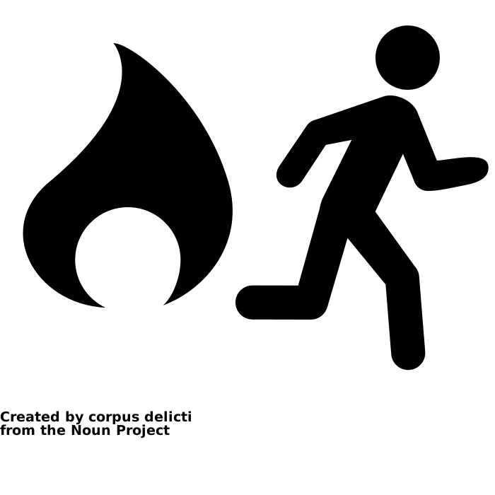



Housekeeping
Icons by corpus delicti, Iconangelo, Alice Design, Gregor Cresnar, CC BY, The Noun Project.

Slide 3
ELDeR process and guiding principles
At the heart of ELDeR is the design of student learning experiences
2-day, collaborative, team-based, learning design workshop
Facilitators and learning designers
Framework to develop: building blocks for course
This is a safe space. There are no silly questions
Collaborative document populated live – digital artefact to take away
Free to use images by Andrea Piacquadio, fauxels, Tirachard Kumtanom, Julia M Cameron, Ksenia Chernaya, and Canva Studio on Pexels.

Slide 4
Plan for Day 1
Time | Activity | Duration
9.00 | Coffee | 15
9.15 | Welcome and introductions | 15
9.30 | Summary statement | 30 + 15
10.15 | ‘Look and feel’ cards and Barnett & Coate | 45
11.00 | Coffee | 15
11.15 | What do you want your students to learn? | 15
11.30 | Learning outcomes | 45
12.15 | Assessment and feedback | 15
12.30 | Lunch | 30
13.00 | Storyboarding | 2 ½ hours
15.30 | End of Day 1 | -
Notes:
FACILITATOR: Update schedule timings if necessary after pre-ELDeR meeting

Slide 5
Course Summary Statement
Write a tweet-sized summary of your course (approx. 25 words).
Example
“The Masters in Learning Innovation enables higher education practitioners to promote positive change by equipping them with the skills and understanding to deploy innovative approaches to learning, teaching and assessment.”
30 + 15 mins
Notes:
Agree on the overarching aims and intentions of your course. Write a statement that captures those aims and intentions below (or copy it, if it already exists).
Ask yourself: what should potential students on this course not possibly miss?
Example:
Consider how this maps to the wider programme goals. This is the text you might want to write just above the ’s learning outcomes (approx. 25 words).

Slide 6

'Look and Feel’ Cards
Sort the cards into three piles: Yes, No, Maybe
Choose key features
Explain your rationale
Pick top 12 from your selection (at least one from each of the four colour groups)
We will refer to these, especially during storyboarding
1. Yes,
definitely want in your course
Orange Guidance & Support
Blue Content & Experience
Green Communication & Collaboration
Purple Reflection and Demonstration
2. Maybe.
Things you’re not sure about
3. No,
definitely don’t want in your course
Free to use image by Photo by Ravi Palwe on Unsplash.
45 mins
Notes:
Use the course features cards provided, to choose the key features of your course or programme. The student learning experience is about more than their experience of the course curriculum and assessment strategy. It includes their experience of being supported and guided, and feeling part of the learning community.
Sort the look and feel cards into three piles, explaining your rationale as you place each card: things you definitely want in your course, things you're not sure about, and things you definitely don't want.
Next pick your top 12 ‘YES’ cards: the non-negotiable ones. We will refer back to these throughout the workshop (especially during storyboarding) to make sure we stay on track.
Orange: Guidance and Support,
Blue: Content and Experience,
Green: Communication and Collaboration,
Purple: Reflection and Demonstration.

Slide 7
Curriculum Design
Knowing
Being
Acting
Barnett and Coate (2005)
Notes:
Barnett and Coate’s evidence based theory of HE curriculum puts the emphasis on doing and being. Curriculum is not just about knowledge and content. For example, history curricula are not just about learning about history, but also about how to be a historian. There are specific methodologies and techniques that are particular to historians, and ways of looking at historical texts.

Slide 8
Disciplinary Differences
Knowing
Being
Acting
Knowing
Being
Acting
Knowing
Being
Acting
Science and technology
Professional subjects
Arts and humanities
Notes:
Some disciplines place more emphasis on one of three circles than the others. The key point is that knowing doesn’t dominate everything.

Slide 9

What do you want your students to learn?
It is crucial to begin with the learner in mind
Consider:
What do you want your students to be able to do at the end of this course?
How will students know they are getting there?
Begin at the end to get a strong handle on what you are designing to achieve
30 mins
Free to use image by Desola Lanre-Ologun on Unsplash.
Notes:
Starting with the end in mind, before you plan your schedule, means that you get a very strong handle on what you are designing to achieve, the direction you need to take and the destination. This approach is known as “backwards design” (Wiggins and McTighe, 2005). You may find it helpful to refer back to your Summary statement at this point.
It is crucial to begin with the learner in mind.
In the next 15 minutes, think about the following questions:
What do you want your students to be able to do at the end of this course? (“they will need to be able to…” - refer to your mission statement here)
How will the students know they are getting there? Considering this here places feedback at the heart of the learning and teaching process.
You can record your answers in the table below - don’t worry about formatting or phrasing, as we will link these into measurable learning outcomes in the next step:

Slide 10
Learning Outcomes
Each learning outcome falls into one of five SCQF characteristics:
Knowledge and understanding (mainly subject based)
Practice (applied knowledge and understanding)
Autonomy, accountability and working with others.
Communication, numeracy and IT skills
Generic cognitive skills (e.g. evaluation, critical analysis)
By the end of this course the student will be able to...
Introduction to LOs - Cathy Bovill
45 mins
Notes:
The next step is to translate this into the learning outcomes for the course. If you already have these in your course specification, copy and paste them in below. You might also want to add in your learning outcomes for the programme, to see how they map together.
We will check these as a team for:
Sense (are they clear to the learner?)
Level (are they appropriate to the level of the course?)
Assess-ability (is it clear how the learner will be able to demonstrate achievement?)
As a Scottish Higher Education Institution, we use the Scottish Credit and Qualifications Framework (SCQF) to guide the level of our learning outcomes.
Each learning outcome falls into one of five characteristics:
knowledge and understanding (mainly subject based);
practice (applied knowledge and understanding);
generic cognitive skills (e.g. evaluation, critical analysis);
communication, numeracy and IT skills; and
autonomy, accountability and working with others.
SCQF About the Framework: https://scqf.org.uk/about-the-framework/
SCQF Interactive Framework: https://scqf.org.uk/about-the-framework/interactive-framework/

Slide 11
Example Active Verbs
6 Evaluation | Judge, evaluate, support, criticise
5 Synthesis | Argue, relate, organise, generalise, conclude, design
4 Analysis | Compare, separate, differentiate, contrast, break down, classify
3 Application | Predict, select, assess, find, show, use, construct, compute, solve
2 Understanding | Identify, illustrate, represent, explain
1 Knowledge | Write, state, recall, recognise, select
Notes:
Show examples

Slide 12
Graduate Attributes
University of Edinburgh graduates…
Mindsets
have:
1) curiosity for learning that makes a positive difference
2) courage to expand and fulfil their potential
3) passion to engage locally and globally
Behaviours
are:
4) creative problem solvers and researchers
5) critical and reflective thinkers
6) effective and influential contributors
7) skilled communicators

Slide 13
Assessment and Feedback
Check assessment and learning outcome alignment.
 | Essay | Class test | Group presentation | End of course exam
LO1 | ✔ |  | ✔
LO2 | ✔ |  |  | ✔
LO3 |  |  | ✔ | ✔
LO4 |  | ✔
15 mins

Slide 14
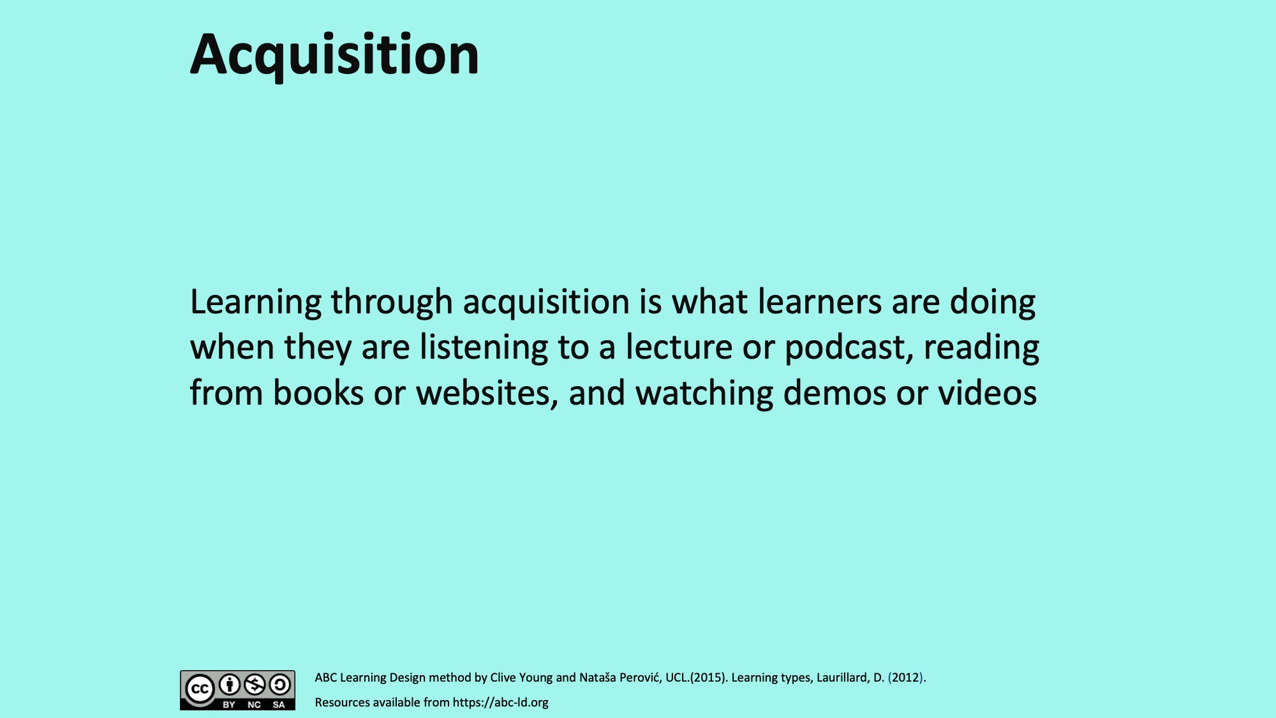
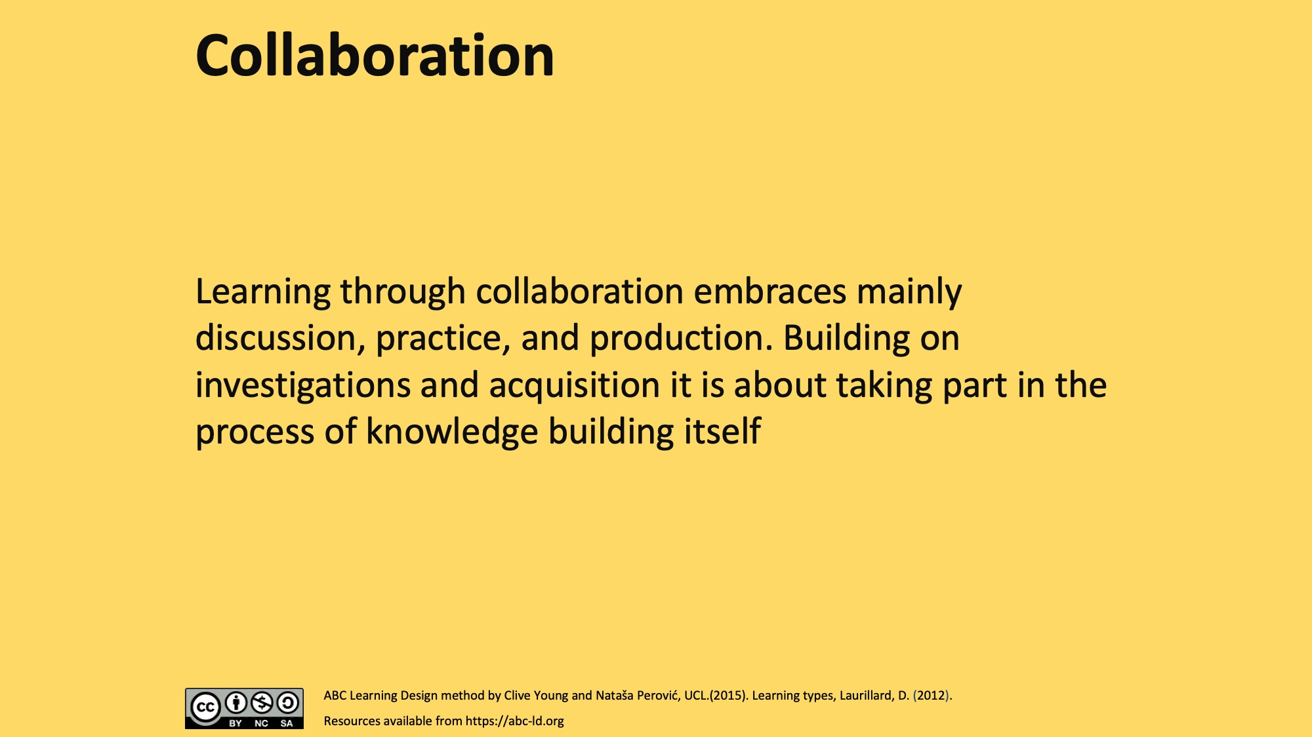
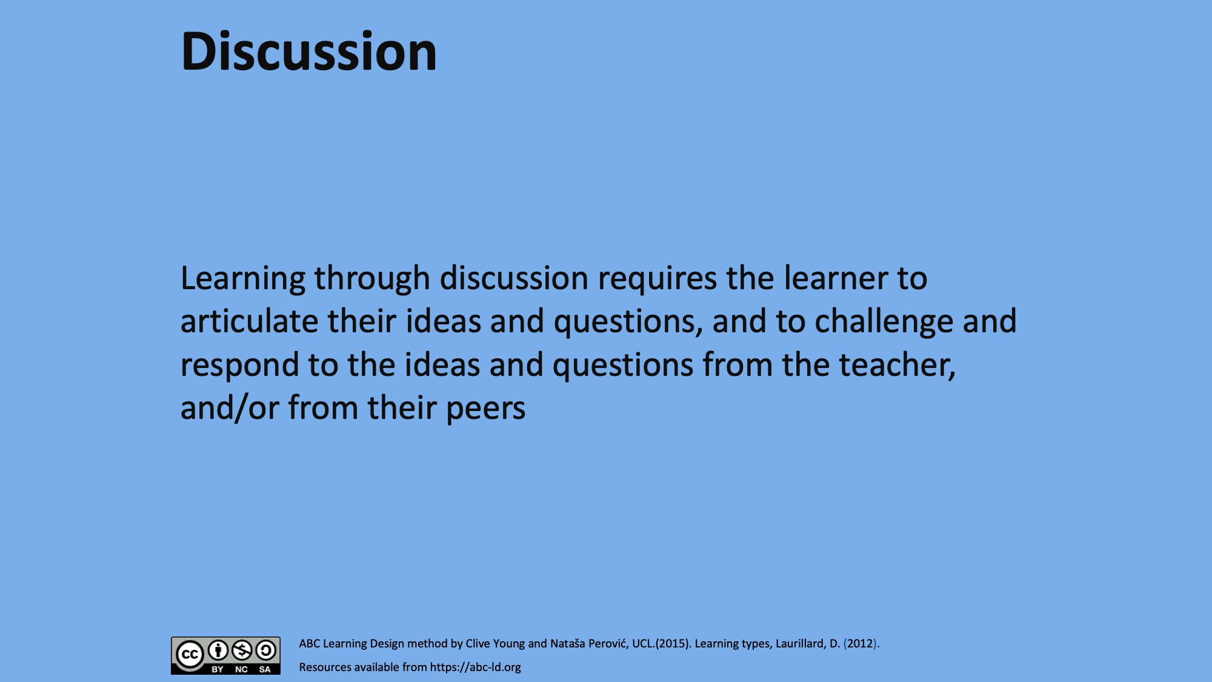
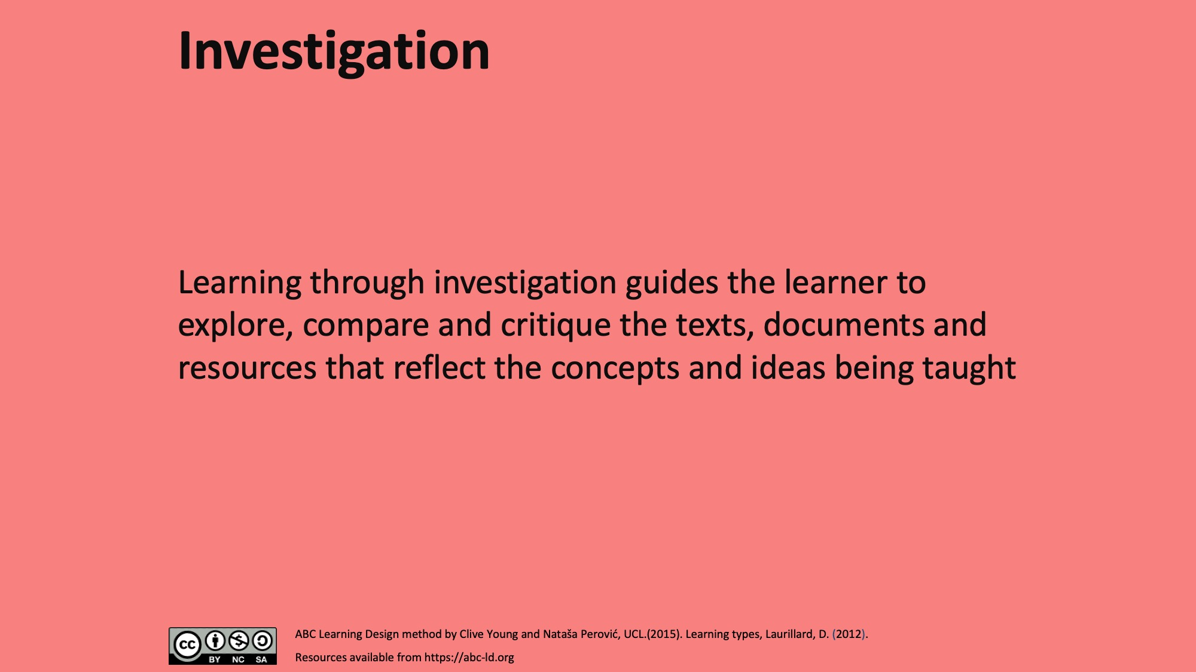
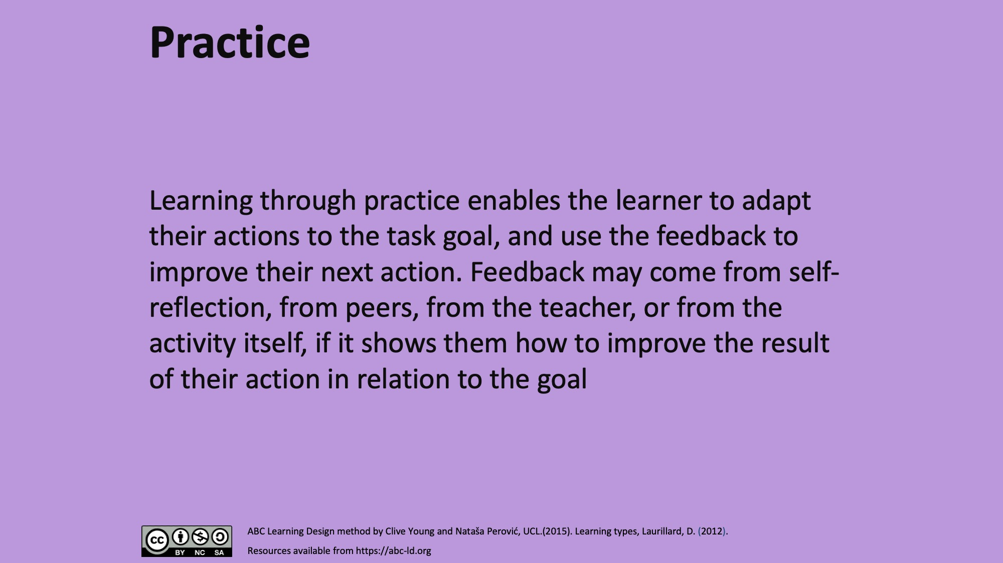
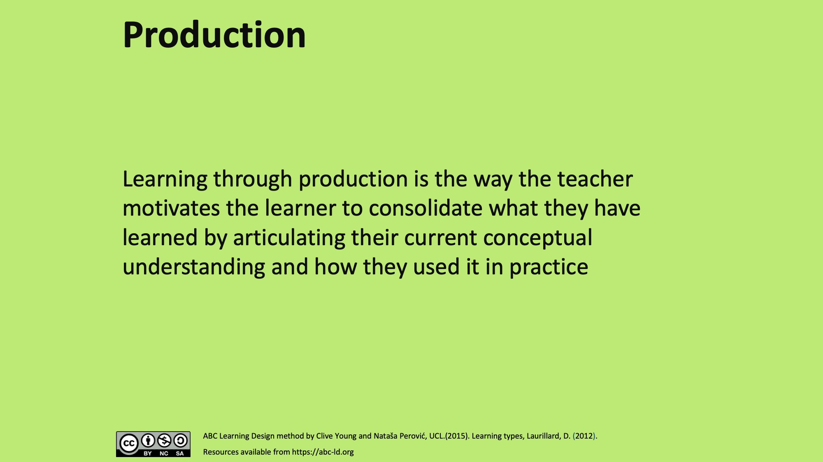
Storyboarding
ABC Learning Design method by Clive Young and Nataša Perović, UCL (2015), CC BY NC SA 4.0.
Notes:
All the resources that you now have around you form a blueprint (your mission, your assessment plans, the look and feel of your course,) but you need to create a process of integration and flow. You can do this by ‘storyboarding’.
Storyboarding means visually representing a process that you can later build. It needs to show what the key players do, how they move through the process, what the critical moments are in the ‘story’ and of course what it’s all leading to and what happens in the end. You don’t need to get into the nitty gritty details at this stage. Think more about sequencing and progression. You might also want to start thinking about the best use of contact time (if you have it).
If you’ve taught this programme or course before in a different mode, you may find it useful to reflect on learning activities that have worked well for your outcomes, as well as those that haven’t worked as well. Some of this good practice may be translated to the online environment.
It’s helpful at this stage to keep your audience in mind. If your learners have varying levels of previous knowledge and experience, or the course in question is taught across a range of programmes, you may need more than one activity for each outcome to make it relevant and engaging for all your learners. Diagnostic or self-assessment activities early on can help you adjust and target these activities appropriately.
If you have activities or resources that you know work well, make a note of them. We’ll build them into structured learning activities later on.
Learning design board - Your blank course canvas. This will consist of the course title (e.g. ‘Evaluation of Predictive Models’). You will need to populate this with content.​
Learning sequences​ - Input your topic titles – this will be the outline of your topics in your modules, the starting point of your learning sequence which will consist of a variety of activities.​
ABC cards ​- The cards will form the activities within the module. A mixture of colours within each learning sequence on the board will represent a variety of activities on the online platform, ensuring that the module is engaging and stimulates the learners’ interest.​

Slide 15

Learner Timeline worksheet
LEARNER TIMELINE
LEAD: |  |  | DATE:
E.g. Weeks or topics
E.g. Weeks or topics
E.g. Weeks or topics
E.g. Weeks or topics
ABC Learning Design Method by Clive Young and Nataša Perović, UCL. (2015). Learning types, Laurillard, D. (2012). Resources available from https://abc-ld.org
Storyboard worksheet adapted from Viewpoints Curriculum Design, University of Ulster. Available at https://ulster.atlassian.net/wiki/spaces/VIEW/overview

Slide 16
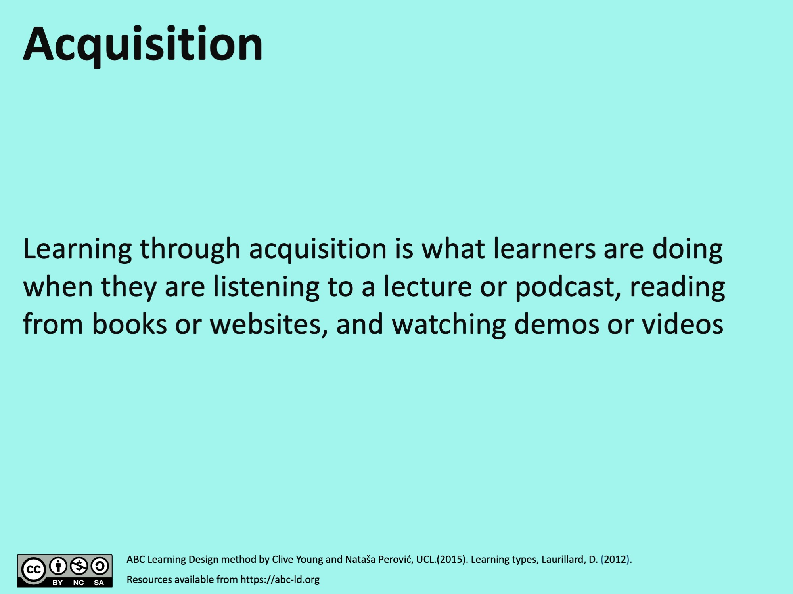
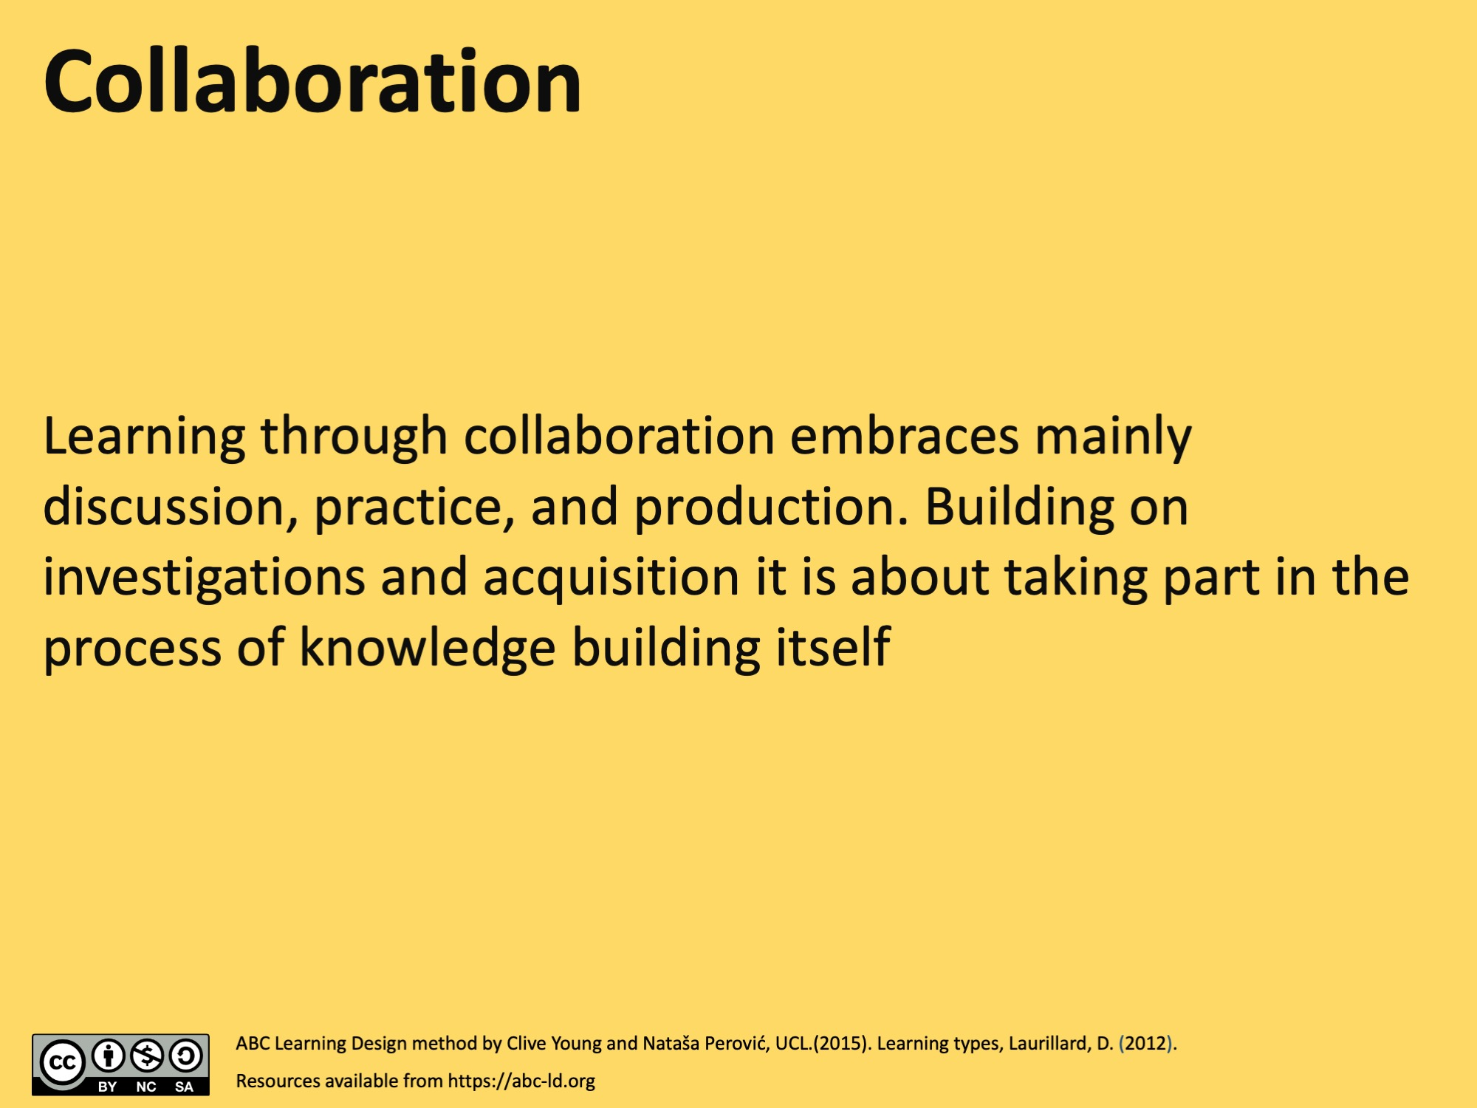
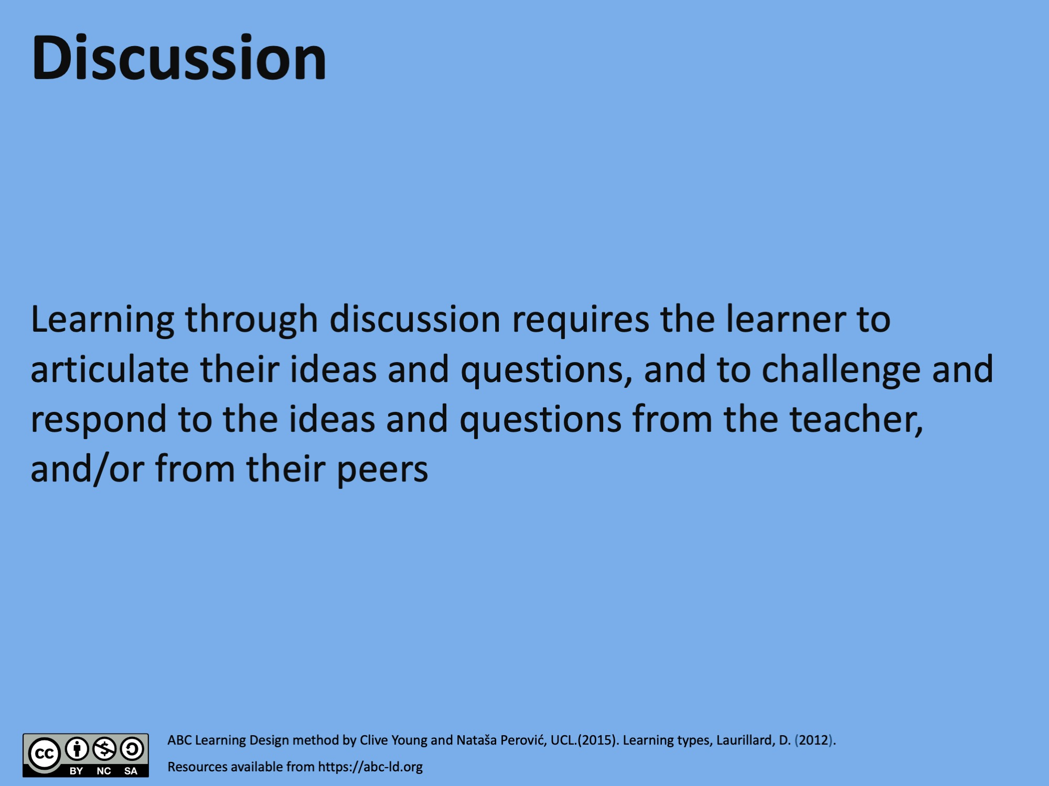
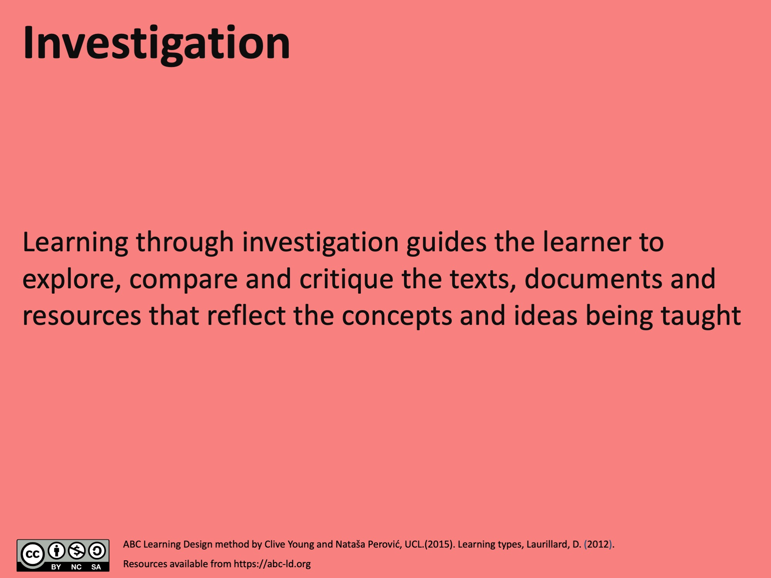
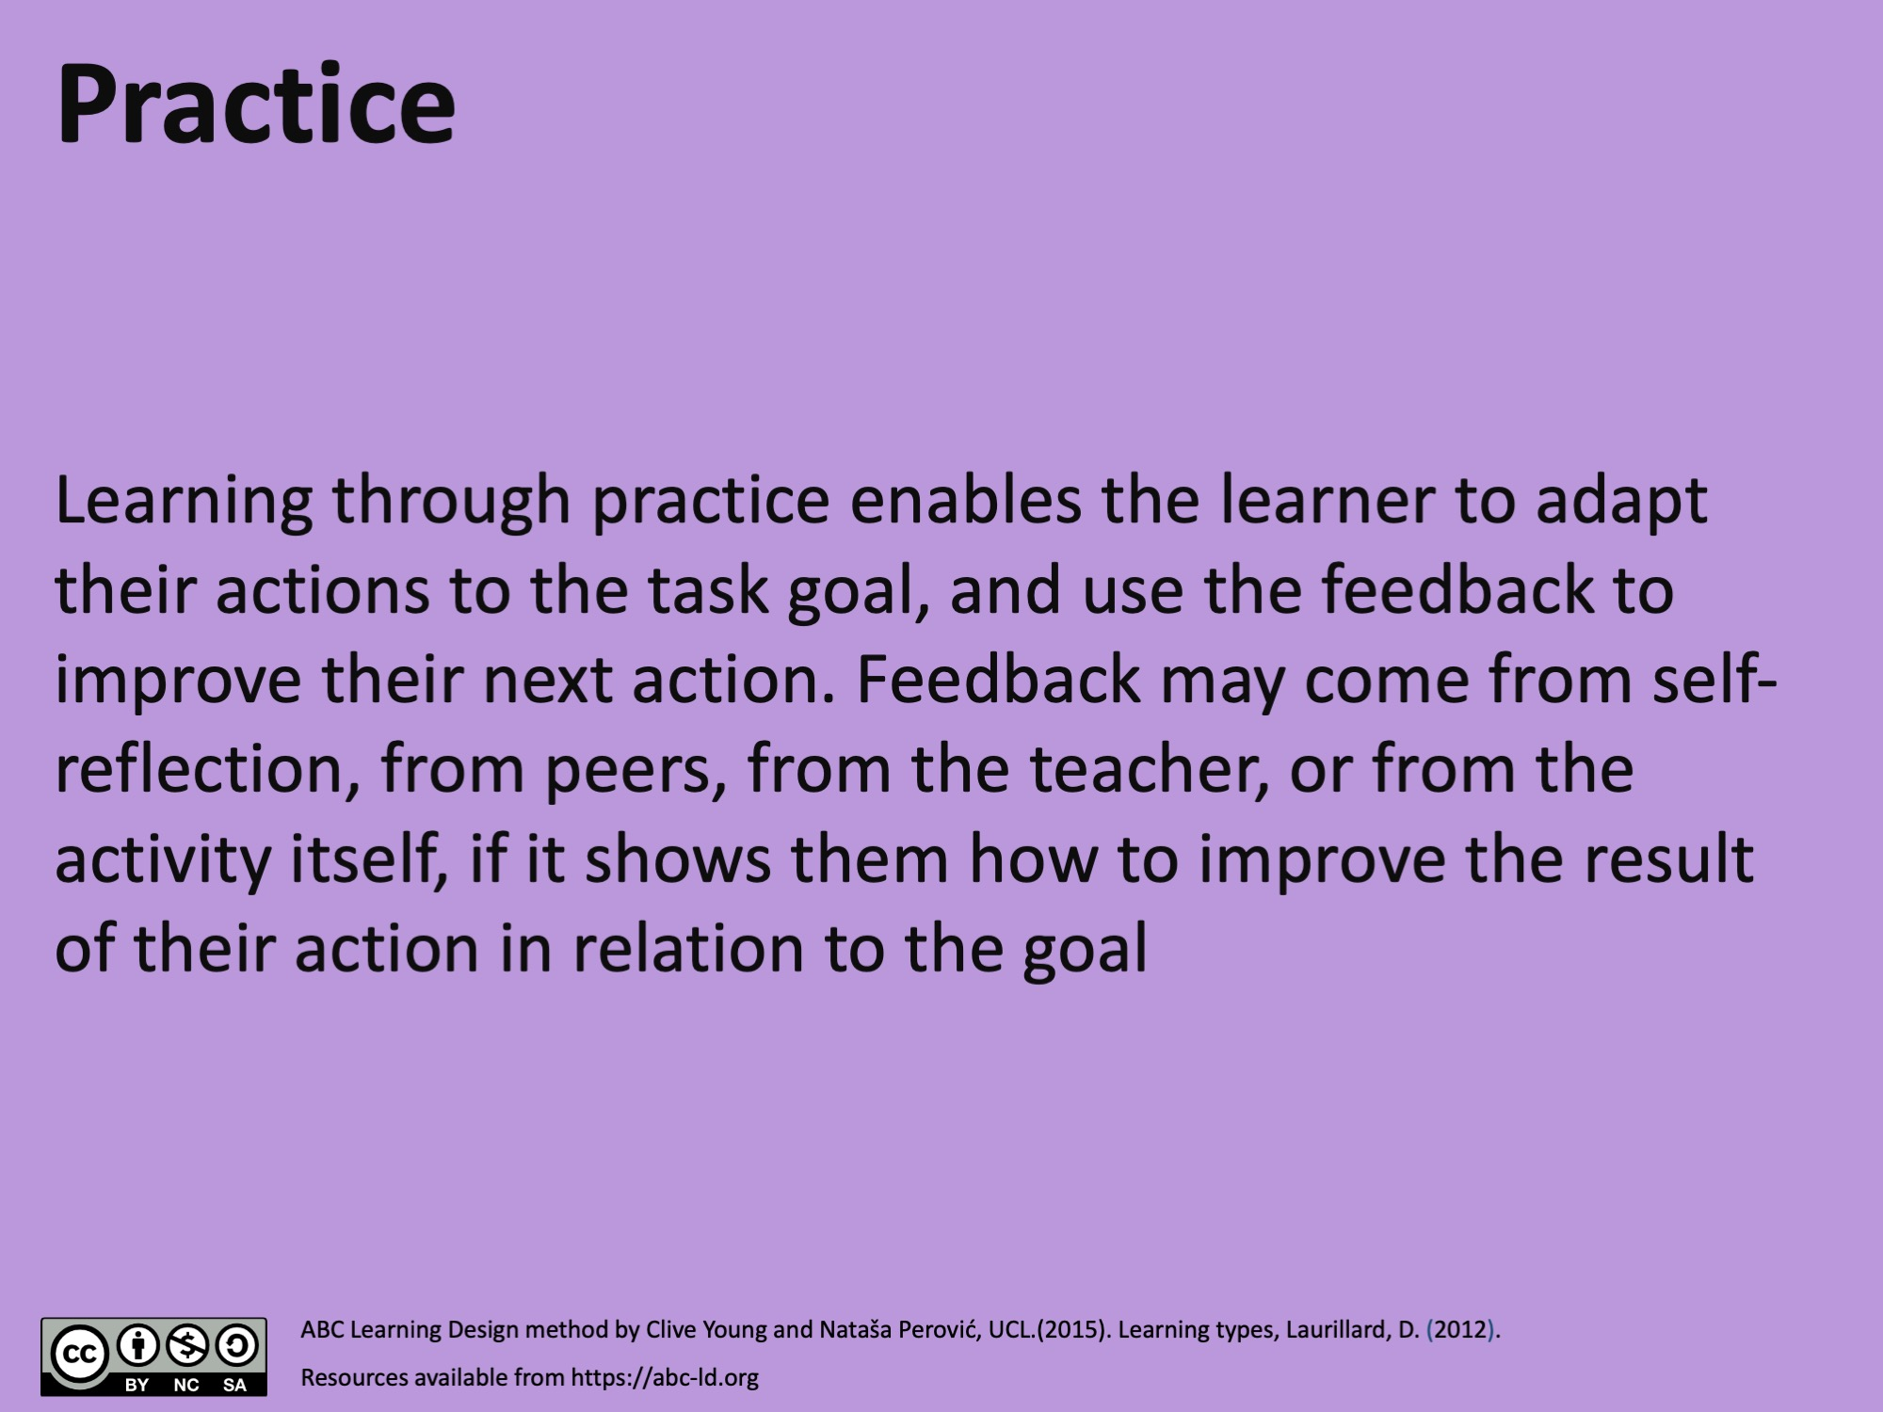
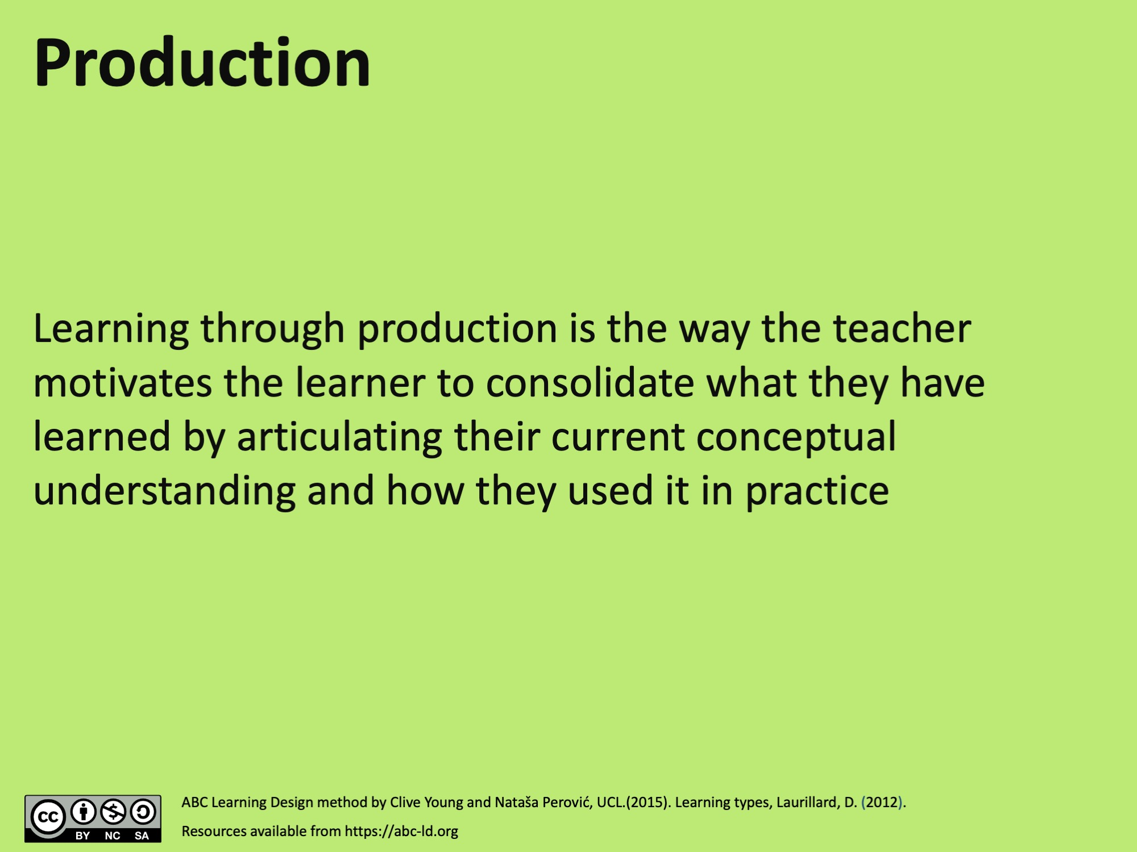
Learner Timeline worksheet
LEARNER TIMELINE
LEAD: |  |  | DATE:
E.g. Weeks or topics
E.g. Weeks or topics
E.g. Weeks or topics
E.g. Weeks or topics
ABC Learning Design Method by Clive Young and Nataša Perović, UCL. (2015). Learning types, Laurillard, D. (2012). Resources available from https://abc-ld.org
Storyboard worksheet adapted from Viewpoints Curriculum Design, University of Ulster. Available at https://ulster.atlassian.net/wiki/spaces/VIEW/overview

Slide 17
Diversifying Assessment
Crisis management scenario
Seen exam questions
Blogs
Self-critique of practice
Portfolios
Book review
Research bid
Dragons den pitch
Tender for a contract
Popular account of an experiment
Teach a concept to the class
Problem-based case scenarios
Respond to a news article
Annotated photo montage
Debates
PeerWise
Notes:
Diversifying assessment (ideas):
Crisis management scenario
Seen exam questions
Blogs
Self-critique of practice
Portfolios
Book review
Research bid
Dragons den pitch
Tender for a contract
Popular account of an experiment
Teach a concept to the class
Problem-based case scenarios
Respond to a news article
Annotated photo montage
Debates
PeerWise

Slide 18
Reflections and Plan for Day 2
Time | Activity | Duration
9.00 | Coffee | 15
9.15 | Recap of day 1 | 15
9.30 | Storyboarding continued + overlay learning outcomes | 2 ½ hours
12.00 | Lunch | 30
12.30 | Critical friend – pitch your storyboard, feedback and review | 30
13.00 | Action plan: next steps | 30
13.30 | Reflection – postcard exercise + workshop evaluation | 30
14:00 | End of day 2 | -

Slide 19
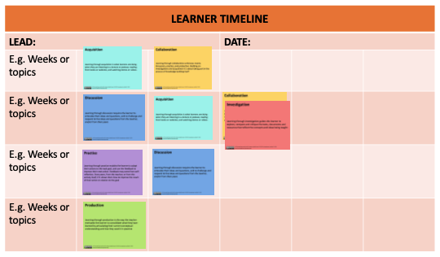
Storyboarding Continued
Do you have new ideas after reflecting on Day 1?
2 hours
Notes:
Complete the storyboard from Day 1. Storyboard stage almost always runs into day 2. This is not an issue and it has been commented that actually “sleeping on it” provides some reflection time for changes, alterations, new directions to come to light.

Slide 20
Overlay Learning Outcomes
By the end of this course the student will be able to...
1.
2.
3.
4.
5.
30 mins
Notes:
FACILITATOR: Update list of learning outcomes after Day 1

Slide 21

Critical Friend – Pitch, Feedback, Review
Explain the design thinking behind your course storyboard
Your ‘critical friend’ will then offer direct feedback on your learning design
After receiving feedback, review your design and make any adjustments
Particularly consider navigation, timings and assessment
Free to use image by ThisIsEngineering on Pexels.
45 mins
Notes:
Ask your students, colleagues, peers, and managers to come and help you for an hour or two. It’s useful if people know something about the topic but they do not have to be experts. They will be your ‘critical friends’.
Ensure that by the time the reality checkers arrive you have a storyboard ready for them to feedback on. Depending on how many activities you have designed, you may need to allow up to an hour. Ask the reality checkers to make notes on a form which has some basic guidance and they can leave with you.
(FACILITATOR: Provide form. Sit out of their way but be available in case they need help. Do not interrupt or intervene. If they ask for help, offer enough to get them started again. Do not enter into explanations but encourage them to work autonomously as much as possible.)
Ask the reality checkers to give direct feedback to the team based on their experience of trying out the activities. Ask them questions, listen and not get defensive. Ask them to leave their notes with you.
You have received your feedback from the reality checkers.
As a team, list your reality checker’s main concerns and suggestions. Talk through the impact of these comments. Decide whether you need to:
Rethink any of the components of your blueprint
Adjust your storyboard, especially consider navigation, timings and assessment
Work on immediate improvements to the activities
Take the actions you can immediately but also start to consider next steps. Before you move on, just make sure you are in a different and better place with your course than when you started (if not, why not?) on the morning of day 1.

Slide 22
Action Plan: Next Steps
What else needs doing and who will do it?
Assess the risks
Resources needed?
Set a date for your next team meeting
What post-ELDeR follow-up would be useful?
30 mins
Notes:
What else needs doing and who will do it?
Assess the risks (how are you going to find the time to complete the work, what might interfere, who else might need to be involved)?
Consider what other resources or people you need to consult or include, as well as resources that you had available but did not use.
Set clear deadlines.
Set a date for your next team meeting when you will review progress.
What post-ELDeR follow-up would be useful? This might include training, peer observation, and/or collaborative review of developments.

Slide 23

Reflection: Postcard Exercise
What have you gained from participating in the ELDeR workshop?
What 2 actions will you commit to doing in the next 3 months?
Include your work address
☺ We will send this back to you in a month’s time.
30 mins
Free to use image by Ylanite Koppens on Pexels.
Notes:
You should now write a postcard to yourself reflecting on what you have gained from participating in the ELDeR workshop. What two actions will you commit to doing in the next 3 months? Write your work address on the right-hand side and we will send this back to you in a month’s time.

Slide 24

Licence and Attribution
The ELDeR Planner, The University of Edinburgh, 2019, is adapted from The CAIeRO Planner, University of Northampton, ABC Learning Design by Clive Young and Nataša Perović, University College London, the Open University Learning Design tools and principles, and Viewpoints Curriculum Design, University of Ulster, and is similarly licensed under a Creative Commons Attribution NonCommercial ShareAlike 4.0 International License.

