Slide 1


Democracy in Theory and Practice
9. The Future of Democracy: Innovations and Reforms
Dr Max Jaede, 2020

Slide 2

Recap of last week
Deliberative democrats argue that public justification and debate can enhance the quality and legitimacy of decision-making in modern liberal democracies
Agonistic or radical pluralists are critical of deliberative democracy and highlight positive aspects of certain forms of political conflict

Slide 3
Outline of this class
Referendums and citizen initiatives
Participatory governance and budgeting
Deliberative mini-publics

Slide 4

Referendums and citizen initiatives

Slide 5
Referendums
Referendums (or referenda) are votes on a single issue which may be binding or (formally) advisory
As exercises in direct democracy, referendums are meant to increase citizen participation and to decide important political/constitutional matters
Often they require a minimum turnout or a super-majority
Worldwide, the number of referendums tripled in the 1990s and has remained at a high level since then

Slide 6
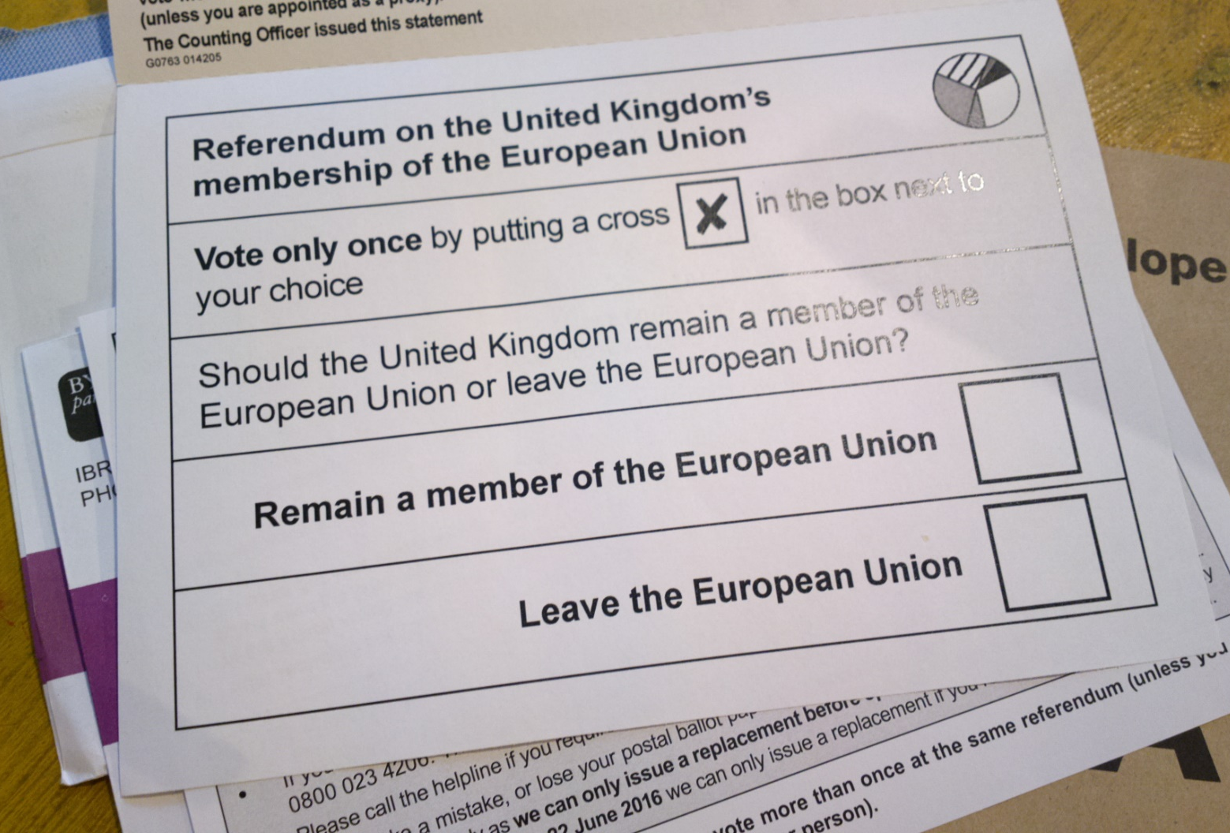
The Brexit referendum In 2016 the UK held a referndum on whether the country should leave the European Union (EU). 52% voted in favour of leaving, and 48% voted in favour of remaining a member of the EU. Leave won the majority of votes in England and Wales, though not in Scotland and Northern Ireland.
EU referendum ballot paper, by hugovk, 2016, CC BY-NC-SA 2.0, https://www.flickr.com/photos/ hugovk/27417772170

Slide 7
Referendums in the UK since the 1990s
1997 Welsh devolution: 50.3% Yes 49.7% No
1997 Scottish devolution: 74/64% Yes 26/36% No
1998 Greater London Authority: 72% Yes 28% No
1998 Good Friday Agreement: 71% Yes 29% No
2004 North East England devolution: 22% Yes 78% No
2011 Welsh further devolution: 63% Yes 37% No
2011 UK Alternative Vote: 32% Yes 68% No
2014 Scottish independence: 45% Yes 55% No

Slide 8
The pros and cons of referendums
Referendums are very inclusive and, if designed well, give clear results with a high level of legitimacy
But, referendums may reduce complex issues to binary either/or choices, which prevent compromise and serious consideration of the trade-offs involved
Politicians can interpret vague propositions according to their own preferences (e.g., what does ‘leave the EU’ mean?)
Voters can only hold themselves to account for the outcome of a referendum – unlike in periodic elections

Slide 9
Citizen initiatives
Citizen initiatives allow a certain number of citizens to achieve a certain objective, such as:
to hold a debate in parliament (e.g. e-petitions in the UK);
to recall an office-holder;
to put a proposition to a referendum;
to introduce legislation.
This democratic mechanism originated in Switzerland and has been adopted by other countries (and the EU), though it is less common than referendums

Slide 10
Participatory governance and budgeting

Slide 11
Participatory governance and budgeting
Public institutions are experimenting with various participatory arrangements which seek to ensure cooperation with stakeholders and (self- or purposefully selected) citizens
Participatory budgeting (PB) is a process which allows citizens to take part in deciding how public resources should be allocated, typically at the local level
Participedia.net is a global database on democratic innovations such as PB.

Slide 12
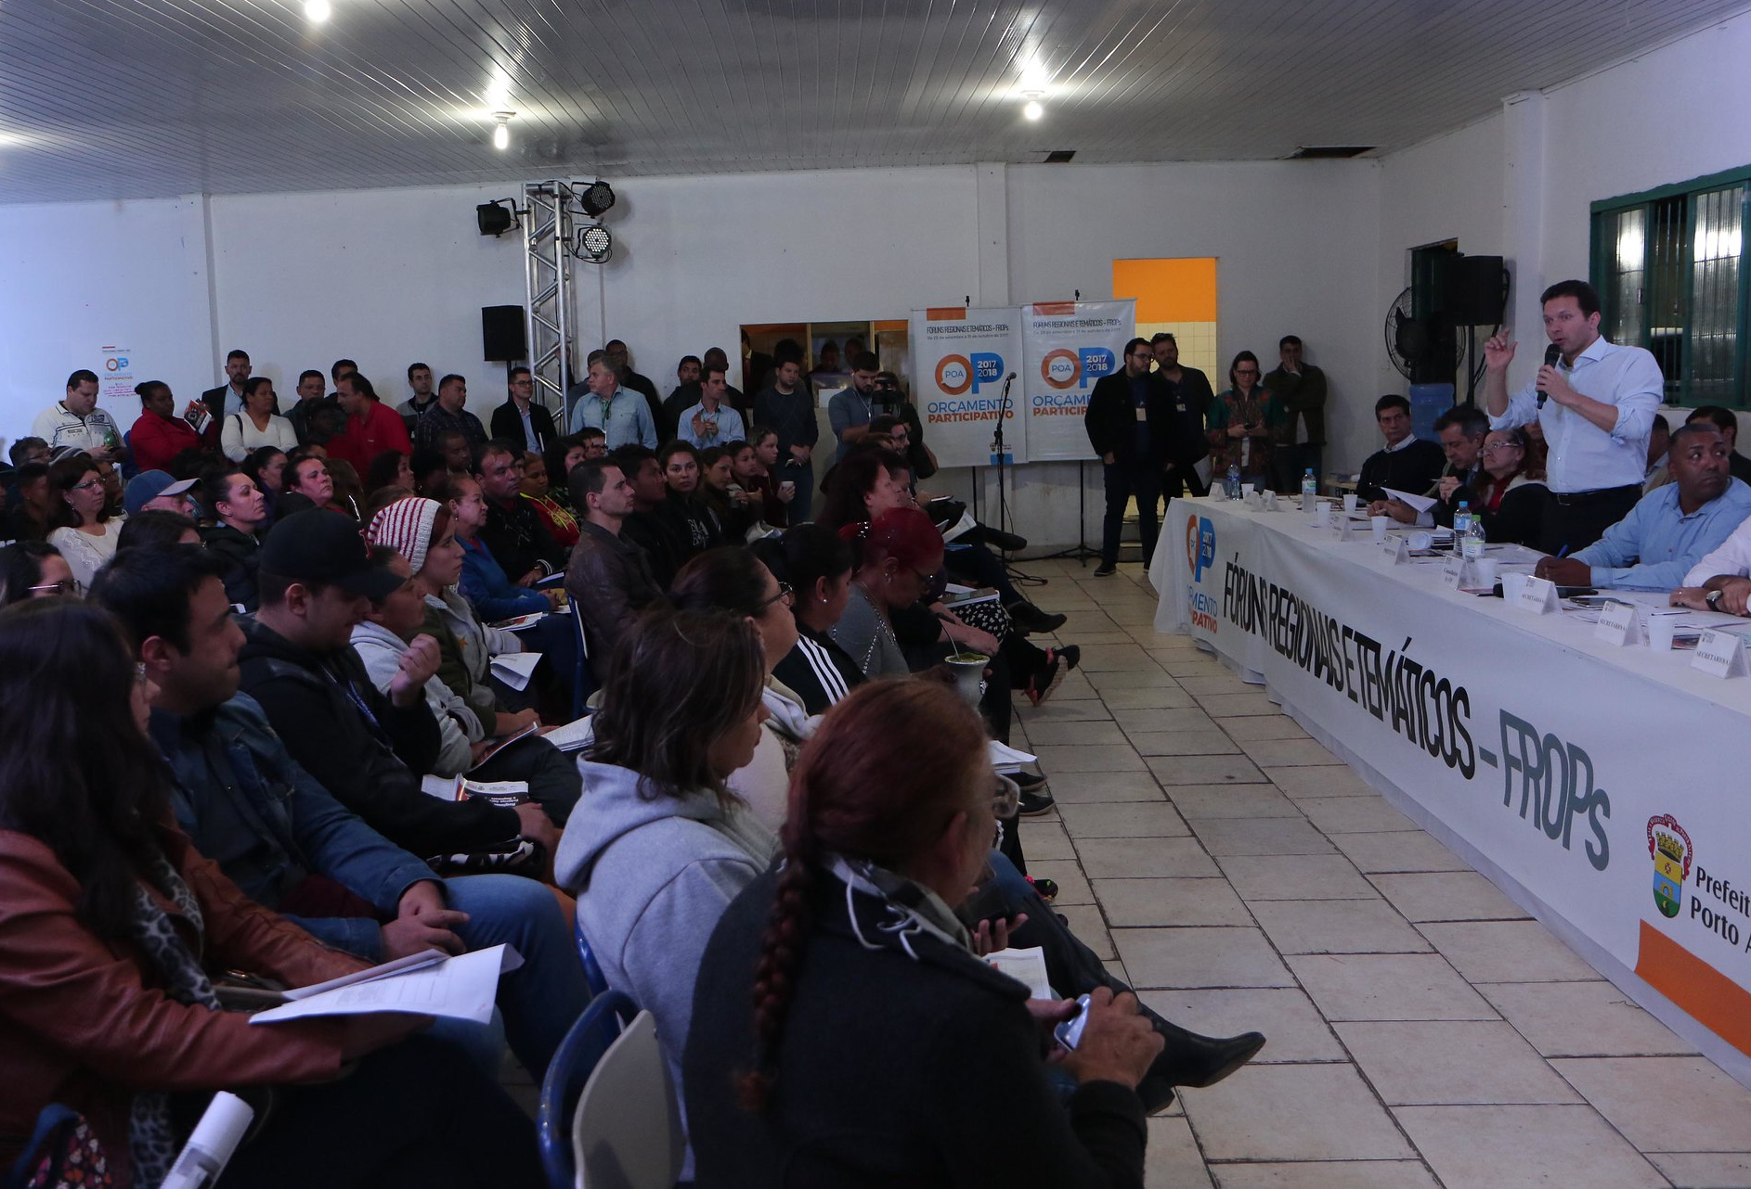
Participatory budgeting in Brazil Porto Alegre in Brazil was the first city to involve citizens in local governance through participatory budget allocation. PB is held on a yearly cycle, and has been repeated every year since 1989. Participation in PB has grown over time, reaching 50,000 citizens by 2004. Participation from underrepresented groups (low-income, women, people without formal education) has been particularly high.
Orcamento Participativo, by Prefeitura de Porto Alegre, 2017, CC BY-NC-SA 2.0, https:/www.flickr.com/ photos/48286463@N08/37433549616/

Slide 13
Participatory budgeting in Scotland
The Scottish Government supports PB across Scotland, including through small grants for community groups which are selected through PB (Community Choices Fund)
Council Leaders have committed to a target of 1% of council budgets to be subject to PB by 2021
Public institutions and stakeholders have created a PB Charter which sets out key principles (pbscotland.scot/charter)

Slide 14
Deliberative mini-publics

Slide 15
Deliberative mini-publics
‘Mini-publics’ are forums of randomly selected citizens which are representative of the wider electorate
The focus is on deliberation (weighing options and making choices), as opposed to dialogue (building mutual understanding) or debate (winning an argument)
Participants are exposed to different perspectives, re-examine their preferences, and seek to find some level of agreement to inform political decision-making

Slide 16
Types of mini-public
Citizens’ jury: a small group of citizens (12-25) that come together to reach a collective decision or recommendation on a policy issue
Citizens’ assembly: larger than a citizens’ jury (usually 30-160 people) and more intensive (often meetings over several weekends)
Deliberative polling: combines techniques of public opinion research and public deliberation

Slide 17
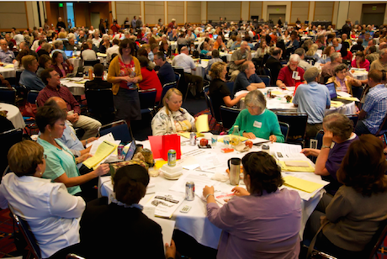
The Irish Citizens’ Assembly Established by the Irish parliament in 2016, the Citizens’ Assembly was as a deliberative body of 99 randomly selected citizens who considered a number of topics including the eighth constitutional amendment, which outlawed abortion. The findings were published at the end of 2017 and debated in parliament in 2018. In the same year, a referendum was passed to remove the ban on abortion.
The Irish Citizens’ Assembly, by B. Hennig, 2016, CC BY-NC 4.0, https://www.opendemocracy.net/en/ opendemocracyuk/irish-citizens-assembly-on-abortion-democratisation-or-dodging-responsibility/

Slide 18
The view from the inside
‘My experience shows that some of the most polarising issues can be tackled in this manner. […] I felt empowered and informed – it gave me the language and skills to have difficult discussions. In a room of 100 people, only a handful ever tried to create division or build walls among us. I think most people want to find things to agree on and to discover common ground – through this we can always learn new ways to go forward.’
Louise Caldwell, a randomly selected member of the 2016 Irish Citizens’ Assembly on abortion and other issues, The Guardian, 16 Jan 2019

Slide 19
Citizens’ Assembly of Scotland (2019-20)
Comprises 130 citizens broadly representative of the adult population
Meets over six weekends from October 2019 to April 2020 to consider:
what kind of country are we seeking to build
how best can we overcome the challenges Scotland and the world face in the 21st century, including those arising from Brexit, and
what further work should be carried out to give us the information we need to make informed choices about the future of the country
The report on Scotland’s future will be laid before the Scottish Parliament for scrutiny and debate, and the Scottish Government has committed to act on recommendations within 90 days

Slide 20
UK Climate Change Assembly (2020)
Set up by six Select Committees of the House of Commons to understand public preferences on how the UK should tackle climate change
The assembly has 100 randomly selected members, who together are representative of the UK population
Meetings over four weekends from January to March 2020
Members will hear evidence on the choices the UK faces, discuss them, and make recommendations about what the UK should do to become ‘net zero’ by 2050

Slide 21
Experiences with mini-publics so far
Examples from around the world show that deliberative mini-publics can and do influence public policy, but their impacts vary and are often indirect
Procedural design matters, e.g. publicity or the use of independent facilitators can limit elite power
The effectiveness of mini-publics depends on the public legitimacy of the process and, ultimately, the willingness of politicians or policymakers to act on the recommendations

Slide 22
Institutional reforms
Some scholars view mini-publics as preliminary experiments for more large-scale, participatory democratic practices
Alternatively, mini-publics could become institutionalised as permanent features of democracy
The ‘Ostbelgian model’: in 2019 the German speaking community of Belgium set up a permanent Citizen Council, consisting of 24 members, which will work with temporary citizens’ assemblies and propose policy recommendations to the elected parliament
In the UK, there are proposals to replace the House of Lords with a permanent citizens’ chamber

Slide 23
Summary and discussion

Slide 24
Summary
Referendums are highly inclusive but may reduce complex matters to binary choices, and there is a potential problem with accountability for the result
Participatory budgeting allows citizens to take part in deciding how public resources should be allocated, often at the local level
Deliberative mini-publics are representative citizen bodies intended to facilitate collective preference formation and informed decision-making on important policy issues

Slide 25
Discussion questions
How has democracy in the UK changed since 1918? (Gamble, 2019)
What are the similarities and differences between the various ‘democratic innovations’ discussed by Elstub and Escobar (2019)?
Do you think citizens‘ assemblies can play a positive role in shaping governance and public policy?

Slide 26
Reference list
Curato, N. et al., 2017. Twelve Key Findings in Deliberative Democracy Research. Daedalus, 146(3), pp. 28-38.
Elstub, S. and Escobar, O., 2019. Defining and Typologising Democratic Innovations. In: Elstub, S. and Escobar, O. eds. The Handbook of Democratic Innovation and Governance. Cheltenham: Edward Elgar. Ch. 1.
Fishkin, J.S., 2018. Democracy When the People Are Thinking: Revitalizing Our Politics Through Public Deliberation. Oxford: Oxford University Press.
Gamble, A., 2019. A Hundred Years of British Democracy. In Gamble, A. and Wright, T. eds. Rethinking Democracy. Oxford: Wiley. Ch. 3.

Slide 27

This presentation is an Open Educational Resource. It was originally created for a lifelong learning course (SCQF level 7) at the Centre for Open Learning. You are free to use, share, and adapt this work. To view a copy of the license, visit https://creativecommons.org/licenses/by-sa/4.0/
© Max Jaede, University of Edinburgh, 2020, CC BY-SA 4.0

Slide 28

Centre for Open Learning The University of Edinburgh Paterson’s Land Holyrood Road Edinburgh EH8 8AQ T: 0131 6504400 E: col@ed.ac.uk W: www.ed.ac.uk/open-learning Facebook: www.facebook.com/uoeshortcourses Twitter: www.twitter.com/uoeshortcourses

