Slide 1


Democracy in Theory and Practice
8. The Future of Democracy: Alternative Models
Dr Max Jaede, 2020

Slide 2

Recap of last week
Democratic theory has traditionally assumed that the fate of a society is largely is in its own hands
The nature of the international system and globalisation raise doubts about this assumption
Theories of cosmopolitan democracy advocate extending and deepening democracy beyond the state

Slide 3
Outline of this class
The challenges facing modern democracies
Theories of deliberative democracy
Theories of agonistic pluralism

Slide 4

The challenges facing modern democracies

Slide 5
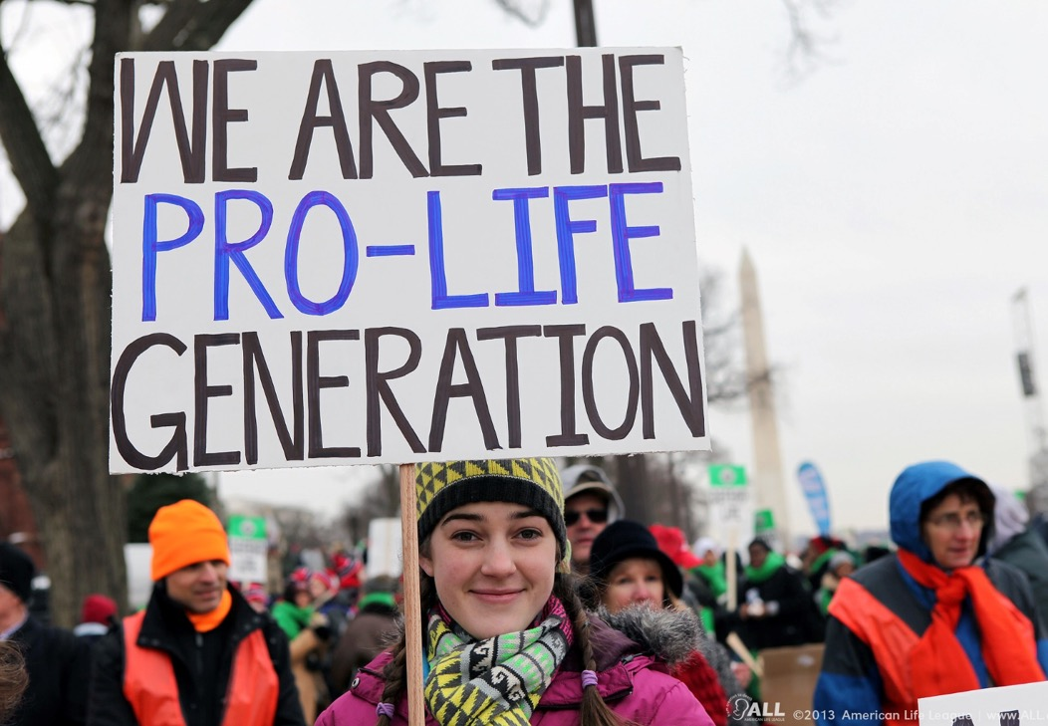
Moral conflict In western societies, individuals and groups disagree on a number of deeply held moral values. These concern issues such as abortion, marriage, gender norms, the family, and religion. Liberal democracies are often faced with a dilemma between tolerating alternative ways of life and promoting equality and individual rights.
2013 March for Life, by American Life League, CC BY-NC 2.0, https://www.flickr.com/photos/americanlifeleague/8429292177

Slide 6
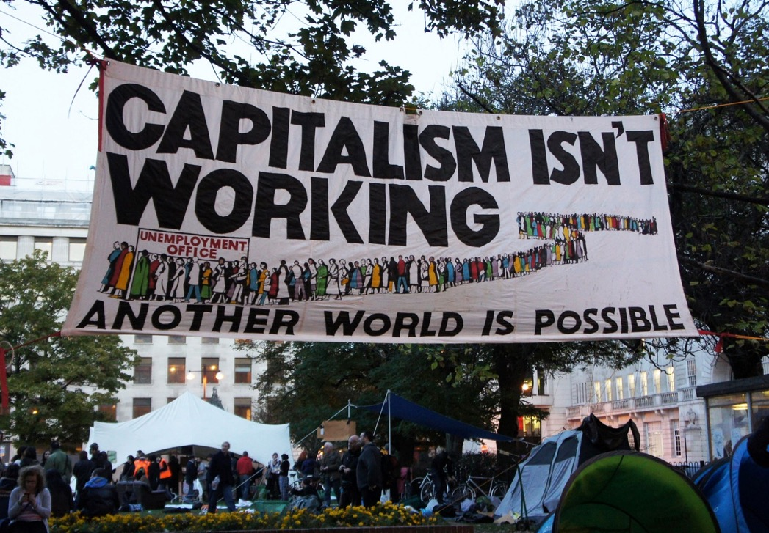
Global capitalism in crisis After the end of the Cold War, most political actors agreed that there is no alternative to global capitalism. The decade after the financial crisis of 2007–08 has seen a rejection of neoliberal policies in light of social and environmental concerns, as well as a resurgence of economic nationalism.
Capitalism Isn’t Working, by J. MItchell, 2011, CC BY-SA 2.0, https://www.flickr.com/photos/jamesmitchell/6273922558

Slide 7

Populism We are experiencing a wave of ‘populism’. This term is used (often pejoratively) to describe a style of politics which pitches ‘we the people’ – embodied in a leader who expresses their supposedly unified will – against a ‘corrupt elite’. Populism is often seen as a threat to liberal democracy, though some also consider it to be a corrective to the ‘depoliticising’ tendencies in liberal constitutionalism.
Donald Trump Campaign Rally, by G. Skidmore, 2016, CC BY-SA 2.0, https://www.flickr.com/photos/gageskidmore/25858555481/

Slide 8
Theories of deliberative democracy

Slide 9
Theories of deliberative democracy
Deliberative democratic theories developed in response to perceived deficiencies in democratic practice, including:
Poor quality of decision-making: short-sighted, ill-informed, and purely self-interested political decisions
Lack of legitimacy: citizens’ non-participation and disinterest in the political process
These theories focus on the formation of collective preferences through public deliberation, as opposed to the mere aggregation of pre-existing individual preferences

Slide 10
Origins of deliberative democracy
In ancient Greek democracies, all citizens had the right to speak in the law-making assembly
Aristotle was among the first to praise the wisdom of the multitude: ‘although individually they may be worse judges than those who have special knowledge, as a body they are as good or better’ (Politics, Book III, Ch.11)
In the modern period, deliberation has been linked to political representation and the perceived need to ‘refine and enlarge’ the views of the people (James Madison)

Slide 11
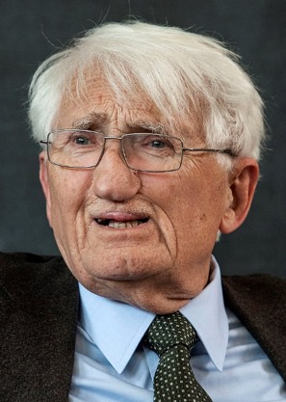
Habermas on rational discourse
Jürgen Habermas (1929–), a German philosopher and sociologist, played a leading role in reviving the idea of deliberation in the late 20th century
He theorised the ideal of rational consensus, guided by impartial reasoning, as a criterion for democratic legitimacy
Under conditions of ideal discourse, ‘no force except that of the better argument is exercised’ (Habermas, 1976, p.108 cited in Held, 2006, p.238)
Jürgen Habermas, by Európa Pont, 2014, CC BY 2.0, via Flickr

Slide 12
Deliberation under non-ideal conditions
Other deliberative democrats, such as Gutman and Thompson (2004), reject the ideal of an impartial rational consensus
In their view, deliberation in the real world cannot resolve all moral disagreements
But, deliberative democracy can clarify and narrow disagreements, facilitate accommodation based on mutual respect, and enhance the legitimacy of collective decisions

Slide 13
Examples of deliberative democracy
Constitutional conventions are a classic example of deliberative democracy
Legislatures are the most important formal discussion arena in modern democracies, but parliamentary debates usually fall short of the standards of deliberative democracy
In more recent years, theories of deliberative democracy have inspired democratic innovations such as citizens’ assemblies and deliberative polls

Slide 14
Deliberation and ‘post-truth’ politics
There are concerns about post-truth politics, characterised by the brazen denial of objectively verifiable claims and the spread of misinformation via social media
Deliberation requires a certain level of adherence to shared facts and deliberative norms
Questions about the status of expert knowledge vis-à-vis ordinary citizens participating in public discourse

Slide 15
Deliberation and power inequalities
Obstacles to deliberative democracy include the distorting influences of educational differences, structural inequalities, elite control over the agendas of deliberation, and ‘hegemonic discourses’ (Young, 2001)
On the other hand, deliberative processes may also help to hold the powerful to account
Can you think of situations where inequalities could undermine deliberation?

Slide 16
Theories of agonistic pluralism

Slide 17
Classical pluralism
‘Pluralism’ generally refers to theories which maintain that many parties or organisations co-exist and have access to political power
Agonistic pluralism is a more radical democratic theory than classical pluralism, which developed after World War II and focused on the ways in which interest (or pressure) groups compete over political influence (see Held, 2006, ch.6)

Slide 18

Agonistic pluralism
Chantal Mouffe (1943–) is one of the main proponents of agonistic pluralism, along with Bonnie Honig, William E. Connolly and others
The term is derived from the Greek agon (a dramatic or athletic contest)
Agonistic pluralists argue that conflict – including conflict over the rules of the game – is an inevitable part of political life, in which different actors assert their collective identities and struggle for power and hegemony
Chantal Mouffe, by Columbia GSAPP, 2014, CC BY 2.0, via Flickr

Slide 19
Agonism and antagonism
‘[Democratic politics] presupposes that the “other” is no longer seen as an enemy to be destroyed, but as an “adversary”, i.e., somebody with whose ideas we are going to struggle but whose right to defend those ideas we will not put into question. […] An adversary is a legitimate enemy, an enemy with whom we have in common a shared adhesion to the ethico-political principles of democracy. […] We could say that the aim of democratic politics is to transform an “antagonism” into an “agonism.”’
Chantal Mouffe (1999, p.755)

Slide 20
Against deliberative democracy
For Mouffe and others, deliberative democracy is the latest attempt by liberals to suppress political conflict
Due to the pervasiveness of power relations, agonistic pluralists question the possibility of free, unconstrained public deliberation leading to rational decisions on political questions
At best, what can be achieved is a temporary ‘conflictual consensus’ between political adversaries

Slide 21
Populism and the future of democracy
Mouffe (1999, p.756) originally argued that the survival of democracy ‘depends on collective identities forming around clearly differentiated positions’, that is, a clear left-right opposition
More recently, she has advocated left-wing populism to counter right-wing populism (Mouffe, For a Left Populism, 2018)
In her view, the left must provide an alternative (non-xenophobic) conception of ‘the people’ and the ‘establishment’ to mobilise popular support

Slide 22
Summary and discussion

Slide 23
Summary
Public deliberation has always played some role in democratic theory and practice
Deliberative democrats argue that public justification and debate can enhance the quality and legitimacy of decision-making in modern liberal democracies
Agonistic or radical pluralists are critical of deliberative democracy, and highlight positive aspects of certain forms of political conflict (possibly including populist politics)

Slide 24
Discussion questions
How do Gutman and Thompson (2004, pp.1-7) use the example of the Iraq War to illustrate the main features and potential of deliberative democracy?
How democratic is deliberation? What purposes does it serve?
Do you think that deliberative democracy or agonistic pluralism can help to address the challenges facing democracies today?

Slide 25
Reference list
Gutmann, A. and Thompson, D., 2004. What Deliberative Democracy Means. In: Why Deliberative Democracy? Princeton: Princeton University Press. Ch. 1, especially pp.1-21.
Held, D., 2006. Deliberative Democracy and the Defence of the Public Realm. In: Models of Democracy. 3rd ed. Cambridge: Polity. Ch. 9.
Mouffe, C., 1999. Deliberative Democracy or Agonistic Pluralism? Social Research, 66(3), pp. 745-758.
Mouffe, C., 2018. For a Left Populism. London: Verso.
Young, I.M., 2001. Activist Challenges to Deliberative Democracy. Political Theory 29(5), pp. 670-690.

Slide 26

This presentation is an Open Educational Resource. It was originally created for a lifelong learning course (SCQF level 7) at the Centre for Open Learning. You are free to use, share, and adapt this work. To view a copy of the license, visit https://creativecommons.org/licenses/by-sa/4.0/
© Max Jaede, University of Edinburgh, 2020, CC BY-SA 4.0

Slide 27

Centre for Open Learning The University of Edinburgh Paterson’s Land Holyrood Road Edinburgh EH8 8AQ T: 0131 6504400 E: col@ed.ac.uk W: www.ed.ac.uk/open-learning Facebook: www.facebook.com/uoeshortcourses Twitter: www.twitter.com/uoeshortcourses

