Slide 1


Democracy in Theory and Practice
6. Modern Democracy: The Role of the State
Dr Max Jaede, 2020

Slide 2

Recap of last week
Political parties and elite competition are key features of modern representative democracies
Political representation involves authorisation (of representatives) and accountability (towards the electorate)

Slide 3
Outline of this class
The rise of economic planning and the welfare state
The neoliberal critique of modern democracy
Democracy and the economy

Slide 4

The rise of economic planning and the welfare state

Slide 5
Capitalism and socialism
Economic systems and theories provide an important context for modern democracy:
Capitalism advocates a free market economy in which the means of production are privately owned and economic activity is directed by supply and demand
By contrast, a socialist economic system is characterised by central planning and public ownership of the means of production

Slide 6
Marx and Engels on liberal democracy
‘Each step in the development of the bourgeoisie was accompanied by a corresponding political advance of that class […]. The bourgeoisie has at last, since the establishment of modern industry and of the world market, conquered for itself, in the modern representative state, exclusive political sway. The executive of the modern state is but a committee for managing the common affairs of the whole bourgeoisie.’
Marx and Engels, The Communist Manifesto (1848, Ch.1)

Slide 7
Social democracy
The extension of voting rights, introduction of pay for MPs (1911 in the UK) and other reforms improved the democratic representation of working-class interests
The British Labour Party grew out of the trade union movement of the late 19th century
The ideology of social democracy, which advocates a peaceful evolutionary transition from capitalism to socialism, developed as an alternative to revolutionary socialism

Slide 8
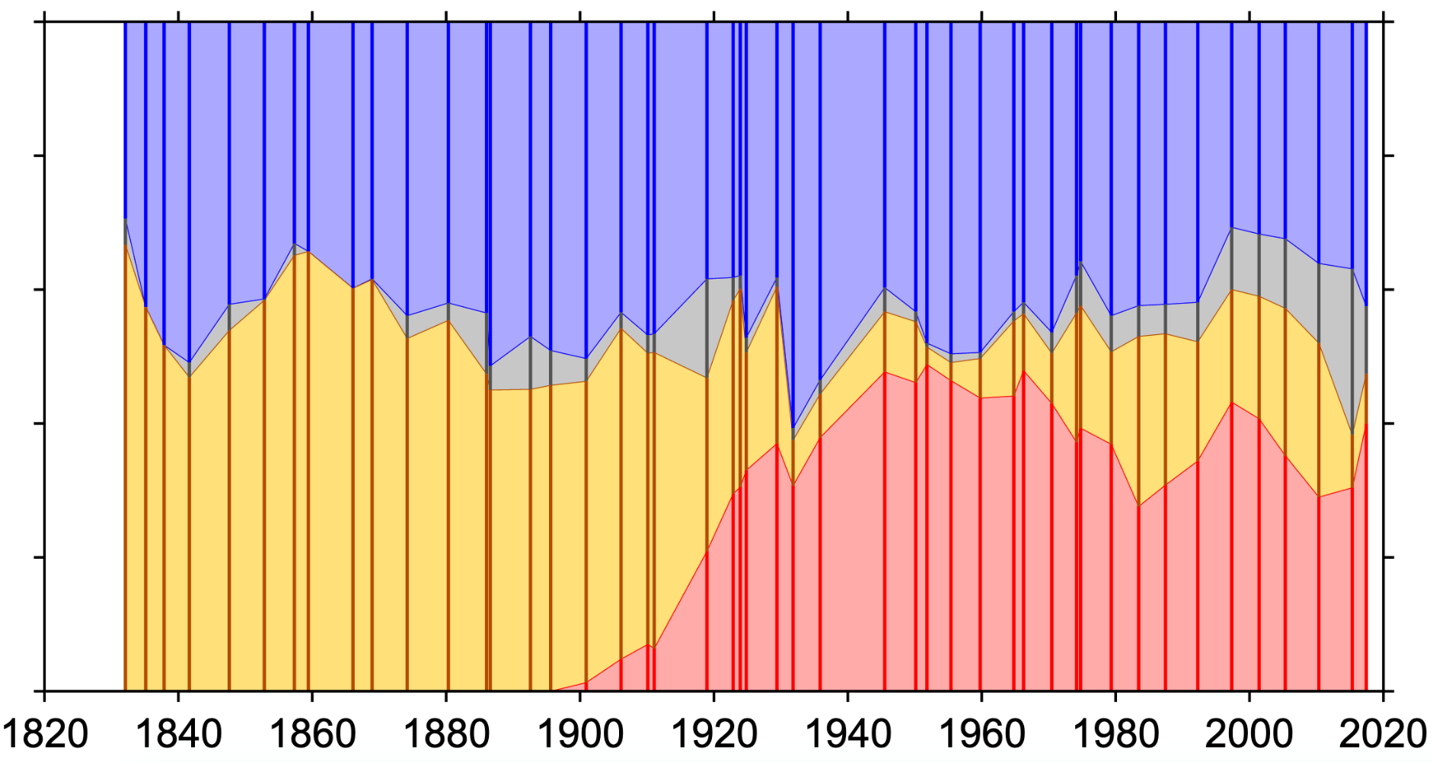
UK election results
Shares of the vote in general elections received by Conservatives (blue), Whigs/Liberals/Liberal Democrats[ (yellow), Labour (red) and other parties (grey).
UK popular vote, 2010, CC BY-SA 3.0, https://en.wikipedia.org/wiki/List_of_United_Kingdom_general_elections#/media/File:UK_popular_vote.svg

Slide 9
State welfare and economic planning
After World War II, there was widespread agreement in the UK and other countries that the state should correct and compensate for the deficiencies of the market (‘post-war consensus’)
Labour governments introduced extensive social security provision from 1945 onwards
The welfare state was meant to combat five ‘giant evils’: squalor, ignorance, want, idleness, and disease
‘Keynesian’ economic policy: state interventions in the economy to manage levels of demand and unemployment

Slide 10
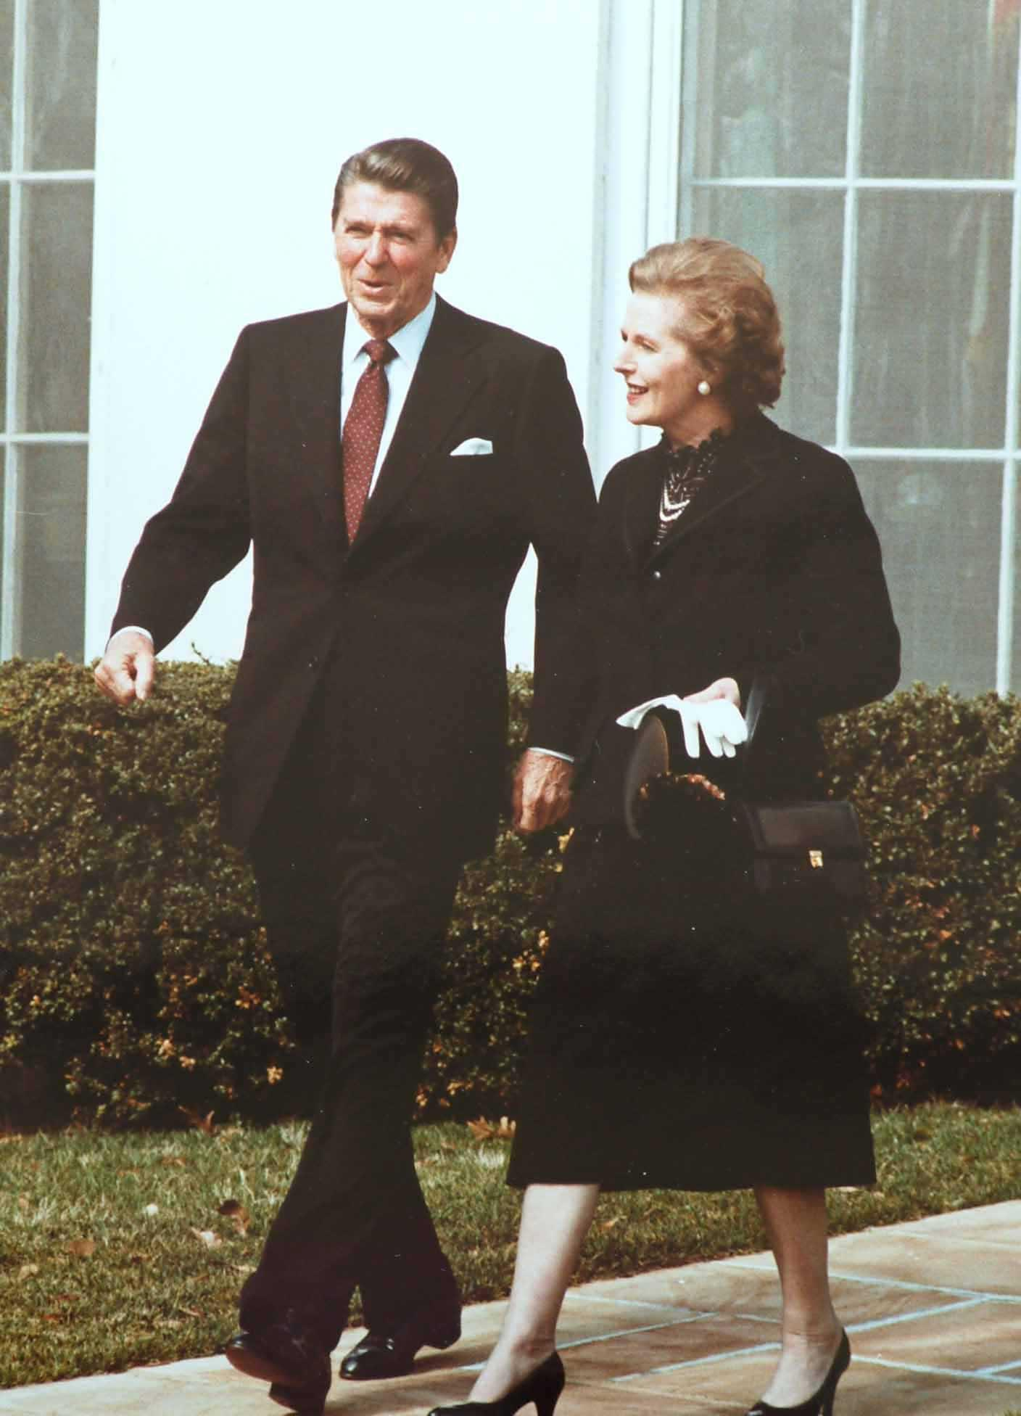
‘Rolling back the state’
Ronald Reagan, US President from 1981-89, and Margaret Thatcher, UK Prime Minister from 1979-90, were leading early proponents of ‘neoliberal’ reforms, including tax reduction, deregulation, marketisation, privatisation, cuts to government spending, and economic policies designed to control inflation rather than stimulate economic growth.
Margaret Thatcher with Ronald Reagan, White House Photographic Office, 1981, https://commons.wikimedia.org/wiki/File:Reagan_Thatcher.jpg

Slide 11
The neoliberal critique of modern democracy

Slide 12
Constitutional limits of democracy
The liberal tradition of political thought sees the state as a potential threat to individual liberties
Liberal constitutionalism holds that political power must be legally restrained
Liberals have always advocated the rule of law, constitutionally guaranteed rights, and a separation of powers to prevent arbitrary government and a ‘tyranny of the majority’

Slide 13
Arguments for a ‘minimal state’
Neoliberal thinkers such as Robert Nozick and Friedrich von Hayek reclaimed and further developed these classical liberal ideas
In their view, the expanding welfare state infringes upon individual liberty and property rights, denying citizens the right to choose their own ends
The only legitimate role of the state is to enforce property rights and laws of contract, issue and control money, and protect citizens from aggression (Dryzek and Dunleavy, 2009, p.108)

Slide 14
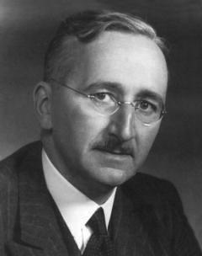
Hayek on liberty and democracy
Friedrich von Hayek (1899-1992), a Nobel Prize-winning
Austrian-born British economist, inspired politicians
such as Reagan and Thatcher
He warned against ‘making a fetish of democracy’ and
oppressive uses of democratic power (Hayek, 1976,
cited in Held, 2006, p.204)
Hayek draws a distinction between law (general, universal rules required to regulate social interaction), and legislation (commands directed towards achieving specific ends)
F.A. Hayek, by Mises Institute, 2009, CC BY-SA 3.0, via Wikimedia Commons

Slide 15
Problems with democratic government
Neoliberal and rational choice theorists have highlighted deficiencies of democratic practice which may limit individual freedom and economic efficiency
Self-interested pressure groups, voters, bureaucrats, and politicians place growing demands on the state, which therefore plays an ever-increasing role in social and economic life
The co-called ‘overloaded government’ thesis is one version of this argument (Held, 2006, pp.190-201)

Slide 16
The neoliberal agenda
Key policy goals include the shrinking of government, deregulation, tax cuts, privatisation, and the uses of market mechanisms in the public sector
To implement these policies, neoliberals have favoured constitutional arrangements which limit the power of social actors and facilitate strong leadership by a president, prime minister – or even a dictator as in Chile in the 1970s and 80s

Slide 17
Democracy and the economy

Slide 18
Property-owning democracy
Classical republican thinkers such as Rousseau have long been concerned with private property and its effects on the liberty and the independence of citizens
In the UK, different views on ‘property-owning democracy’ developed since the 1920s (Jackson, 2012)
Conservatives promoted home ownership to turn workers into small-scale capitalists
Liberals and social democrats argued for a wider distribution of property, as opposed to a concentration in state or capitalist hands

Slide 19
Blair on citizen-consumers
‘People do want choice, in public services as in other services […]. Choice puts the levers in the hands of parents and patients so that they as citizens and consumers can be a driving force for improvement in their public services. We are proposing to put an entirely different dynamic in place to drive our public services; one where the service will be driven not by the government or by the manager but by the user – the patient, the parent, the pupil and the law-abiding citizen.’
Tony Blair, quoted in The Guardian, 24 June 2004

Slide 20

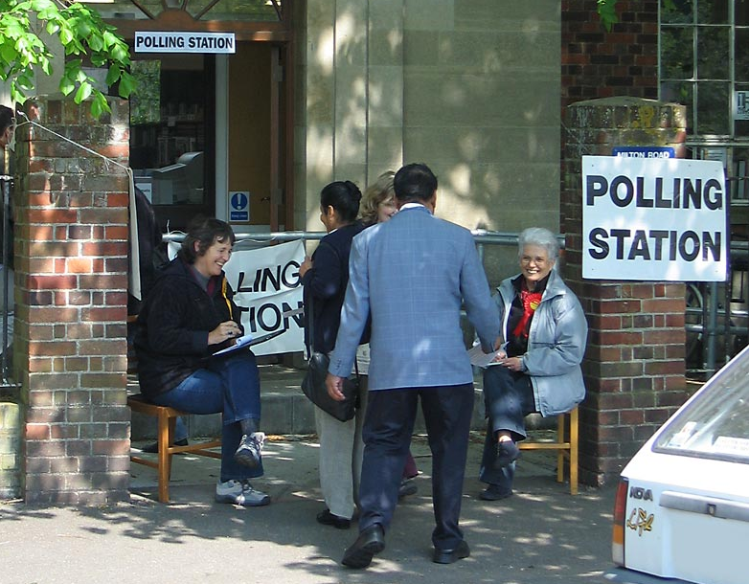
Democracy and the market
Do you have more influence as a consumer or as a citizen?
Food Market at Sanremo, by T. Jokl, 2009, CC BY-NC 2.0, https://www.flickr.com/photos/tmjokl/33250758098/
Polling Station in the UK, by A. Dunn, 2005, CC BY-SA 2.0, https://commons.wikimedia.org/wiki/File:PollingStation_UK_2005.jpg

Slide 21
Economisation of democracy
Critics of capitalism highlight threats posed by corporate power and growing social inequality
According to Wendy Brown (2015), democracy is undermined by ‘neoliberal reason’ which subsumes political activities to a project of capital enhancement
Neoliberal states focus on economic growth, global competitiveness, and maintaining a strong credit rating
Individual citizens are only valued as ‘human capital’

Slide 22
Global markets
Today’s democracies are exposed to the pressures of global markets and multinational corporations (MNCs)
International organisations, including the World Trade Organisation (WTO) and the International Monetary Fund (IMF), promote free-market, neoliberal policies
This is known as the ‘Washington consensus’

Slide 23
Summary and discussion

Slide 24
Summary
There are different views on the legitimate role of the democratic state vis-à-vis the private sphere and the market
The rise of the welfare state and economic planning over the course of the 20th century has prompted a backlash from neoliberal theorists and reformers
Critics argue that market mechanisms and ‘neoliberal reason’ are hollowing out democracy from within

Slide 25
Discussion questions
What role should a democratic state play in citizens’ lives? And who gets to decide that?
In what ways do markets and economic ideas shape the reality of democracy in today’s world?

Slide 26
Reference list
Brown, W., 2015. Undoing Democracy: Neoliberalism’s Remaking of State and Subject. In: Undoing the Demos Neoliberalism's Stealth Revolution. New York: Zone Books. Ch. 1.
Dryzek, J.S. and Dunleavy, P., 2009. Market Liberalism. In: Theories of the Democratic State. Basingstoke: Palgrave Macmillan. Ch. 5.
Held, D., 2006. From Postwar Stability to Political Crisis: The Polarization of Political Ideals. In: Models of Democracy. 3rd ed. Cambridge: Polity. Ch. 7.
Jackson, B., 2012. Property-Owning Democracy: A Short History. In: O’Neill, M. and Williamson, T. eds. Property-Owning Democracy: Rawls and Beyond. Malden, MA: Wiley-Blackwell. Ch. 2.

Slide 27

This presentation is an Open Educational Resource. It was originally created for a lifelong learning course (SCQF level 7) at the Centre for Open Learning. You are free to use, share, and adapt this work. To view a copy of the license, visit https://creativecommons.org/licenses/by-sa/4.0/
© Max Jaede, University of Edinburgh, 2020, CC BY-SA 4.0

Slide 28

Centre for Open Learning
The University of Edinburgh
Paterson’s Land
Holyrood Road
Edinburgh EH8 8AQ
T: 0131 6504400
E: col@ed.ac.uk
W: www.ed.ac.uk/open-learning
Facebook: www.facebook.com/uoeshortcourses
Twitter: www.twitter.com/uoeshortcourses

