Slide 1


Democracy in Theory and Practice
5. Modern Democracy: Representative Government
Dr Max Jaede, 2020

Slide 2

Recap of last week
Key ideas of liberal constitutionalism include the rule of law; constitutionally guaranteed citizen rights; a separation of powers (executive, legislative, judicial)
Although liberal constitutionalism emerged in European monarchies, its principles have shaped the development of modern mass democracies

Slide 3
Outline of this class
Presidential and parliamentary systems of government
Elections and voting systems
Political parties and political leadership
Democratic representation

Slide 4

Presidential and parliamentary systems of government

Slide 5
Systems of government
In the broadest sense, ‘government’ includes all public institutions that make and implement political decisions, including the three branches of government:
  Executive, which implements and enforces the law
  Legislature, a parliament which makes the law
  Judiciary, a system of courts which interpret and apply the law
In a narrower sense, ‘government’ may refer to the executive only (prime minister or president, cabinet, other ministers, and the government bureaucracy)

Slide 6
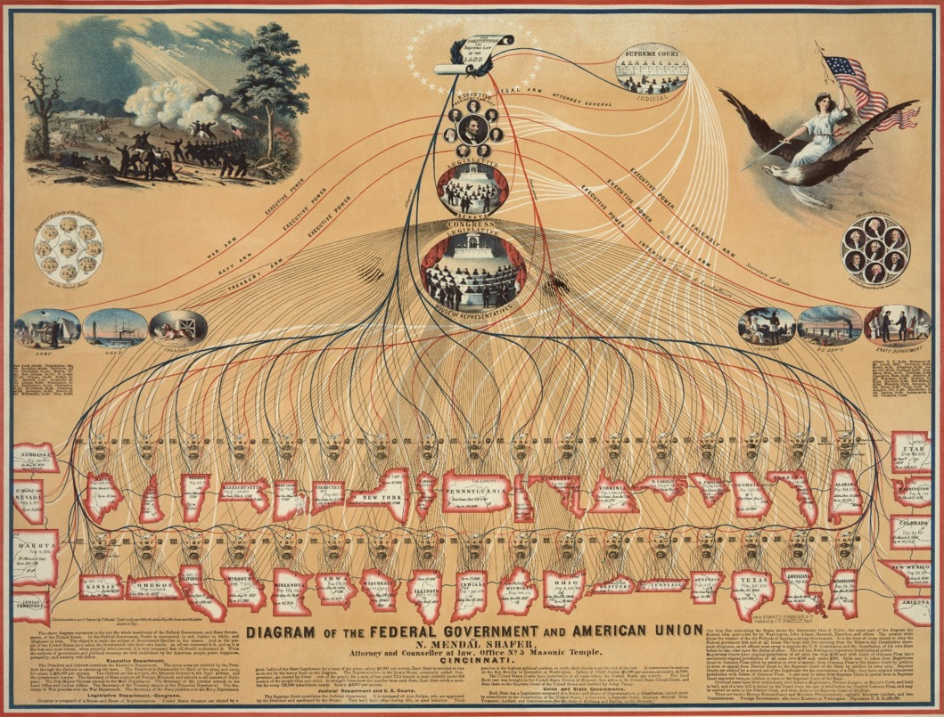
US government system
This organisational chart from the mid-19th century depicts the different parts of the US federal government and the institutions of the then 42 states, as well as the relationships between them.
Diagram of the Federal Government and American Union, by N.M. Shafer, 1862, Library of Congress, https://commons.wikimedia.org/wiki/File:Diagram_of_the_Federal_Government_and_American_Union_edit.jpg

Slide 7
Three types of government system
The structure and power dynamics of government vary across states, and there are three main types:
Parliamentary systems (e.g. UK, most Western European states, Australia, India, Japan)
Semi-presidential systems (e.g. France, Poland, Portugal, Ukraine, Russia)
Presidential systems (e.g. US, most Latin American states, Nigeria, South Korea)

Slide 8
Election of the head of state
The most obvious difference between different systems is whether or not there is a popularly elected head of state (‘president’)
In (semi-)presidential systems, the people elect a a parliament and a president (directly or via an electoral college) – this usually results in a clear separation of powers
In parliamentary systems, people only elect the parliament, which then selects (not necessarily elects) the executive – in practice, this leads to a ‘fusion’ of executive and legislative powers

Slide 9
Legislative confidence
A second major difference between government systems concerns whether or not the legislature can force the executive to resign
If the executive is selected by parliament, it usually also depends on the confidence of parliament
Popularly elected presidents generally do not depend on legislative confidence (there may be an exceptional process of impeachment in the event of presidential misconduct)

Slide 10
Legitimacy and accountability
The basic structure of government has important implications for government legitimacy and accountability
(Semi-)presidential systems may create a problem of dual legitimacy – both president and parliament can claim to represent the people
In parliamentary systems, the cabinet is collectively accountable to the legislature (a successful motion of no-confidence usually leads to a general election)
Popularly elected presidents are accountable to the electorate at the next election (but exception of ‘lame duck’ presidents)

Slide 11
Elections and voting systems

Slide 12
Elections
Elections are a method of assessing preferences through votes
All modern states – including democratic and authoritarian states – hold elections (growth of democratically disguised dictatorships since the 1990s)
All states hold parliamentary elections, in which members of a constituency (voting district) choose their representatives
In presidential and semi-presidential states, there are parliamentary and presidential elections

Slide 13
Electoral systems
In practice it is difficult to ascertain ‘objective’ electoral majorities, especially when there are three or more choices
A range of voting systems are currently in use, and the choice of system can have dramatic effects on the outcome
  E.g. US presidential election 2016: Donald Trump received 304 Electoral College votes and Hillary Clinton 227, even though Clinton received almost three million more popular votes (65,853,514 to 62,984,828)

Slide 14
Three types of electoral system
Majoritarian systems
  ‘First-past-the-post’ (FPTP), also known as ‘single-member plurality’ (SMP) (e.g. UK, US, India)
  Alternative vote (e.g. Australia) or two-round system (e.g. France)
Proportional representation (PR)
  Party list (e.g. the Netherlands, Israel, Brazil)
  Single transferable vote (e.g. Ireland, Scottish council elections since 2007)
Mixed systems
  Mixed-member PR (e.g. Scottish Parliament, Germany, New Zealand)

Slide 15
First-past-the-post
FPTP tends to exaggerate the margin of victory, and is therefore associated with strong single-party governments
  E.g. 2015 UK general election: Conservatives won 330 out of 650 seats with 36.8 % of the vote
It can facilitate a strong opposition and disadvantages extreme parties (e.g. UKIP, Brexit Party)
But, it may contribute to minorities being under-represented and can lead to large number of ‘wasted votes’

Slide 16
Proportional representation
PR is aimed at reflecting a wide range of opinions, rather than producing ‘strong and stable’ majorities
It allows a greater chance of representation to small parties, but may lead to a fragmentation of the party system and tends to result in coalition governments
Small parties may have disproportionate influence (but this can also happen in a FPTP system, e.g. DUP 2017-19)

Slide 17
Mixed systems
In mixed-member systems, some seats are elected on the basis of simple majority and some on the basis of PR
There is a global tendency for electoral reform to move from FPTP to mixed or PR systems
Have you voted in elections that use different electoral systems? Did the system affect your vote in any way?

Slide 18
The structure of legislatures
One third of parliaments worldwide has two chambers (‘bicameral’), the rest has one chamber (‘unicameral’)
Reasons for having a second chamber include:
  Representation of the aristocracy (e.g. historically the House of Lords)
  Federalism (e.g. US, Germany, India – but not in the UK)
  Improved legislation (?)
One or both chambers may have veto power, and there are different mechanisms to achieve compromise

Slide 19
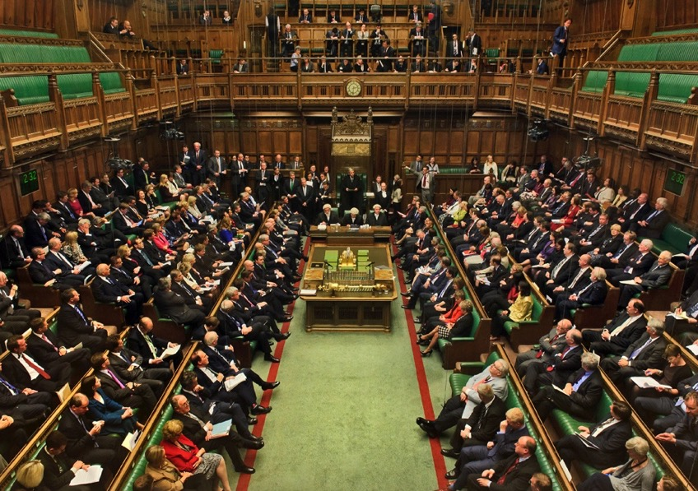
The House of Commons (lower house in the UK)
House of Commons: MPs debate 2013 Queen's Speech, by UK Parliament, 2013, CC BY-NC 2.0, https://www.flickr.com/photos/uk_parliament/8737181234

Slide 20
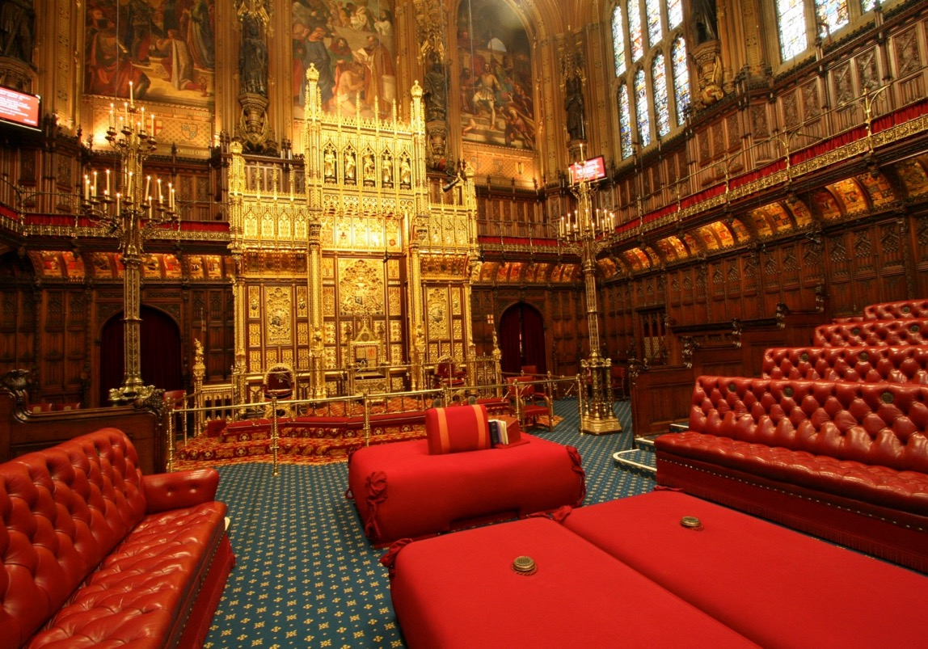
The House of Lords (upper house in the UK)
House of Lords Chamber, by UK Parliament, 2008, CC BY-NC-ND 2.0, https://www.flickr.com/photos/uk_parliament/2701203046/

Slide 21
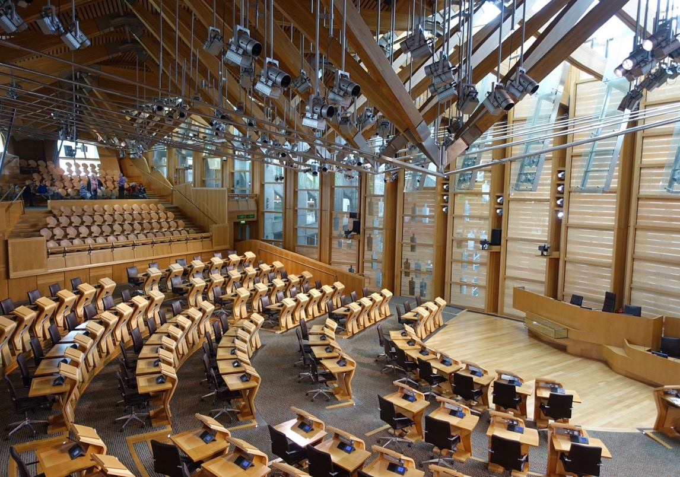
The Scottish Parliament (single chamber)
Scottish Parliament, by S. Munson, 2015, CC BY-NC-ND 2.0, https://www.flickr.com/photos/logicalrealist/24548113674/

Slide 22
The role of MPs
‘Your representative owes to you, not his industry only, but his judgement; and he betrays, instead of serving you, if he sacrifices it to your opinion. […] Parliament is a deliberative assembly of one nation.’
Edmund Burke (1774)
‘I believe passionately in the institution of Parliament and in the rights of members of this House and in their commitment to their duty. The solemn duty of every MP is to do what he or she thinks is right.’
John Bercow (then Speaker of the House of Commons, in an address to MPs in response to criticism by Prime Minister Theresa May, 2019)

Slide 23
Political parties and political leadership

Slide 24
The emergence of political parties
The first political parties were loose coalitions of independently elected MPs (e.g. in the UK)
Modern mass parties developed after the widening of the electoral franchise in order to mobilise public support (earliest example is US Democratic Party in 1828 – electoral turnout increased from 30% to 50% within 4 years)
In the second half of the 20th century, many evolved into ‘catch-all’ parties which aim to attract people with diverse political views

Slide 25
Competition for political power
Parties run increasingly professionalised, capital-intensive campaigns, while membership has declined in many democracies (exceptions of Labour and the SNP in the UK)
Parties are often associated with corruption and self-serving, power-hungry elites
But, competing for positions in government is a defining feature of political parties – as opposed to other types of organisation, such as NGOs, interest groups or trade unions

Slide 26
Functions of political parties
In both democratic and authoritarian states, parties fulfil various functions, including:
Legitimation of the political system
Recruiting of candidates for public office (including heads of government, government ministers, and MPs)
Mobilisation of citizens
Representation and aggregating of diverse interests
Formulation of public policy

Slide 27
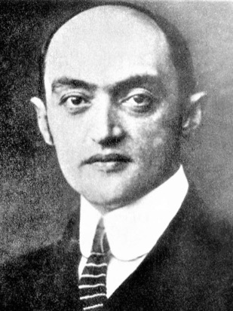
Schumpeter on political leaders
Joseph Schumpeter (1883-1950), an Austrian-born US
economist, provided an influential ‘realist’ or minimalist
definition of democracy
In his book Capitalism, Socialism and Democracy (1942),
he argued that democracy is merely a method of
selecting leaders from among competing political elites
(= political parties)
In his view, parliament is merely an intermediate organ between leaders and voters, and the latter are largely ignorant
Joseph Schumpeter, CC BY-SA 3.0, via Wikimedia Commons

Slide 28
‘Fooling the people’
‘[E]ven if there were no political groups trying to influence him [sic], the typical citizen would in political matters tend to yield to extra-rational or irrational prejudice and impulse. […] Human Nature in politics being what it is, [political leaders] are able to fashion and, within very wide limits, even to create the will of the people. What we are confronted with in the analysis of the political processes is largely not a genuine but manufactured will. […] So far as this is so, the will of the people is the product and not the motive of power in the political process.’
Joseph Schumpeter (1942, p.263)

Slide 29
Democratic representation

Slide 30
The concept of representation
Following Jean-Jacques Rousseau (1712-1778), many democratic theorists have long been critical of representation
More recently, democratic theory has paid increasing attention to the problems and potential of political representation (Urbinati and Warren, 2008)
Authorisation and accountability are generally regarded as the two key components of democratic representation

Slide 31




Limitations of territorial representation
The geographical nature of constituencies means that non-territorial interests may not be adequately represented through elections in territorial constituencies – e.g. LGBTQ:

Slide 32
Concerns about fairness and exclusion
Democratic theorists have been particularly concerned with the exclusion of historically marginalised groups, including those based on class, gender and ethnicity
Institutions of representative democracy may replicate patterns of disadvantage (Lovenduski, 2019)
In addition, there are concerns about fairness with regard to non-proportional electoral systems (PR may be advocated on the grounds of group representation or political equality)

Slide 33
Non-electoral representation
Electoral representation is increasingly complemented by different forms of non-electoral representation
‘Self-authorised’ representation by interest groups, social movements, etc. – also ‘surrogate representatives’ within electoral institutions (e.g. MPs who claim to speak for women or ethnic minorities)
In addition, there are different mechanisms to consult (self-selected or randomly selected) citizen representatives, e.g. public hearings, deliberative polling, citizens’ assemblies, etc.

Slide 34
Summary and discussion

Slide 35
Summary
The structure of government (presidential/parliamentary systems) has implications for the power dynamics between different branches (executive, legislative, judicial), and for the legitimacy and accountability of political institutions
Political parties and elite competition are key features of modern representative democracies
Political representation involves processes of authorisation and accountability

Slide 36
Discussion questions
Do you feel that your interests and concerns are adequately represented in political decision-making?
How representative are different electoral systems, such as first-past-the-post and PR?
Do you agree with Lovenduski (2019, p.21) that ‘political institutions […] are organised around men’s lives and interests’?

Slide 37
Reference list
Held, D., 2006. Competitive Elitism and the Technocratic Vision. In: Models of Democracy. 3rd ed. Cambridge: Polity. Ch. 5.
Lovenduski, J., 2019. Feminist Reflections on Representative Democracy. In Gamble, A. and Wright, T. eds. Rethinking Democracy. Oxford: Wiley. Ch. 3.
Moran, M., 2015. Politics and Governance in the UK. 3rd ed. London: Palgrave.
Urbinati, N. and Warren, M.E., 2008. The Concept of Representation in Contemporary Democratic Theory. Annual Review of Political Science, 11(1), pp. 387-412.

Slide 38

This presentation is an Open Educational Resource. It was originally created for a lifelong learning course (SCQF level 7) at the Centre for Open Learning. You are free to use, share, and adapt this work. To view a copy of the license, visit https://creativecommons.org/licenses/by-sa/4.0/
© Max Jaede, University of Edinburgh, 2020, CC BY-SA 4.0

Slide 39

Centre for Open Learning
The University of Edinburgh
Paterson’s Land
Holyrood Road
Edinburgh EH8 8AQ
T: 0131 6504400
E: col@ed.ac.uk
W: www.ed.ac.uk/open-learning
Facebook: www.facebook.com/uoeshortcourses
Twitter: www.twitter.com/uoeshortcourses

