Slide 1


Democracy in Theory and Practice
4. Classic Models: Liberal Constitutionalism
Dr Max Jaede, 2020

Slide 2

Recap of last week
Civic republicanism developed from the Italian Renaissance and was inspired by ancient Rome, as opposed to ancient Greece/Athens
The value of political participation is one of the central themes in the republican tradition
This tradition has been ‘rediscovered’ in the 20th century as a possible alternative to liberalism

Slide 3
Outline of this class
The philosophical underpinnings of liberalism
Constitutional checks and balances
The triumph of election

Slide 4

The philosophical underpinnings of liberalism

Slide 5
Absolutism
The doctrine and practice of ‘absolutism’, which developed in Europe from the mid-16th to the end of the 18th century, provided the backdrop for the development of liberal thought
The central tenet of absolutism is that the authority of a ruler should not be subject to any legal or political constraints (e.g. Louis XIV of France)
This contributed to the consolidation of state power, reducing the influence of the church and the nobility
Absolutism was justified in terms of the ‘divine right of kings’

Slide 6
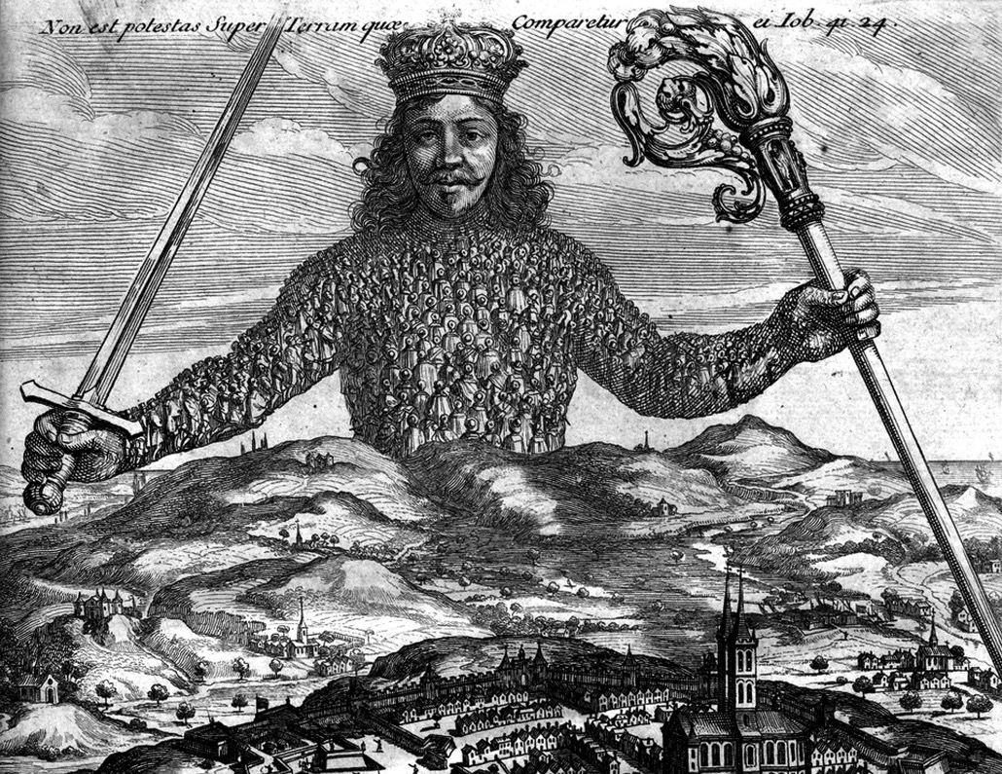
Re-imagining the state: Hobbes’s Leviathan
Frontispiece of Leviathan by Thomas Hobbes; engraving, by A. Bosse, 1651, image in the public domain, https://commons.wikimedia.org/wiki/File:Leviathan_by_Thomas_Hobbes.jpg

Slide 7
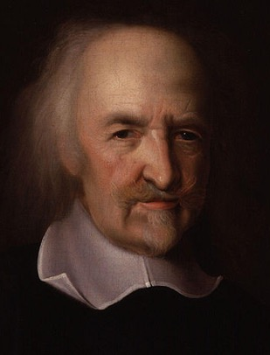
Hobbes on political authority
Thomas Hobbes (1588-1679) was an English
philosopher whose main works were published around
the time of the British Civil Wars
He thought of individuals as naturally free and equal,
and sought to provide a rational basis for the political
authority of a ‘sovereign’ ruler
Hobbes did not arrive at liberal political conclusions, but his ideas influenced later liberal thought (methodological individualism; idea of a warlike ‘state of nature’; social contract)
Thomas Hobbes, by John Michael Wright, image in the public domain, via Wikimedia Commons

Slide 8
The creation of the state
‘The only way to establish a common power that can defend [people] from the invasion of foreigners and the injuries of one another […] is to confer all their power and strength on one man, or one assembly of men, so as to turn all their wills by a majority vote into a single will. […] They are unified in that they constitute one single person, created through a covenant of every man with every other man […]. He who carries this person is called SOVEREIGN, and said to have sovereign power, and all the others are his SUBJECTS.‘
Hobbes, Leviathan (Ch.17)

Slide 9


The creation of the state (cont.)
‘I hereby declare that I will obey the sovereign…’
Sovereign
Subjects
Individuals make mutual agreements in which they promise to obey a ‘sovereign’
This ‘social contract’ unites individuals and creates a common power (the state)

Slide 10
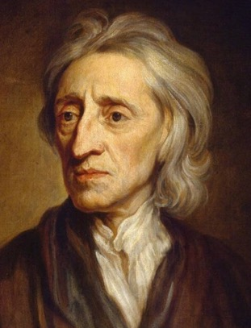
Locke on legitimate government
John Locke (1632-1704), another English philosopher,
is considered to be a ‘founding father’ of liberalism
His Two Treatises of Government were published
shortly after the ‘Glorious Revolution’ of 1688, which
marked a shift from an absolute monarchy to a
constitutional monarchy
Locke developed Hobbes’s ideas of the state of nature and a social contract to establish criteria for legitimate government
John Locke, by Godfrey Kneller, image in the public domain, via Wikimedia Commons

Slide 11
Natural rights and consent
Locke’s starting point is that individuals have natural rights to life, liberty, and property (Second Treatise, Ch.2)
Unlike Hobbes, he argues that people also have a moral duty to protect these natural rights (Ch.2)
In order to do this more effectively, individuals must consent to establish society and government (Ch.8)
Consent is not unconditional: rulers who fail to respect natural rights ‘put themselves into a state of war with the people’ (Ch.19)

Slide 12
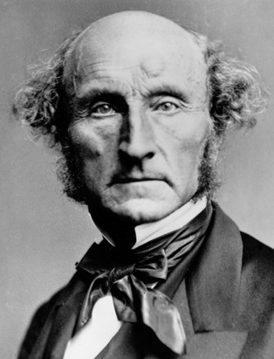
Mill’s harm principle
Many 18th and 19th century liberal thinkers rejected
ideas such as natural rights and the social contract, and
instead developed ‘utilitarian’ theories
John Stuart Mill (1806-1873) provided an influential
argument for liberty as a criterion for legitimate
government
He argued that ‘the only purpose for which power can be rightfully exercised over any member of a civilised community, against his will, is to prevent harm to others.’ (On Liberty, Ch.1)
John Stuart Mill, London Stereoscopic Company, image in the public domain, via Wikimedia Commons

Slide 13
Constitutional checks and balances

Slide 14
From liberalism to constitutionalism
Classical liberalism is committed to defending the (negative) liberties of individuals
In this view, the state is a necessary evil: its power is required to protect individual freedoms, but it may also infringe upon them
‘Constitutionalism’ is a doctrine that holds that government authority should be defined by fundamental laws
Liberal constitutionalism advocates particular legal and political mechanisms to limit and control the power of government

Slide 15
Constitutional limits of power
In contrast to civic republican thinkers, liberal constitutionalists do not trust in civic virtue, but hold that political power must be legally restrained
Thus, they emphasise the importance of the rule of law, as opposed to rule by law, to prevent the the arbitrary exercise of power
Liberals also advocate constitutionally guaranteed citizen rights, usually in the form of a bill of rights, as well as a separation of powers (executive, legislative and judicial)

Slide 16
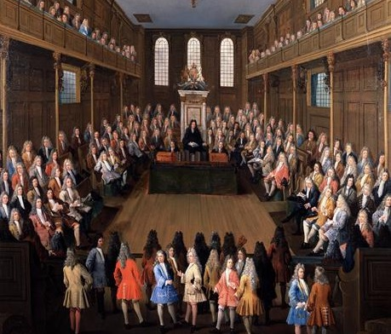
Constitutional monarchy
British practices inspired debates on constitutional government in Europe and America. An influential account of British politics was provided by a French writer, Baron de Montesquieu (1689-1755), who praised the ‘balanced’ system of government in which legislation required the consent of King, Lords and Commons. The painting depicts the chapel of St. Stephen’s where the House of Commons convened until 1834.
The House of Commons in Session, 1709, Painting in the Parliamentary Art Collection, London, by Peter Tillemans, Open Parliament Licence

Slide 17
History of judicial independence
The independence of the judiciary (= system of courts) is one of the key features of liberal constitutionalism
An early form of judicial independence was established in England by the Act of Settlement 1701 (extended to Scotland by the Act of Union 1707)
Judges no longer held office at the king’s pleasure, but became removable only with the consent of Parliament

Slide 18
Tyranny of the majority
Although liberal constitutionalism initially developed to control the power of monarchs, its principles also shaped the development of modern democracies
Liberal thinkers such as John Stuart Mill feared that the democratic participation of poor, uneducated citizens would result in a ‘tyranny of the majority’, which restricts individual liberties and undermines liberal values
Constitutionalist thought played a particularly important role in debates about mass democracy in America

Slide 19
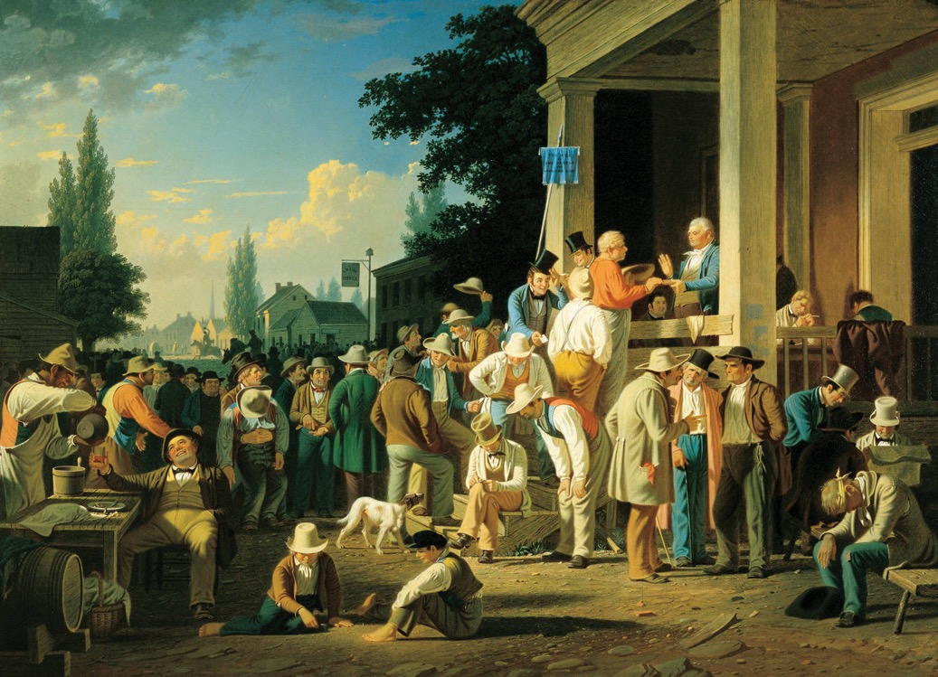
Mass democracy
Following the 1787 Constitutional Convention, the USA developed into the first large representative democracy. Voting rights were gradually extended and in 1828, non-property owning white men could vote in most US states. This painting depicts a crowd of men gathered around a polling place in Missouri.
The County Election, 1852, Oil Painting, Saint Louis Art Museum, by George Caleb Bingham, image in the public domain

Slide 20
Liberalism and democracy
‘Only in the late 1940s did most western countries become fully-fledged democracies with universal adult suffrage. But 100 years earlier most of them had adopted important aspects of constitutional liberalism: the rule of law, private property rights and, increasingly, the separation of powers, free speech and assembly. For much of modern history, what characterised governments in Europe and North America […] was not democracy but constitutional liberalism. The “western model” is best symbolised not by the mass plebiscite but by the impartial judge.‘
Fareed Zakaria (1997)

Slide 21
The triumph of election

Slide 22
The triumph of election
Liberal democracies today combine liberal constitutionalism with representative government
However, it is not obvious why liberal democracy has become closely associated with elections, as opposed to sortition (selection by lot) or direct democracy
Possible explanations include: (A) the role of representation as a constitutional safeguard; (B) the liberal emphasis on consent as a condition of legitimate government

Slide 23
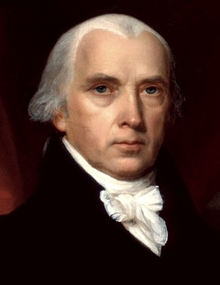
Madison on representation
James Madison (1751-1836), one of the American
founders, combined liberal and civic republican ideas
He argued that representation ‘refine[s] and enlarge[s]
the public views, by passing them through the
medium of a chosen body of citizens, whose wisdom
may best discern the true interest of their country.’
(The Federalist Papers, No. 10)
Understood in this way, the election of representatives provides an additional constitutional safeguard against majority tyranny
James Madison, by John Vanderlyn, 1816, image in the public domain, via Wikimedia Commons

Slide 24
Elections and consent
Manin (1997) suggests that representative government appealed to liberals because the casting of a vote may be understood as consent to government authority
In other words, citizens do not only choose their representatives, but in doing so also legitimise political authority and acknowledge their obligation to obey it
By contrast, sortition (selection by lot) ‘cannot possibly be perceived as an expression of consent’ (Manin, 1997, p.85)

Slide 25
Liberal arguments for universal suffrage
Early liberals were concerned with the ‘natural rights’ of property-owning white men
However, liberal ideas of freedom and equality before the law provided arguments for extending the vote to all adults (‘universal suffrage’)
Voting in elections – as opposed to direct participation in government – has become the main political expression of citizenship in large, representative democracies (apart from voting, liberal citizenship is understood primarily as a legal status)

Slide 26
Towards universal suffrage
E.g., the extension of voting rights in the city of Edinburgh:
  Before 1832: only 33 men have the vote
  1832: 1 in 8 men have the vote
  1867: 1 in 3 men have the vote
  1884: 2 in 3 men have the vote
  1918: All men over 21 and women over 30 have the vote
  1928: All men and women over 21 have the vote
  1969: All men and women over 18 have the vote
  2014: All men and women over 16 have the vote (for Scottish elections only)
  Scottish Elections [Franchise and Representation] Bill debated in 2019/20

Slide 27
Summary and discussion

Slide 28
Summary
Liberal constitutionalism holds that political authority must be legally restrained in order protect individual liberties and prevent the arbitrary exercise of power
Key ideas include: the rule of law; constitutionally guaranteed citizen rights; a separation of powers (executive, legislative, judicial)
Although liberal constitutionalism emerged in European monarchies, its principles have shaped the development of modern representative democracies

Slide 29
Discussion questions
What are the main differences between liberal constitutionalism and civic republicanism?
Would you rather live in a liberal dictatorship or an illiberal democracy?
Can democracy be identified with majority rule or does it entail certain political rights, such as the right to assembly, freedom of the press, etc.?

Slide 30
Reference list
Bobbio, N., 1990. Liberalism and Democracy. London: Verso.
Held, D., 2006. The Development of Liberal Democracy: For and Against the State. In: Models of Democracy. 3rd ed. Cambridge: Polity. Ch. 3.
Manin, B., 1997. The Triumph of Election. In: The Principles of Representative Government. Cambridge: Cambridge University Press. Ch. 2.
Zakaria, F., 1997. Democracy Tyranny. Prospect Magazine, December 20. Available at: <https://www.prospectmagazine.co.uk/magazine/democratictyranny>

Slide 31

This presentation is an Open Educational Resource. It was originally created for a lifelong learning course (SCQF level 7) at the Centre for Open Learning. You are free to use, share, and adapt this work. To view a copy of the license, visit https://creativecommons.org/licenses/by-sa/4.0/
© Max Jaede, University of Edinburgh, 2020, CC BY-SA 4.0

Slide 32

Centre for Open Learning
The University of Edinburgh
Paterson’s Land
Holyrood Road
Edinburgh EH8 8AQ
T: 0131 6504400
E: col@ed.ac.uk
W: www.ed.ac.uk/open-learning
Facebook: www.facebook.com/uoeshortcourses
Twitter: www.twitter.com/uoeshortcourses

