Slide 1


Democracy in Theory and Practice
3. Classic Models: Civic Republicanism
Dr Max Jaede, 2020

Slide 2

Recap of last week
Ancient Athens provides an early and influential example of direct democracy
Throughout much of European history, Athenian democracy was viewed in a very negative light
Athenian democracy has been criticised for its ineffectiveness, instability, and the exclusiveness of citizenship

Slide 3



Different meanings of ‘republicanism’
In democratic theory, ‘civic republicanism’ refers to a tradition of thought which stresses the importance of political participation and civic virtue
This meaning needs to be distinguished from:
Republicanism in a narrow sense as a preference for non-monarchical government
The political movement for the unity and independence of Ireland
The Republican party in the US

Slide 4
Outline of this class
From the Roman republic to the American Revolution
Republican ideals of citizenship and civic virtue
Republicanism and democracy
The 20th century revival of civic republicanism

Slide 5

From the Roman republic to the American Revolution

Slide 6
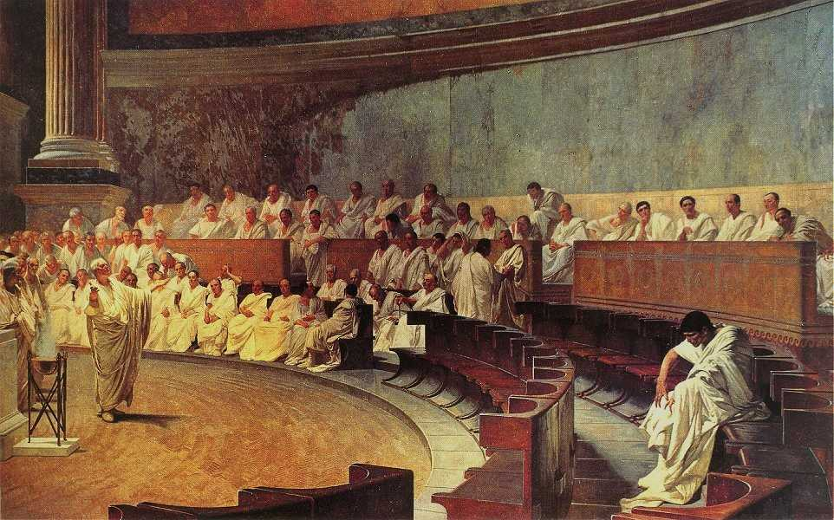
Ancient Rome Republican government was established when the Romans replaced their monarchy with elected magistrates in 509 BC. This picture shows a debate in the Roman Senate. The republic expanded throughout Italy and the Mediterranean, and lasted until 27 BC when the Roman Empire was established.
Cicero Denounces Catiline, Fresco in Maccari Hall, Rome, by Cesare Maccari, image in the public domain, https://commons.wikimedia.org/wiki/File:Maccari-Cicero.jpg

Slide 7
Res publica
The word ‘republic’ comes from the Latin res publica, which literally means ‘a public thing’ and can be translated as matters of common concern or government for the common good
The liberty and power of the Roman republic provided a model for later republicans, who were critical of the instability and civil strife of Greek democracies

Slide 8
Classical republicanism
‘Classical republicanism’ is a tradition of republican ideas and practices which drew on the model of Rome and developed from the middle ages in Italy, and in the 17th and 18th centuries in other countries such as Britain and the USA
Cicero, the Roman statesman and writer (106-43 BC), and Roman historians such as Sallust (86-c.35 BC) were the main sources of later republican thinkers
Republicans also drew on some ancient Greek ideas, e.g. Aristotle’s concept of a ‘mixed constitution’

Slide 9
Cicero on the republic
‘A commonwealth [res publica] is the property of a people [res populi]. But a people is not any collection of human beings brought together in any sort of way, but an assemblage of people in large numbers associated in an agreement with respect to justice and a partnership for the common good.’
Cicero, De re publica (Book 1.25, 39)

Slide 10
Italian city-republics
During the medieval and Renaissance periods, Italian cities such as Florence, Siena and Venice asserted their independence from the Papal State and the Holy Roman Empire
They established different forms republican government, generally with a ‘mixed constitution’
E.g., Venice’s system of government combined monarchical (Doge, the chief magistrate elected for life), aristocratic (Senate with 60 members) and ‘democratic’ elements (Great Council with more than 2000 members, though all of them were members of the nobility)

Slide 11
Anglo-American republicanism
During the British Civil Wars between 1639 and 1651, republican arguments were made against Charles I’s claims to absolute power
Republican ideas inspired the short-lived ‘Commonwealth and Free State’ (erected in 1649 and led by a Council of State, until Oliver Cromwell seized power in 1653)
James Harrington’s The Commonwealth of Oceana (1656) is a key work of English republicanism

Slide 12
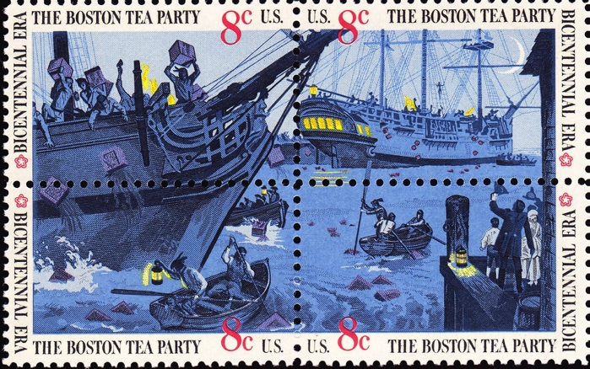
The American Revolution Classical republican ideas gained prominence during the American war for independence between 1765 and 1783, resulting in the independence of the thirteen founding states. One of the key events was the protest against the British Tea Act in 1773.
US Postage Stamps, Boston Tea Party, 1973, image in the public domain, https://commons.wikimedia.org/ wiki/File:Boston_Tea_Party-1973_issue-3c.jpg

Slide 13
Republicanism and liberalism
The American founders, including John Adams (1735-1826), Alexander Hamilton (1757-1804) and James Madison (1751-1836) drew on the republican tradition
However, the founders’ thought combined both classical republican and liberal elements (more on this next week!)

Slide 14
Republican ideals of citizenship and civic virtue

Slide 15
The concept of civic virtue
All republicans stress the importance of active citizenship and civic virtue, meaning personal qualities associated with a good life or the effective functioning of the republic
Virtue in this sense (Latin virtus; Italian virtù) often implies a partial view on morality, focussing on prudence, justice, fortitude and temperance
Can you think of other, ‘non-political’ virtues?

Slide 16
Citizen participation and the good life
Some civic republican thinkers have argued that political participation has intrinsic value – that is, it is an end in itself, not a means to other ends
One version of this argument is that individuals can only fully develop as human beings if they participate in politics
In other words, active citizenship is considered to be an essential part of a morally good life

Slide 17
Civic virtue and corruption
A second strand of republican thought holds that high levels of citizen participation in government and civic virtue are instrumental to protecting a republic against oppressive government and corruption
In this context, corruption means government for private benefit, rather than the common good

Slide 18
Republicanism and democracy

Slide 19
Nobles and plebs
At the heart of classical republican thought is the social distinction between ‘nobles’ (a patrician class) and ‘plebs’ (all other citizens)
Roman and Rennaissance republican thinkers such as Cicero and Francesco Guicciardini (1483-1540) sought to limit the influence of poorer citizens
James Madison was critical of ‘pure democracy’ and argued for a ‘natural aristocracy’ of elected representatives

Slide 20
Restrictions of citizenship
In early modern city-republics, ‘the people’ generally excluded large parts of the population
Although classical republicans sought to limit the corrupting influence of wealth, citizenship was limited to property-owning, ‘independent’ individuals who could defend their freedom and were considered to have a stake in the republic
The interests of women and children were subsumed under those of male citizens

Slide 21
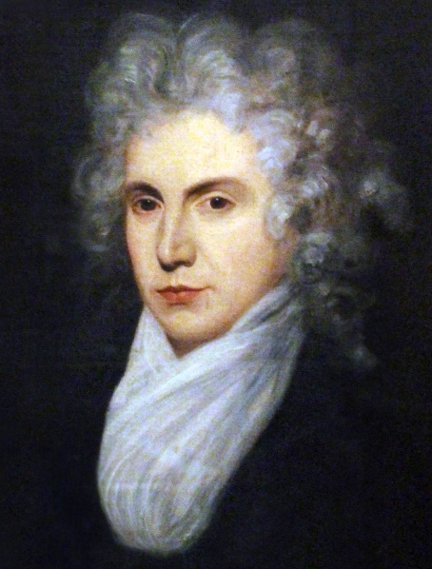
Wollstonecraft on women’s rights
Mary Wollstonecraft (1759-1797), an English philosopher and early advocate of women’s rights, was indebted to republican thinking
In her view, women were taught feminine virtues rather than allowed to have any role in public life, and thus brought up to be dependent
Poverty is less of a threat to liberty than dependency: ‘Liberty is the mother of virtue, and […] women are, by their very constitution, slaves.’ (Vindication of the Rights of Woman, Ch.2)
Mary Wollstonecraft, by John Williamson, image in the public domain, via Wikimedia Commons

Slide 22
The will of the people
The republican understanding of popular sovereignty is based on ideals of political participation and civic nationalism, as opposed to ethnic nationalism
On this view, the ‘will of the people’ is an expression of citizens asserting their liberty by exercising self-government
In political practice, elites may claim to represent the popular will and persecute political opponents and minorities as ‘enemies of the people’

Slide 23
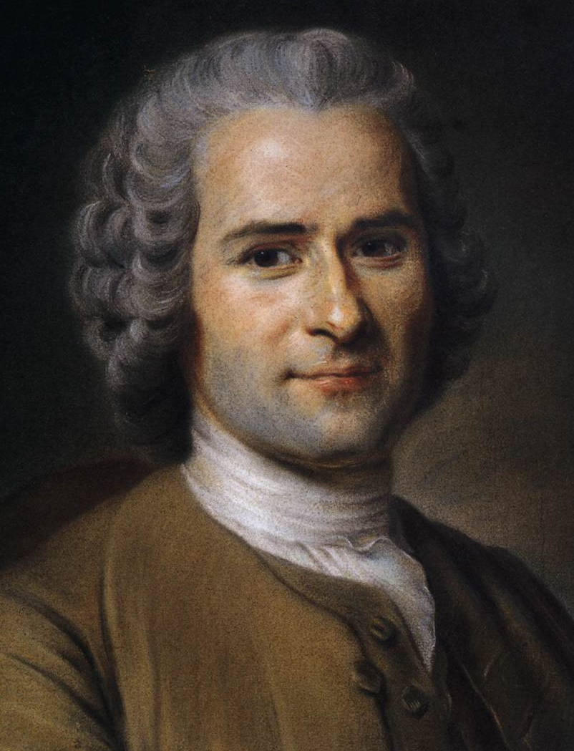
Rousseau on sovereignty
Jean-Jacques Rousseau (1712-1778) was a citizen of the city-republic of Geneva
He drew a distinction between the ‘will of all’ (sum of private interests) and the ‘general will’ (the common good)
Rousseau also argued that the general will cannot be represented: ‘The people’s deputies are not, and could not be, its representatives; they are merely its agents; and cannot decide anything finally.’ (Social Contract, Book 3, 15)
Jean-Jacques Rousseau, by Maurice Quentin de La Tour, image in the public domain, via Wikimedia Commons

Slide 24
Militarism
As part of their arguments for a vigilant citizenry, republicans insisted on the need of a citizen militia, and advocated military service as a type of civic education
Critics argue that the republican tradition adheres to a militaristic ideal of the citizen-solder
Republicans also justified the imperial domination of other countries as a source of glory and power, e.g. Rome’s expanding empire or Florence’s hegemony over Tuscany

Slide 25
The 20th century revival of civic republicanism

Slide 26
Civic republicanism today
In the second half of the 20th century, civic republicanism has been ‘rediscovered’ by historians and political theorists as an alternative to liberalism and socialism
Themes in the revival of civic republicanism:
The intrinsic value of political participation and a supposed decline of the public sphere
A concern with the common good, as opposed to private interests
Freedom as ‘non-domination’

Slide 27
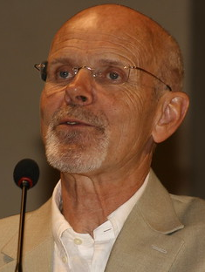
Freedom as non-domination
Philip Pettit (1945-) is one of the main philosophical proponents of republicanism
In his interpretation, the republican tradition’s main concern was with avoiding the evils of domination, not self-government as an end in itself
Political participation is ‘a means of furthering liberty’ (Pettit, 1997, p.30)
The ideal of freedom as non-domination can be distinguished from ‘positive liberty’ and ‘negative liberty’
Philip Pettit, by Francesca Minonne, 2009, CC BY-NC-SA 2.0, via Flickr

Slide 28
Pettit on non-domination
‘Domination […] is exemplified by the relationship of master to slave or master to servant. Such a relationship means, at the limit, that the dominating party can interfere on an arbitrary basis with the choices of the dominated: can interfere, in particular, on the basis of an interest or an opinion that need not be shared by the person affected. The dominating party can practice interference, then, at will and with impunity: they do not have to seek anyone’s leave and they do not have to incur any scrutiny or penalty.’
Philip Pettit (1997, p.22)

Slide 29
Non-domination and social inequalities
Pettit’s theory of non-domination has a wider application beyond politics narrowly defined, e.g.:
Domination of women in personal relationships
Domination of workers by their employers
But, republican theorists tend to focus on individual agents, rather than structural forms of domination and oppression

Slide 30
Summary and discussion

Slide 31
Summary
The republican tradition developed during the Italian Renaissance and had some influence in 17th and 18th century Britain, France and North America (among others)
Civic republicans argue that liberty is based on self-government and active citizenship
Different strands of civic republicanism stress the intrinsic or instrumental value of political participation

Slide 32
Discussion questions
Why has there been a revival of civic republicanism in the second half of the 20th century?
Do you think stable democratic government requires that citizens develop civic virtues?
Republican theorists such as Philip Pettit advocate freedom as non-domination. What would be required to remove all forms of domination from contemporary society?

Slide 33
Reference list
Crick, B., 2002. Republicanism and Democracy. In: Democracy: A Very Short Introduction. Oxford: Oxford University Press. Ch. 3.
Gourevitch, A., 2015. Republican Political Thought. In: Gibbons, M.T. ed. The Encyclopedia of Political Thought. Malden: Wiley.
Held, D., 2006. Republicanism: Liberty, Self-Government and the Active Citizen. In: Models of Democracy. 3rd ed. Cambridge: Polity. Ch. 2.
Pettit, P., 1997. Republicanism: A Theory of Freedom and Government. Oxford: Oxford University Press.

Slide 34

This presentation is an Open Educational Resource. It was originally created for a lifelong learning course (SCQF level 7) at the Centre for Open Learning. You are free to use, share, and adapt this work. To view a copy of the license, visit https://creativecommons.org/licenses/by-sa/4.0/
© Max Jaede, University of Edinburgh, 2020, CC BY-SA 4.0

Slide 35

Centre for Open Learning The University of Edinburgh Paterson’s Land Holyrood Road Edinburgh EH8 8AQ T: 0131 6504400 E: col@ed.ac.uk W: www.ed.ac.uk/open-learning Facebook: www.facebook.com/uoeshortcourses Twitter: www.twitter.com/uoeshortcourses

