Slide 1


Democracy in Theory and Practice
2. Classic Models: Athenian Democracy
Dr Max Jaede, 2020

Slide 2

Recap of last week
The word derives from the ancient Greek demokratia, a compound of demos (the people) and kratia (power or rule)
A historical approach allows us to trace important debates about democracy and to distinguish different models which have evolved over time
Semantic, normative and descriptive questions about democracy are difficult to disentangle

Slide 3
Outline of this class
The origins of democracy: freedom and equality
Institutions of Athenian democracy
Shortcomings of Athenian democracy
Direct democracy today

Slide 4

The origins of democracy: freedom and equality

Slide 5
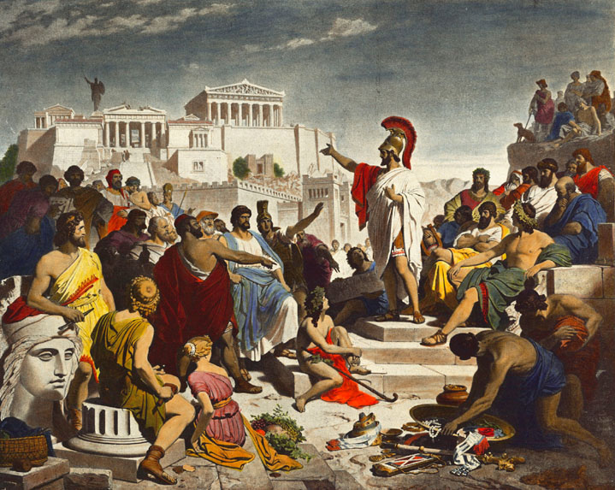
Athenian democracy Popular government in the Greek city-state of Athens lasted from 508/7 to 322/1 BC. Full (male) citizens held offices and attended the Assembly, where political decisions were made.
Pericles’ Funeral Oration, by Philipp v. Foltz, 1852, location unknown, image in the public domain, https://commons.wikimedia.org/wiki/File:Discurso_funebre_pericles.PNG

Slide 6
Greeks vs. barbarians
Although Athenian democracy is the best and most influential example, other Greek city-states were also democratic (e.g. Chios, Kos, Rhodes, Thebes)
The ancient Greeks came to think of themselves as collectively free, in contrast to unfree ‘barbarians’ (non-Greek slaves and non-Greek speaking peoples, including the Persians)

Slide 7
The origins of Athenian democracy
Cleisthenes’ reforms in 508/7 BC are usually considered to be the origin of Athenian democracy, which lasted until the Macedonians took over power
Prior to these reforms, Athens was dominated by competing aristocratic clans and ruled by different ‘tyrants’ who seized power unlawfully
Cleisthenes established equal rights for all (male) citizens, a set of new democratic institutions, and new ‘tribes’ (basically voting districts) to break up older tribal allegiances

Slide 8
Pericles on freedom and equality
‘Our constitution is called a democracy because power is in the hands not of a minority but of the whole people. When it is a question of settling private disputes, everyone is equal before the law; when it is a question of putting one person before another in positions of public responsibility, what counts is not membership of a particular class, but the actual ability which the man possesses. […] And just as our political life is free and open, so is our day-to-day life in our relations with each other.’
Extract from Pericles’ funeral oration in Thucydides’ History of the Peloponnesian War, written in the 5th century BC (Held, 2006, p.13)

Slide 9
Aristotle on freedom and equality
According to Aristotle’s Politics (written 335-323 BC), democracy is based on the interrelated values of liberty and equality:
Liberty
‘Ruling and being ruled in turn’ (political liberty; implies respect for the law)
‘Living as one chooses’ (private liberty)
Equality – the moral and practical basis of 1A
Equal voting power and right to speak in the Assembly
In principle, equal chances to hold office (in later years, some office holders were also financially remunerated)

Slide 10
Institutions of Athenian democracy

Slide 11
The Assembly
The Assembly was the main lawmaking body and also decided on finance, taxation, foreign affairs, etc.
It met at least 40 times a year
All ca. 30,000 male citizens over 20 had the right to attend, speak and vote at the Assembly
Many citizens did not attend the Assembly most of the time, and at least intially, the meeting place could only accommodate around 6,000 people

Slide 12
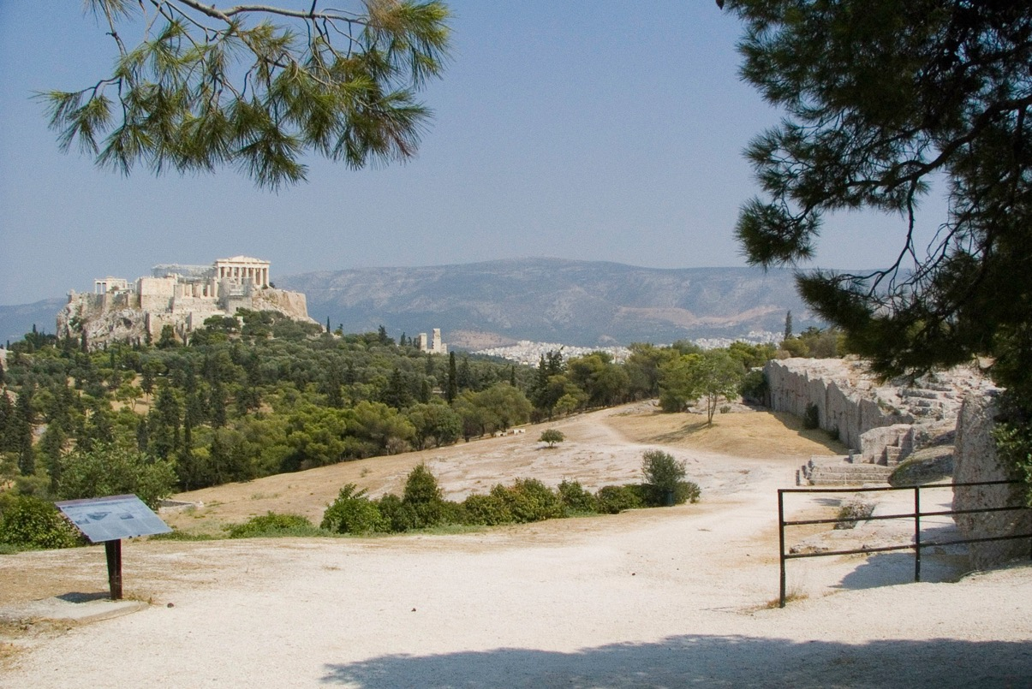
The Pnyx The Assembly's meeting place was located on a hill southwest of the Acropolis (in the background to the left). Citizens sat or stood on the hillside facing a speaker’s platform (on the right behind the fence).
The Pnyx, Athens, by M. McIntyre, 2006, CC BY-NC-SA 2.0, https://www.flickr.com/photos/maccy/206745526

Slide 13
Election, sortition and rotation of offices
In addition to attending the Assembly, many citizens held multiple political offices over their lifetime
A variety of methods were used to prevent abuses of power:
Rotation of offices – nearly all officials only served for a period of one year and could not be re-selected
Election of some officials, but sortition (= selection by lot) was more commonly used because elections favour the rich and the most able
Have you served on a jury? If so, do you know how you were selected?

Slide 14
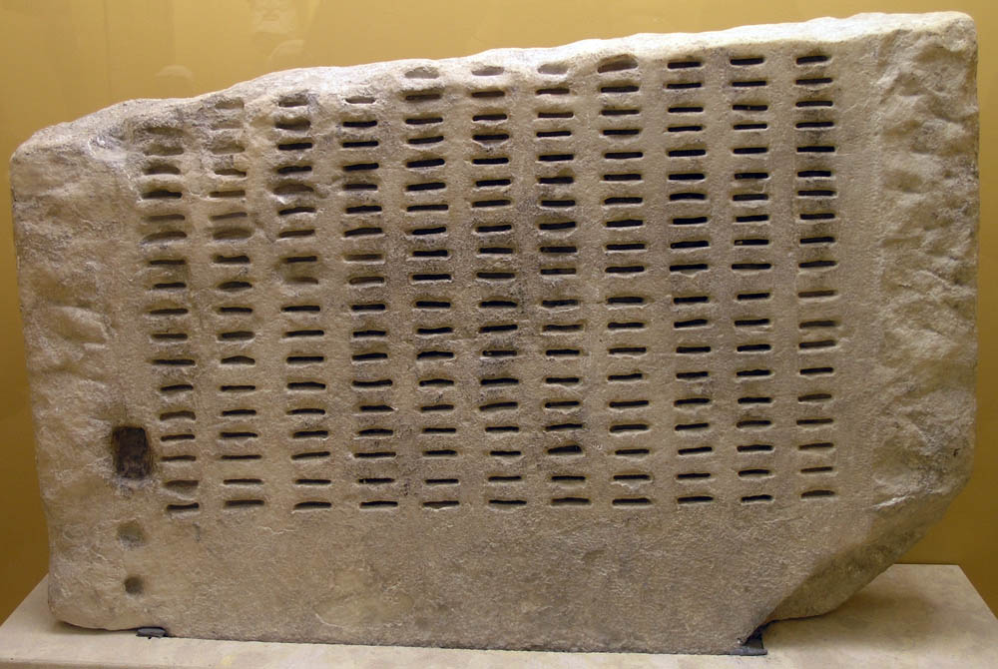
Sortition in practice The picture shows one of the devices used for jury selection. Bronze identification tickets were inserted into the slots to indicate eligible jurors. By a random process, a whole row would be accepted or rejected for jury service on the day.
Kleroterion, Ancient Agora Museum Athens, 2005, CC BY-SA 2.5, https://commons.wikimedia.org/wiki/ File:AGMA_Kleroterion.jpg

Slide 15
The Council of 500
The Council of 500 – also known as ‘Boule’ – fulfilled executive functions and prepared the agenda for the Assembly
It consisted of 50 randomly selected citizens over 30 from each of the ten tribes, and met almost daily
50 members of the Council always served as a standing committee (one of whom was chosen by lot to chair Council and Assembly meetings on that day)
The institution probably derived from an advisory body of nobles which existed before Cleisthenes’ reforms

Slide 16
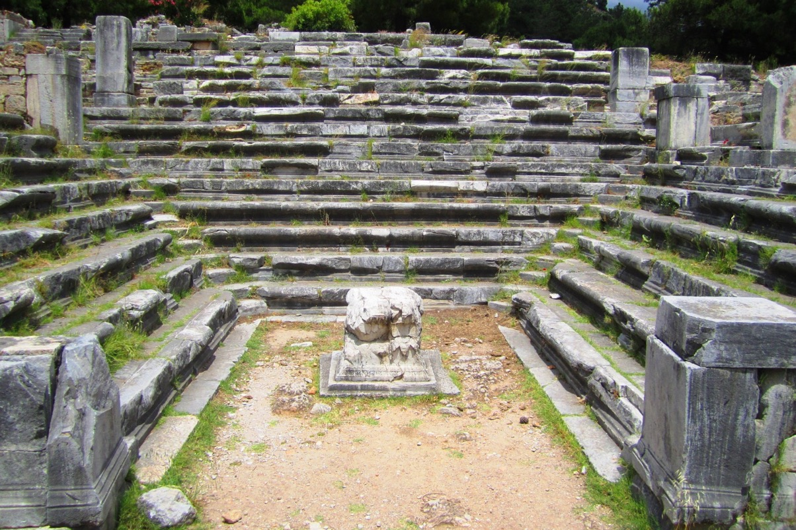
Bouleuterion A ‘Bouleuterion’ housed the Boule, or Council of 500, which met on met every day except during festivals to prepare the meetings of the Assembly. This picture shows a similar, well-preserved building in Priene in modern-day Turkey.
Bouleuterion in Priene, by Elelicht, 2012, CC BY-SA 3.0, https://commons.wikimedia.org/wiki/
File:Priene_Bouleuterion.JPG

Slide 17
Panels of judges
Each year ca. 6,000 citizens served as jurors in the courts (or rather, as panels of judges – there were no professional judges)
Assemblies of citizen judges were very large, consisting of 201, 401 or 501 individuals
Courts were regarded as an essential part of the democracy
When Athens started to pay citizen judges, this became a source of income for older and poorer citizens

Slide 18
Generals and magistrates
10 generals, one from each tribe, were elected and accountable to the Assembly
In addition, 600 magistrates, who were supported by secretaries, carried out administrative functions
The most important magistrates were elected, others selected by lot
All of these officials could only serve for one year at a time
A special court scrutinised the work of all office holders after the end of their term of office

Slide 19
Shortcomings of Athenian democracy

Slide 20
Exclusive citizenship
By today‘s standards, Athenian democracy was highly problematic
Women, metics (foreigners) and slaves did not have citizen rights: Thorley (2004, p.79) estimates that during the 5th century BC, the number of citizens was 30,000 – 50,000 out of a total population of 250,000 – 300,000
Athens’ wealth and the citizens’ leisure to participate in political life were based on a slave economy and imperial expansion
Do you think ancient Athens was really a democracy?

Slide 21
Size and ineffectiveness
The Assembly’s processes were slow and it had to deal with a huge amount of business, including matters of the expanding Delian League/Athenian Empire
Although ancient Athens is often described as a ‘small city-state’ or a ‘face-to-face society’ (Crick, 2002, p.18), it was very large by ancient standards
The majority lived in Athens’ agricultural hinterland – e.g., Marathon on the east coast of Attica is ca. 25 miles away from Athens

Slide 22
Factionalism and poor decisions
Politics was dominated by citizens of high birth and rank such as Pericles (495–429 BC), an influential orator in the Assembly who was repeatedly elected as a general
Democratic practice entailed informal networks and intrigues, competing factions, and frequent accusations and trials against office holders
Democratic Athens lost the Peloponnesian War (431–404 BC) against a league led by aristocratic Sparta

Slide 23
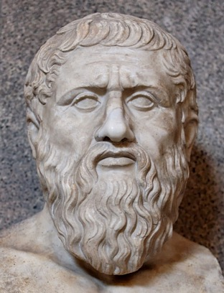
Plato’s criticisms of democracy
Plato’s (429?–347 BC) Republic outlines the ideal of just state governed by a philosopher-king
He provides an analogy to a ship’s captain, a skilful and knowledgeable ‘true navigator’, whom he contrasts to the ship’s prejudiced, divided and erratic crew (Held, 2006, p.24)
In his view, democracy is necessarily unstable and ‘extreme liberty’ eventually leads to ‘extreme subjection’ to a tyrant who promises to restore law and order
Bust of Plato, Vatican Museum, Rome, photo by Dudva, 2017, CC BY-SA 4.0, via Wikimedia Commons

Slide 24
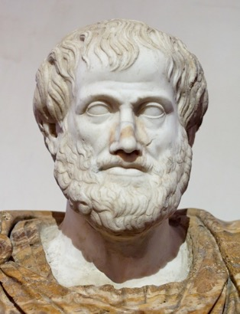
Aristotle’s views of democracy
Aristotle (384–322 BC) distinguishes between government by one person, by a few, or by the many
Bust of Aristotle, Rome, photo by Jastrow, 2006, image in the public domain, via Wikimedia Commons
 | Proper forms | Deviant forms
One ruler | Monarchy | Tyranny
Few rulers | Aristocracy | Oligarchy
Many rulers | Polity | Democracy
A further distinction is between proper government (for the common good, which entails the conditions for citizens to live a virtuous life), and corrupt government (which serves private interests)

Slide 25
Aristotle’s views of democracy (cont.)
Aristotle holds that, in theory, monarchy is the best proper form of government
He argues that, of the three deviant forms, democracy is the least bad (cf. Churchill: ‘Democracy is the worst form of government, except for all the others’)
Aristotle ultimately seems to favour a ‘mixed constitution’, which combines monarchical, aristocratic and democratic elements and reconciles claims of the wealthy and the poor

Slide 26
Direct democracy today

Slide 27
Full direct democracy
From the mid 19th century, ‘democracy’ was taken to denote indirect, representative democracy, which is now distinguished from so-called ‘direct democracy’
In the fullest sense, direct democracy means that (A) citizens meet at an assembly and (B) decide political issues/choose among alternative measures
Today, there are only a few cases of this pure form of direct democracy at the sub-state or local level

Slide 28
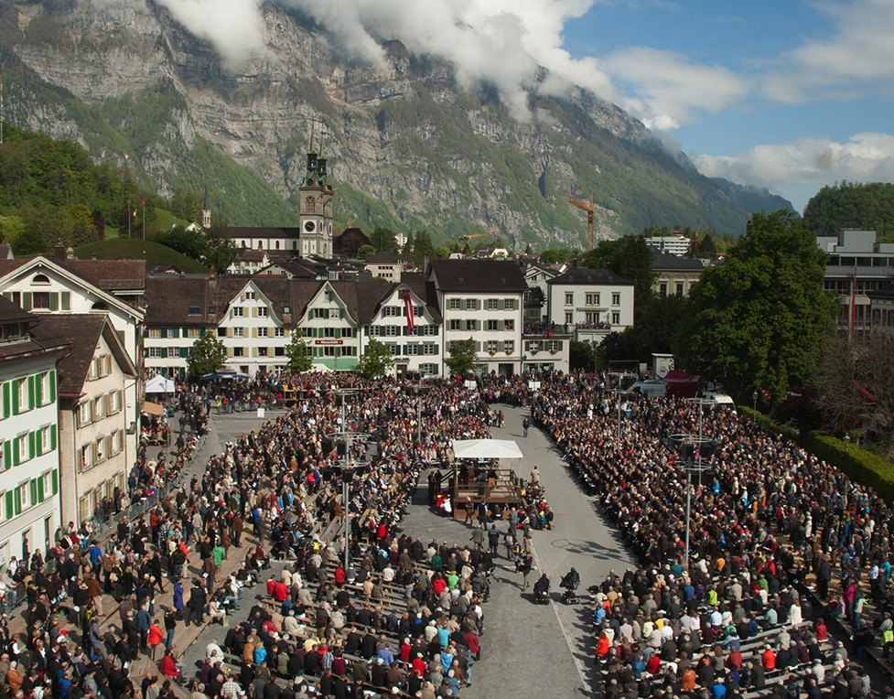
Swiss Landsgemeinde Two of the 26 cantons (federal districts) of Switzerland – Glarus and Appenzell Innerrhoden – still have a Landsgemeinde with legislative powers. In each case, an open-air assembly is held annually and makes decisions by non-secret majority voting.
Landsgemeinde in Glarus, 2014, by L. Péron, CC BY-SA 3.0, https://commons.wikimedia.org/wiki/ File:Landsgemeinde_-_Glarus_2014_-_1.jpg

Slide 29
Partial direct democracy
There are elements of direct democracy in many representative democracies, e.g.:
Popular initiatives, referendums and recalls
Participatory budgeting
Citizens’ juries/assemblies
However, modern practices are in many ways different from direct democracy in ancient Athens
The direct or indirect quality of democratic government is generally a matter of degree, rather than either/or

Slide 30
Summary and discussion

Slide 31
Summary
Democracy in ancient Athens was characterised by an extremely high degree of citizen participation in government
Equality of citizens was the practical and moral basis of political liberty, understood as ‘ruling and being ruled in turn’
Key democratic institutions included sortition (selection by lot) and rotation of offices
Athenian democracy has been criticised for its ineffectiveness, instability, and the exclusiveness of citizenship

Slide 32
Discussion questions
What do you associate with the word ‘citizenship’?
What are the main similarities and differences between the Athenian model and democracy today?
Why were many philosophers critical of democracy?

Slide 33
Reference list
Crick, B., 2002. The Place From Where We Started. In: Democracy: A Very Short Introduction. Oxford: Oxford University Press. Ch. 2.
Hansen, M.H., 1992. The Tradition of Athenian Democracy A.D. 1750-1990. Greece & Rome, 39(1), pp.14-30.
Held, D., 2006. Classical Democracy: Athens. In: Models of Democracy. 3rd ed. Cambridge: Polity. Ch. 1.
Raaflaub, K., Ober, J., and Wallace, R.W. eds. 2007. The Origins of Democracy in Ancient Greece. Berkeley: University of California Press.

Slide 34

This presentation is an Open Educational Resource. It was originally created for a lifelong learning course (SCQF level 7) at the Centre for Open Learning. You are free to use, share, and adapt this work. To view a copy of the license, visit https://creativecommons.org/licenses/by-sa/4.0/
© Max Jaede, University of Edinburgh, 2020, CC BY-SA 4.0

Slide 35

Centre for Open Learning The University of Edinburgh Paterson’s Land Holyrood Road Edinburgh EH8 8AQ T: 0131 6504400 E: col@ed.ac.uk W: www.ed.ac.uk/open-learning Facebook: www.facebook.com/uoeshortcourses Twitter: www.twitter.com/uoeshortcourses

