Slide 1
LGBT+ Healthcare 101 An overview of health disparities affecting LGBT patients
Derrick Ng & Navina Senthilkumar

Slide 2
LGBT Demographics

Slide 3

LGBT Demographics
3.6 million LGBT people
600,000 trans people
Notes:
It is difficult to precisely state the size of the LGBT community in this country because it has not been added to the full census, but estimations say that there are about 3.6 million LGBT people living in the UK, which is over 5% of the entire population.
Likewise there are no nationwide figures on the size of the trans population but estimates say that there are over 600,000.
It is then very likely that all clinicians have come across LGBT patients, even if they were not aware of it.
It must be noted that within this group exists huge diversity: the broad label of LGBT encompasses people of various ages, ethnicity, socioeconomic statuses, and widely different experiences. Their LGBT identity does not wholly define them as a patient and a person, so all of these other characteristics must also be taken into account by their doctor.
Image in Public Domain

Slide 4
LGBT Definitions, Concepts, and Terminology

Slide 5

Sexual Orientation
“An individual’s emotional, romantic, or sexual attraction for another individual”
1
CalebTabor CC BY-SA 3.0
Notes:
A person’s sexual orientation is define as [definition]. However, this definition is quite simplistic and does not fully describe this complex concept ...
CC BY-SA 3.0 – Author CalebTabor

Slide 6
Sexual Orientation
Desire
Identity
Behaviour
*
Desire
Behaviour
Identity
Notes:
Sexual orientation can also be thought of in terms of three dimensions: desire = who they are attracted to; behaviour = who they have sex with; identity = what label they wish to give themselves. On their own, none of these can properly describe a person’s sexual identity: but they overlap and together form a person’s sexual orientation.

Slide 7
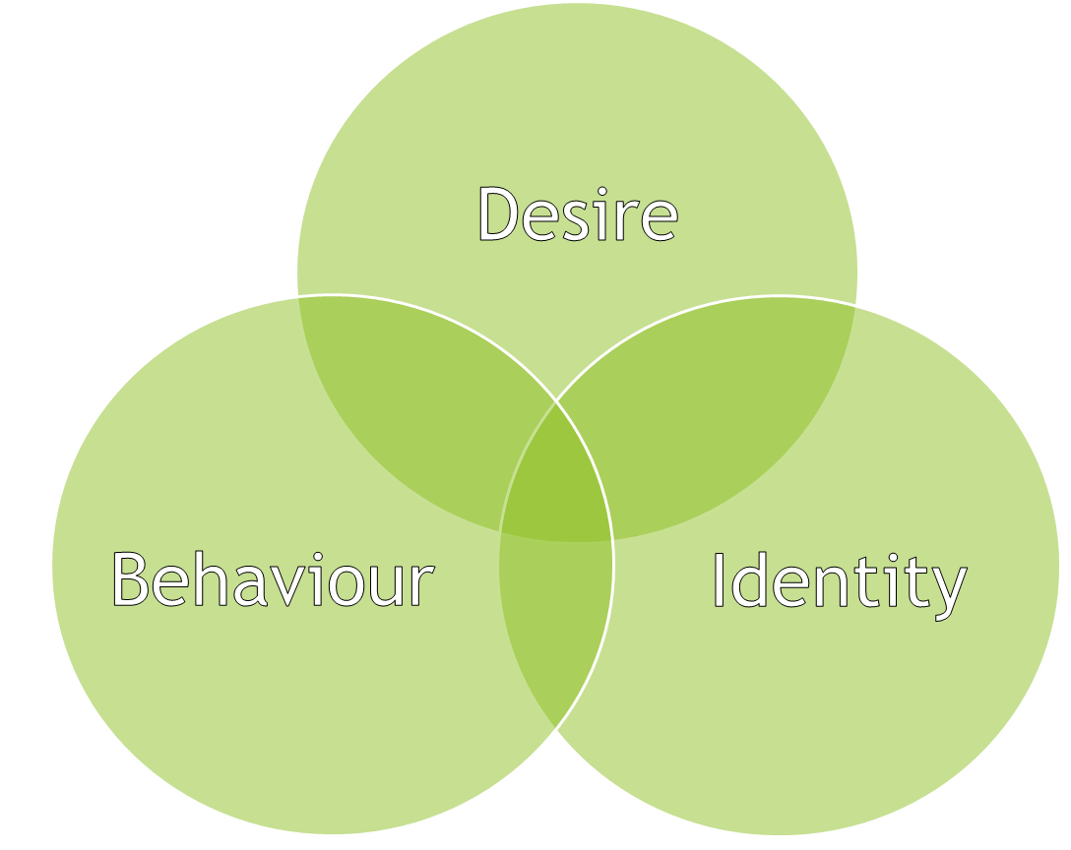

Sexual Orientation
MSM
Desire
Behaviour
Identity
WSW
Notes:
A person’s sexual behaviour is usually the most important factor in a medical context, in terms of determining their sexual health and other health needs. But as we saw before, sexual orientation is not congruent with sexual behaviour.
To get around this mismatch, we use the terms MSM and WSW to describe men who have sex with men and women who have sex with women respectively. These terms respect a patient’s choice to self-identify as they see fit, while addressing the part that sexual behaviour plays in determining health.
Image in public domain

Slide 8


Sexual Orientation
Desire
Behaviour
Identity
Sexuality
Notes:
Just as a patient’s behaviour is very relevant to a doctor, so a person’s desires are much less relevant to their doctor: this information is highly personal, and does not generally determine their health.
In the media and generally in society, we tend to use the terms “sexual orientation” and “sexuality” interchangeably. However, this is wrong. Sexuality is more used in sociology to describe a person’s sexual desires and feelings, and some LGBT people feel that the word sexuality instead of orientation can over-sexualise them and does not acknowledge the many dimensions of sexual identity.
For this reason, NICE recommends that doctors always say “sexual orientation” when talking to a patient, rather than “sexuality.”
Stethoscope adapted from image in the public domain.
Stop sign generated in Powerpoint

Slide 9

Gender Identity
“A person’s highly personal,
deeply felt experience of
gender.”
Body image
Dress
Speech
. . .
Notes:
The next term we will discuss is gender identity, or [definition].
Of course, this definition throws up many questions: such as, what is gender? Now this is very individual, and every person will define their own gender in a specific way: but generally, gender incorporates a person’s body image, dress, speech, and other mannerisms.
Image in Public Domain

Slide 10

Gender Identity
Cisgender =
“An individual whose gender identity matches their assigned sex”
ParaDox under CC BY-SA
2

Slide 11
Gender Identity
Transgender =
“An individual whose gender identity does not match their assigned sex”
ParaDox under CC BY-SA
2

Slide 12
Transgender
Trans men
Trans women
Transsexual
Intersex
Non-binary
FTM
MTF
Genderqueer
Bi gender
Androgynous
Notes:
Transgender, or trans, is an umbrella term, and encompasses a huge range of gender identities.
A trans man is a person who was assigned female at birth but identifies as a man; in a clinical context, the acronym FTM, or female-to-male, is sometimes used to describe trans men.
A trans woman is a person who was assigned male at birth but identifies as a woman; they are also referred to in medicine as MTF, or male-to-female.
I realise this looks like a complicated mess. Unfortunately, there is no way to simplify a person’s innermost feelings about themselves. As a good rule, if you are ever confused or unsure about the definition of your patient’s gender identity or sexual identity – JUST ASK! You do not need to be an expert in every single category of identity, so long as you can acknowledge the diversity of categories.

Slide 13

Pronouns
“Very embarrassing”
He or she
They or it
“Didn’t feel taken seriously”
Ze or zir
3
Notes:
When interacting with transgender patients, correct use of pronouns can be vitally important to making them feel comfortable.
In studies, transgender patients have reported that pronoun errors were very “embarrassing” and meant that they “didn’t feel taken seriously.”
Most trans people will want to be referred to in traditional gender pronouns (he or she) but some people will ask to be referred to in gender neutral pronouns (they or it) and some people even use non-standard pronouns like ‘ze’ or ‘zir.’ You may find it helpful to find out what pronouns your patient prefers when you first meet them.
Image in public domain.

Slide 14

Historical context
“Homosexual”
“Queer”
LGBTQ
Notes:
It is good to be aware of the historical context of some LGBT terminology. For example, the word, homosexuality, is becoming less common because of its historical definition as a mental disorder, or even a criminal offence. It is usually confined to academic and medical contexts. The terms gay and LGBT are now more common.
On the other hand, the historically homophobic slur, queer, has been redefined by LGBT people, especially young LGBT people, to describe any person who does not identify with traditional societal expectations of sexual orientation and/or gender identity. In fact, LGBT is sometimes written as LGBTQ or LGBTQ+ to represent the queer or questioning community.

Slide 15
Social, Legal, and Political Issues

Slide 16


Legislation
2004 Gender
Recognition Act
Clipartcottage under CC-BY-SA 3.0 license.
Notes:
This 2004 Act allowed transgender people to apply for a Gender Recognition Certificate for their new gender. This also gave much needed acknowledgement to the complex topic of gender non-conformity.

Slide 17
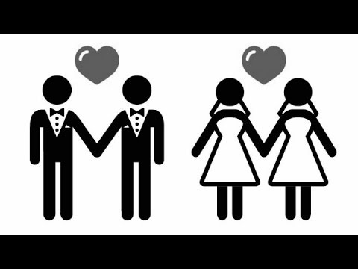
Legislation
2010 Equality Act
“protected characteristics”
2014 Marriage and Civil Partnership Act
4
MattsFTR under CC-BY 4.0
Notes:
The 2010 Equality Act was the first time that sexual orientation and gender identity were made protected characteristics under the law. This meant that the government now had a duty to prevent discrimination because of sexual or gender identity, and they now had a explicit legal duty to end inequalities borne by the LGBT community.
The recent legalisation of same-sex marriage in 2014 in Scotland was a historical milestone for the LGBT community, and led to greater feelings of social inclusions for gay people.

Slide 18

Legislation - parenting
2002 Adoption and Children Act
2008 Human Fertilisation and Embryology Act
“The need of
supportive parenting”
5
Notes:
Many LGBT people will choose to have children – an option that was not available to them in the past.
But now, thanks to these sorts of laws, LGBT parents can get legal custody of children they have adopted or conceived through IVF.
The 2008 was very interesting because it emphasised a child’s “need of supportive parenting” rather than them necessarily needing one mother and one father.
Image in public domain.

Slide 19
Hate Crime
Won’t be taken seriously
1 in 6 gay people have been a victim of homophobic hate crime
73% of trans people have experienced transphobic harassment
Police can’t do anything about it
Notes:
Discrimination and harassment are still a big part of the lives of million of LGBT Brits.
One in six gay people and 73% of trans people have experienced a hate crime.
Three quarters of them do not report the crime to the police, usually because they did believe that their experience would be taken seriously by authorities, or they did not think the police could do anything about it.

Slide 20

Attitudes – health workers
57% do not think sexual orientation is relevant to health
1 in 10 staff have received training on LGBT health needs
6
Notes:
The shocking attitudes of healthcare workers towards LGBT was laid to bare in a recent survey by the charity, Stonewall.
This includes 57% of staff say that they do not consider sexual orientation to be relevant to ones health needs, despite the clear disparities we know exist and that Derrick will elaborate upon.
The levels of training in the health service: only 1 in 10 healthcare staff had received training on the health needs of the community in the last twelve months.

Slide 21

Attitudes – general public
25% would not be happy to elect openly gay Prime Minister
49% would be unhappy for close relative to marry trans person
Notes:
General public attitudes to the LGBT community are also alarming, despite the progress that has been made.
25% of people in this country said they would not be happy to elect an openly gay Prime Minister.
In the Scottish Social Attitudes Survey, 49% of people said they would not be happy for a close relative to marry someone who had undergone a sex change operation.

Slide 22
Health Disparities

Slide 23
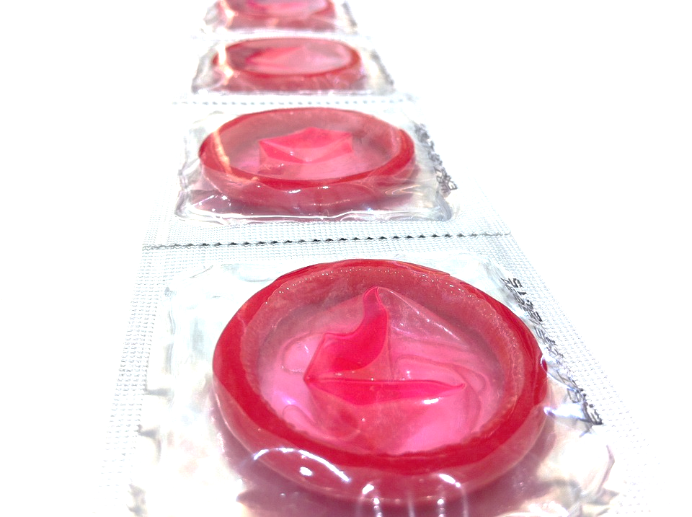
Sexually Transmitted Infections
MSM
HIV, gonorrhoea, syphilis
Lymphogranuloma venereum (LGV)
Reasons: ↑partners, HIV, “Chemsex”
Notes:
CC0 Public Domain
https://pixabay.com/en/condom-safe-sex-aids-latex-health-538601/

Slide 24

Health Related Behaviour
Smoking
Alcohol
Recreational drug use
Eating disorders
Reasons: coping mechanism, body image
Notes:
CC0 Public Domain
https://openclipart.org/detail/196214/drinks

Slide 25

Mental Health
Mental disorder
Self-harm
Suicidal behaviour
Substance misuse
Reasons: “minority stress”, other inequalities
Notes:
CC0 Public Domain
https://pixabay.com/en/brain-business-credit-intelligence-1294854/

Slide 26
Addressing Health Disparities

Slide 27
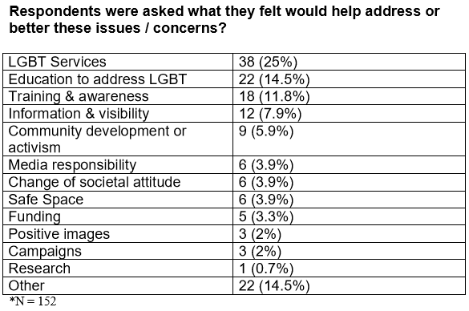
Addressing Health Disparities
Aitken S, Kealey A, Adamson R. LGBT Community Needs Assessment Report. Scotland: LGBT Centre for Health and Wellbeing; 2007

Slide 28
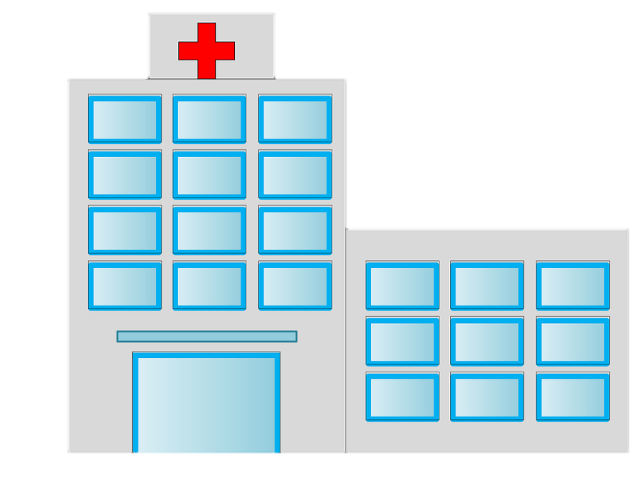
MSM STI Disparities
More frequent HIV testing for high-risk groups
Periodic testing for asymptomatic Chlamydia, gonorrhoea and syphilis
Hep B Vaccination
Notes:
CC0 Public Domain
https://pixabay.com/en/hospital-health-medical-medicine-908437/

Slide 29

Mental Health Disparities
Schools
Social service organisations
Notes:
CC0 Public Domain
https://pixabay.com/en/community-crowd-group-man-men-150124/

Slide 30
Barriers to LGBT Healthcare

Slide 31

Barriers
The “Beyond Barriers” LGBT Scotland survey:
15% of 924 responses reported difficulties in accessing healthcare
Notes:
CC0 Public Domain
https://openclipart.org/detail/216857/simple-stethoscope

Slide 32

Barriers
Negative attitudes and behaviour of healthcare staff
Judgemental
e.g. cervical screening
Notes:
CC0 Public Domain
https://pixabay.com/en/bad-hand-down-red-thumb-157437/

Slide 33
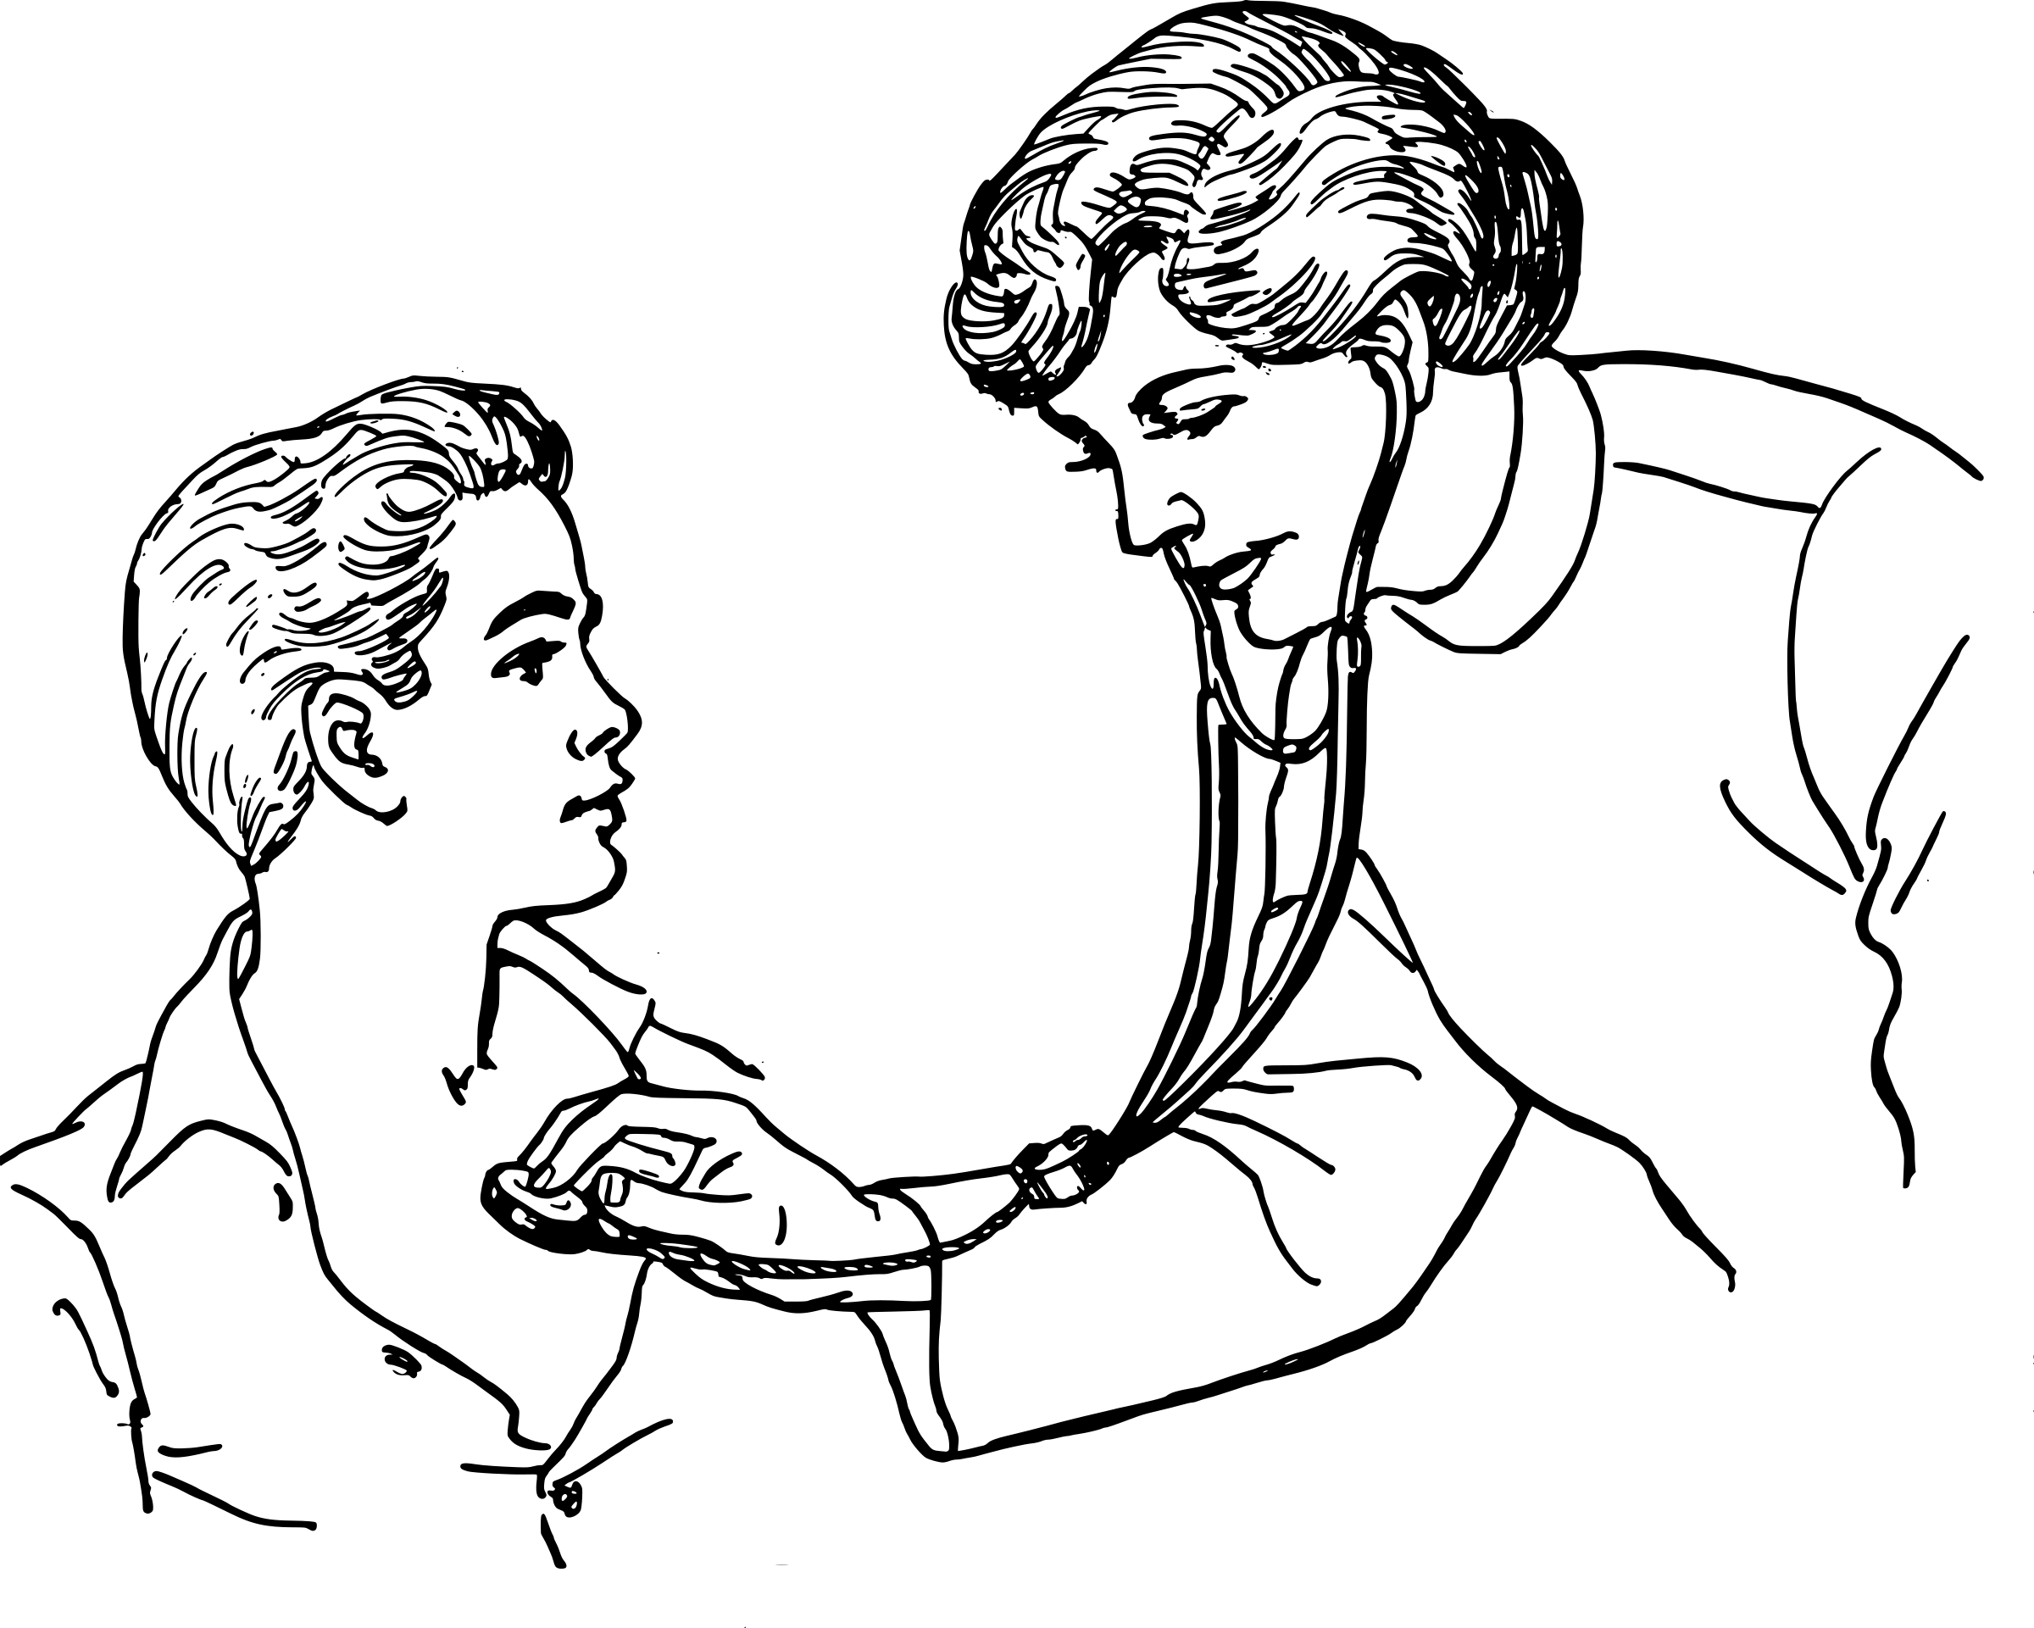
Barriers
Communication barriers with healthcare providers
Over 1/3 of patients do not disclose
Fears of poor Tx, denied care, confidentiality issues
Notes:
CC0 Public Domain
https://openclipart.org/detail/22743/doctor-examining-a-patient

Slide 34

Barriers
Lack of awareness and knowledge of NHS staff
lack of knowledge
concerns about appropriate language
Notes:
CC0 Public Domain
https://commons.wikimedia.org/wiki/File:Gay_flag.svg

Slide 35
Barriers
delay seeking healthcare
participate less in health screenings
Less response to preventative health messages
Trans people: long waiting times, doubts on doctors

Slide 36
Improving LGBT Healthcare Access

Slide 37
Be approachable
Non-judgemental
Sensitive Reassurance
Use respectful language
Clarify confidentiality
Improve knowledge

Slide 38
A trusting doctor-patient relationship which promotes transparency and disclosure

Slide 39
Thank you

